Slide 1

The Complement System: Recent Breakthroughs, Biologics , and Biomarkers
Joshua M. Thurman, MD
Professor of Medicine and immunology
Notes:
Please find your scheduled lectures listed below:
• Date: Monday, June 8
• Time: 8:45 – 9:30 AM PST
• In addition to giving your lecture, please provide:
• One to two lecture-specific learning objectives
• One to two multiple choice or true/false questions for the pre-/post-tests
• PowerPoint presentation slide
45 min, 40 slides

Slide 2
Disclosures
Co-founder Q32 Bio, Inc. Consulting fees, royalties, and stock
Co-founder Compsit3, Inc.
Data safety monitor for Rocket Pharmaceuticals and Biomarin, Inc.

Slide 3
The Complement Cascade – worse than the Krebs cycle!
“In the midst of chaos, there is also opportunity”
-Sun Tzu
https://www.genome.jp

Slide 4
Key learning points (the “opportunity”)
Complement is an important part of the immune system
  Protects against infections
Involved in the pathogenesis of many diseases
  Primary driver of several devastating, rare diseases (e.g., PNH and aHUS)
  Secondarily involved in common diseases (e.g., systemic lupus erythematosus)
Multiple anti-complement drugs have been approved by the FDA
  Categorically different from other immunosuppressive drugs
Generates soluble and tissue bound biomarkers of:
  Complement activation
  ”Immunologically active” disease

Slide 5
The complement cascade simplified
1) Activation
2) Effectors
3) Regulators
Classical
Immunoglobulin
(C4)
Soluble and cell surface proteins
Lectin
C3
C5b-9 (MAC)
C3a
C5a
Alternative
(“Anaphylatoxins”)

Slide 6
Activation pathways
Classical – IgG and IgM
Lectin – conserved sugar motifs
Alternative – always active
Specificity
Same downstream biologic
effects
Rapidity

Slide 7
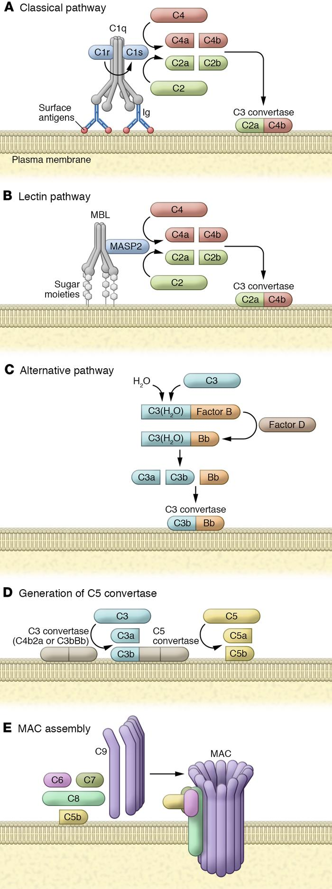
Classical Pathway: “Complementing” antibody function
Discovered by Jules Bordet and Paul Ehrlich in 1890s.
Described as a “system of serum- circulating proteins complementing antibody-mediated immune responses.”
Ab → Complement
Afshar-Kharghan, V. J Clin Invest, 2017. 127(3): 780-789.

Slide 8
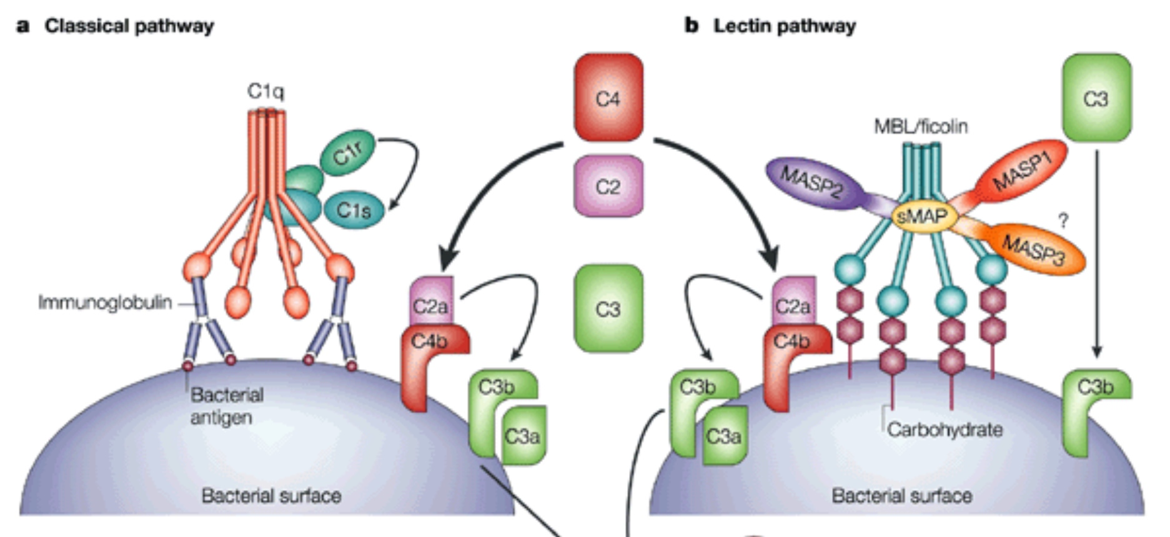
Lectin pathway: like a classical pathway for sugars
Classical pathway
Lectin pathway
Activation
Teijo Fujita, Nat Reviews Immunology, 2002, 2:346.

Slide 9
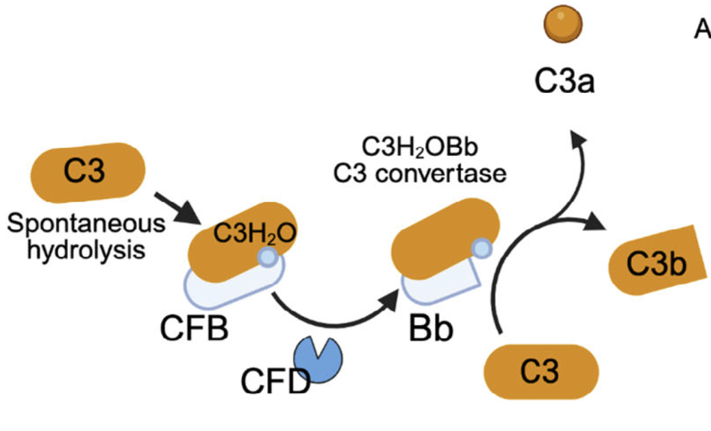
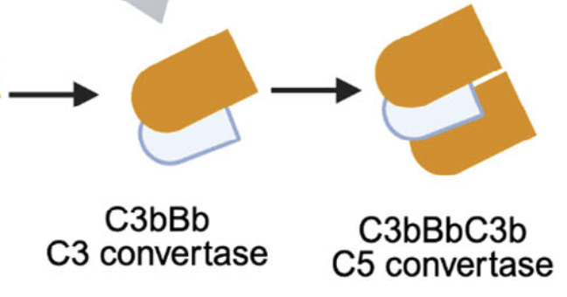
Alternative pathway: always active
2. Amplifies the other activation pathways
3. Self amplifying feedback loop
Spontaneous activation
(“tickover”)
Modified from: King and Blom, Eur J Immunol. 2024;54(8):e2350813.

Slide 10
Complement can be activated in the fluid phase and on surfaces
Liver
Adipocytes
C3
C3
Plasma complement proteins
Leukocytes
Fluid phase
C3a
C3b
Local
C3
C3
Surface
Endosome
C3aR
C3
C3
C3
C3
C3b
C3a
Mitochondria
Intracellular

Slide 11
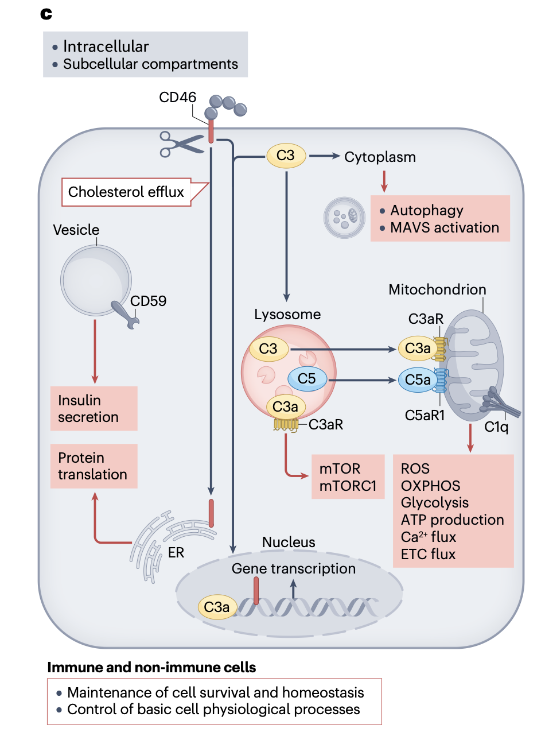
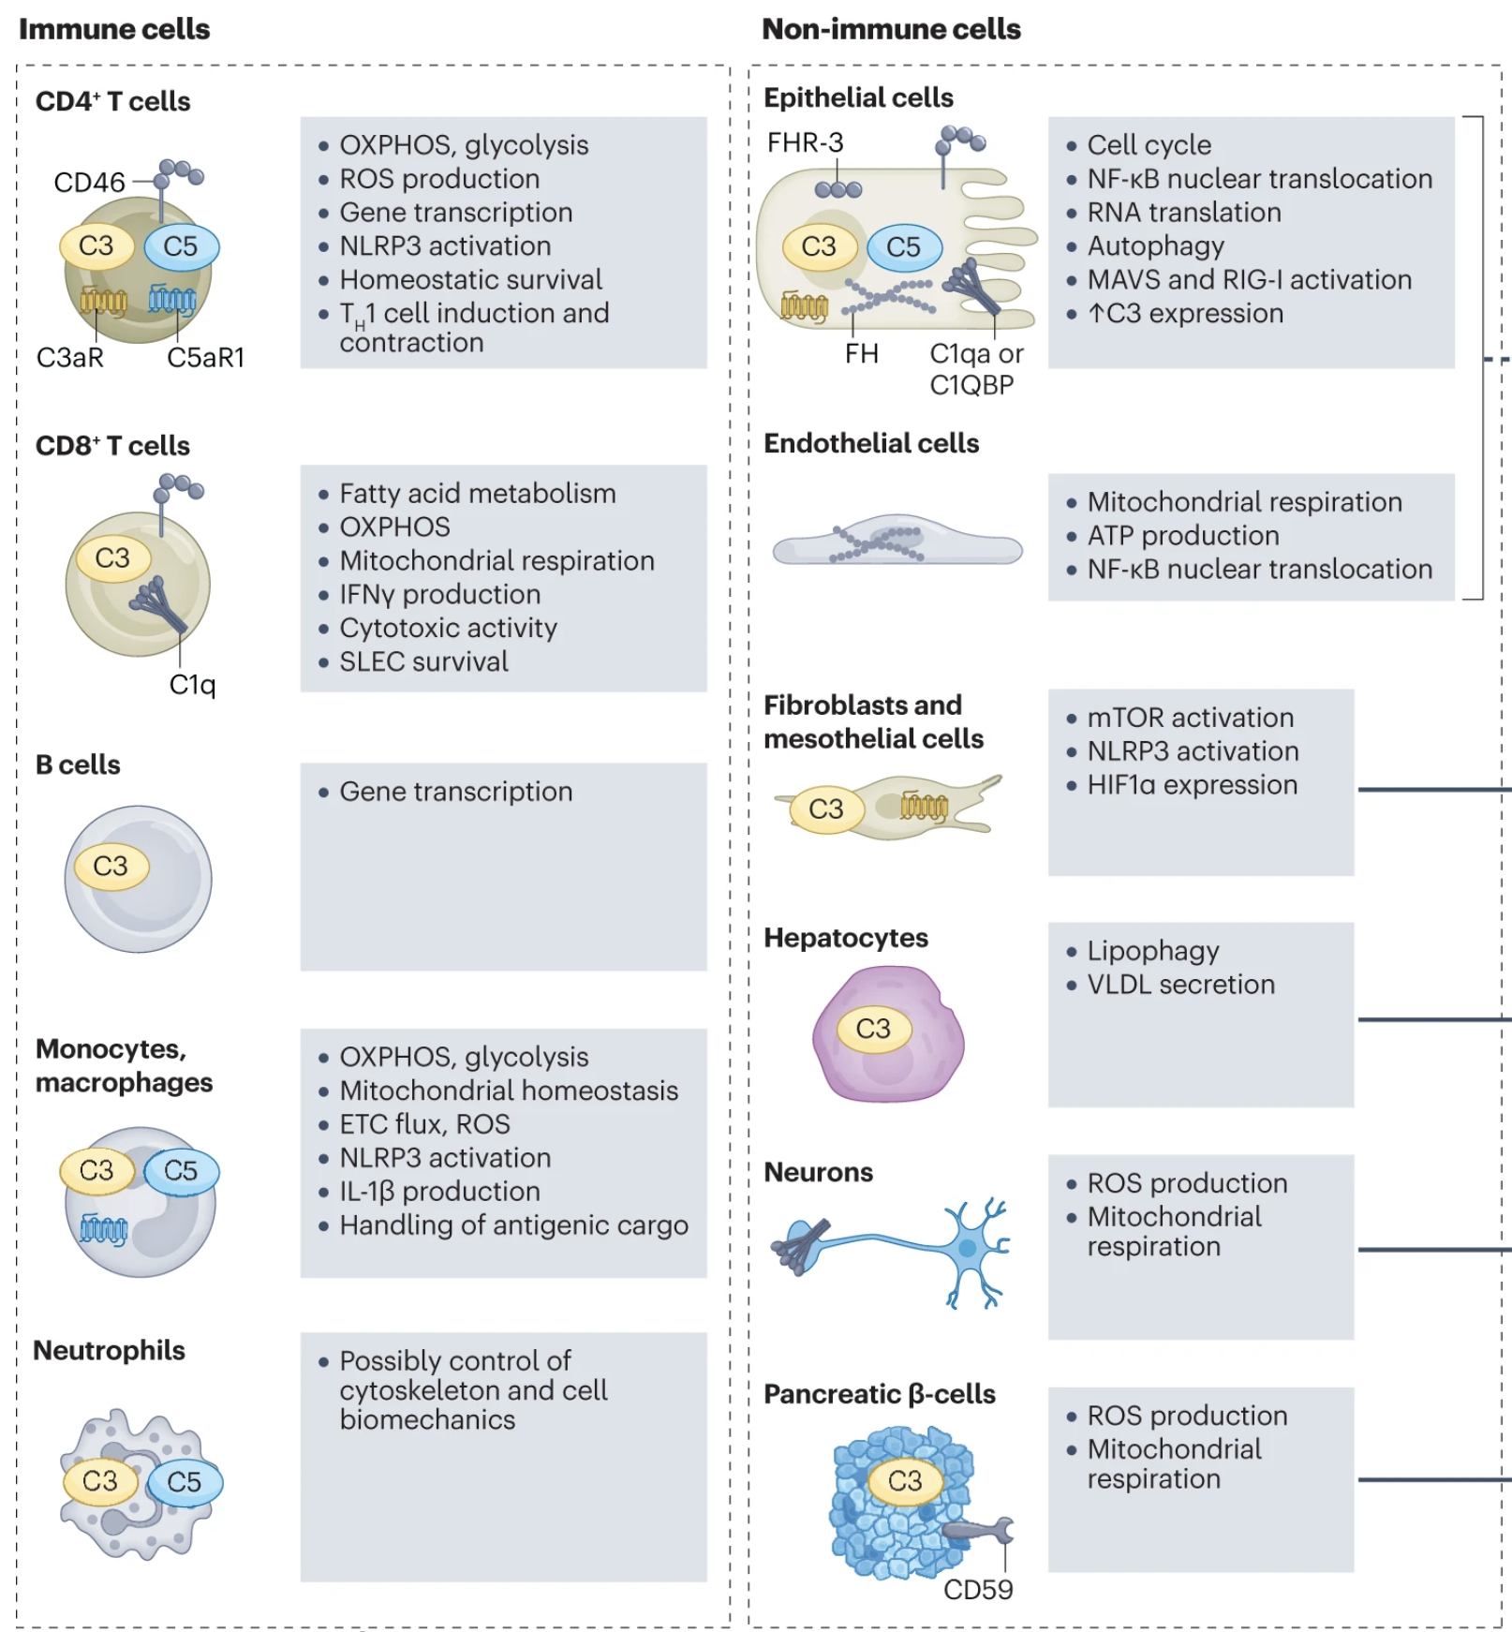
Intracellular Complement – multiple homeostatic and metabolic processes
West and Kemper, Nature Review Nephrology, 2023, 19, 426–439

Slide 12
All three pathways generate the same downstream effectors
1) Activation
2) Effectors
Classical
Lectin
C3
C5b-9 (MAC)
C5a
C3a
C3b
Alternative

Slide 13
Complement activation triggers multiple effects
Systemic Effects of the Anaphylatoxins
(C3a and C5a)
Complement
Activation
Opsonization by C3b
Direct Effects of anaphylatoxins
Direct Effects
of C5b-9 (MAC)
C5aR/C3aR
MAC
C3b
Activate cells
Pro-inflammatory cytokines
Pro-coagulant state
Adhesion Molecules

Slide 14
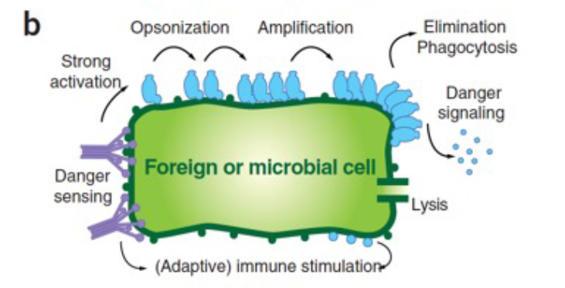
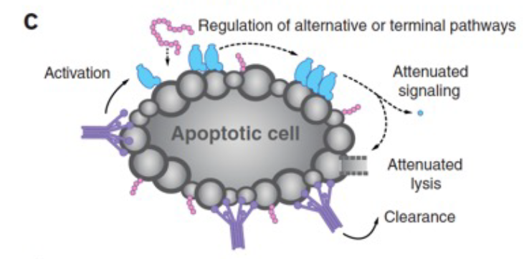
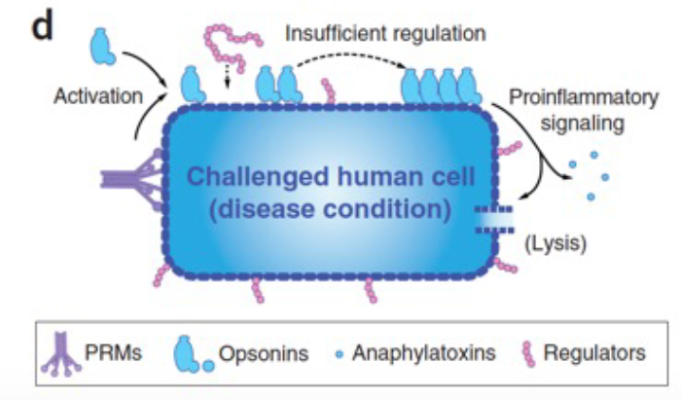
Complement surveillance: elimination of bacteria and damaged cells
Ricklin et al. Nat Immunol. 2010;11(9):785-97.

Slide 15
How do we know that these functions are important?
Complement deficiencies (”Experiments of nature”)
Complement deficiencies are associated with recurrent bacterial infections Shaughnessy et al. Alternative pathway amplification and infections. Immunological Reviews. 2023;313(1):162–80.
Deficiencies of classical pathway proteins are strong risk factors for autoimmune disease Pickering and Botto, Eur J Immunol 2024 54;7, e2350918
  Reduced elimination of apoptotic cells and nuclear contents

Slide 16
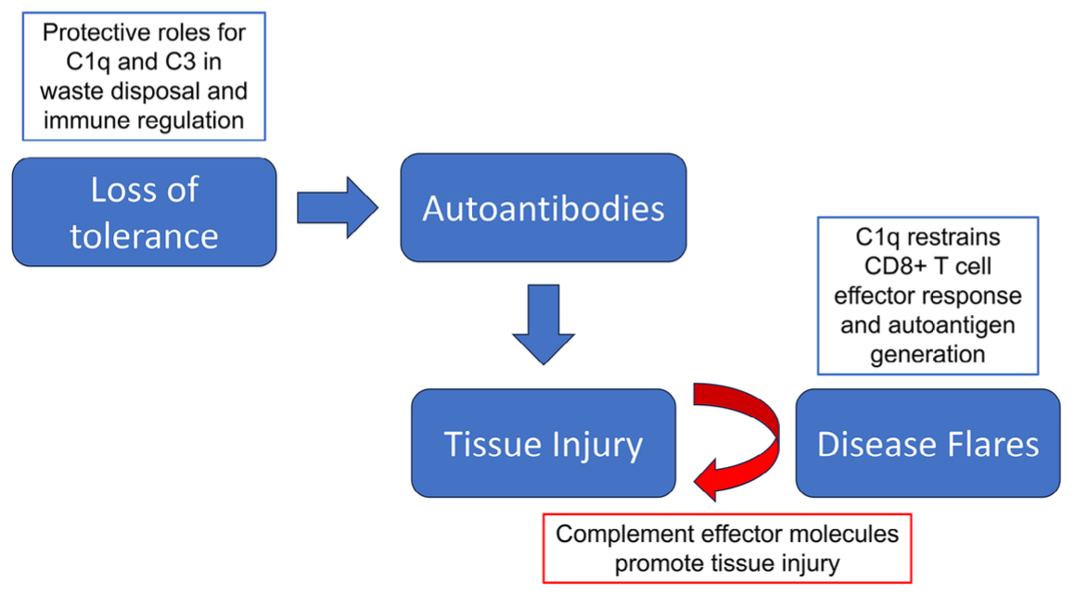
The lupus paradox: complement protects from autoimmunity
Deficiencies of C1r/C1s, C4, C2 are the strongest monogenic risk factors for SLE
Ricklin et al. Nat Immunol. 2010;11(9):785-97.
Pickering and Botto, Eur J Immunol 2024 54;7, e2350918

Slide 17
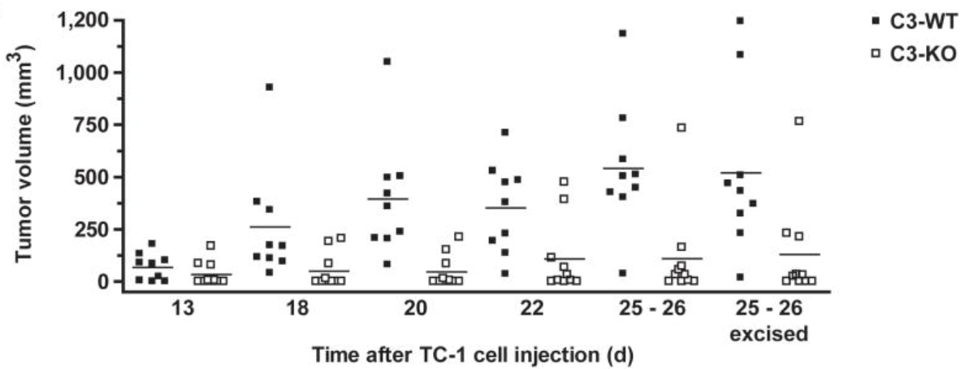
Unexpected: complement activation promotes tumor growth
Markiewski et al., Nat Immunol. 2008;9(11):1225-35.

Slide 18
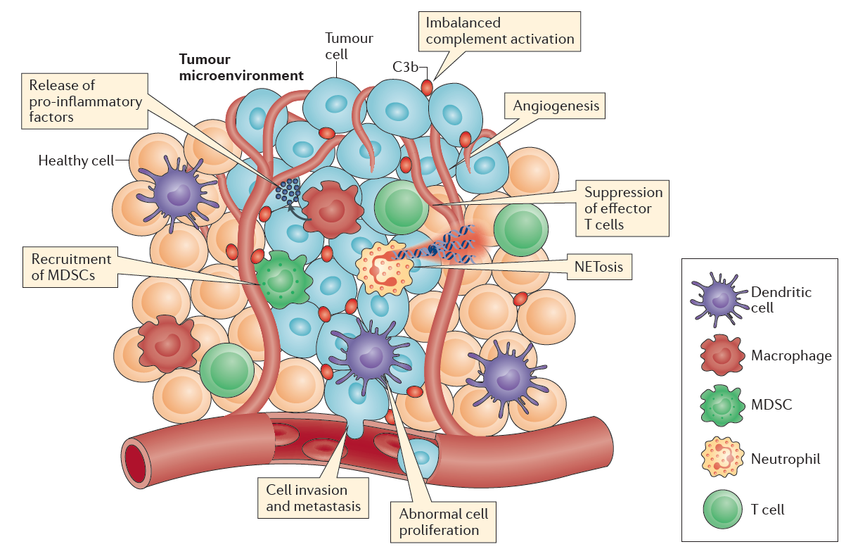
Unexpected: complement activation promotes tumor growth
Functions as an immune checkpoint
Reis et al. Nat Rev Immunol. 2018;18(1):5-18.

Slide 19
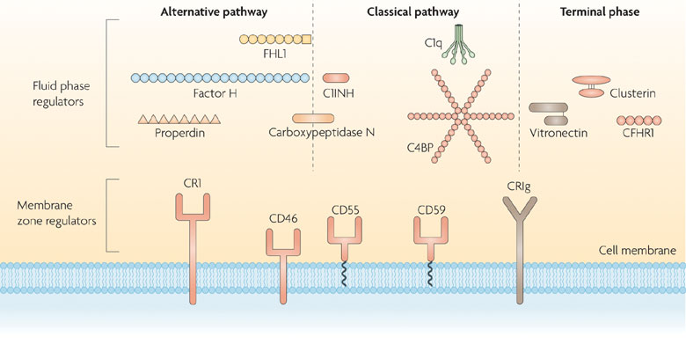
Complement regulatory proteins
Zipfel and Skerka, Nat Rev Immunol., 2009, 9:729.

Slide 20
Regulation is particularly important for controlling the alternative pathway
Impaired
Regulation
Alternative Pathway
Activation
Regulation
Amplification
C3b Inactivation
Amplification
Factor I
+
CR1
Properdin
Factor I
+
Factor H
Serum proteases
C3b
Bb
C3b
C3b
iC3b
C3dg
C3d
Alternative Pathway
C3-convertase
Thurman and Nester, Clin J Am Soc Nephrol. 2016

Slide 21
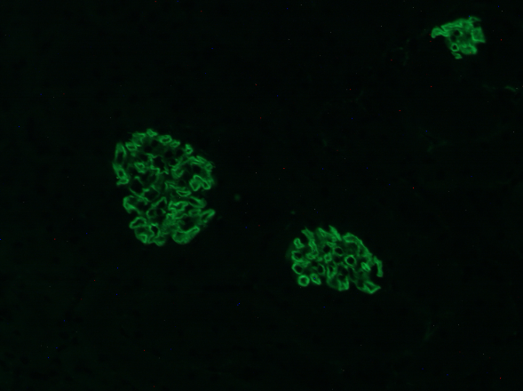
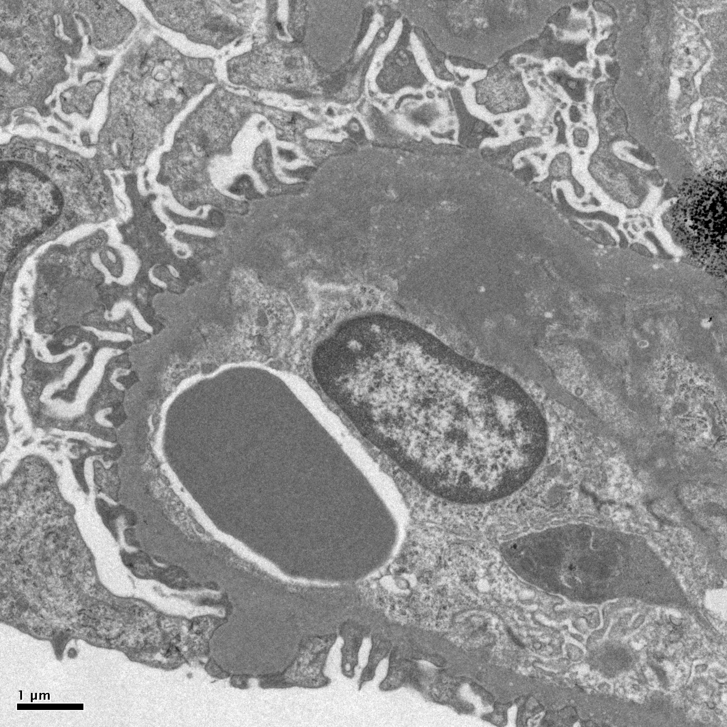
The absence of factor H is sufficient to cause glomerular complement activation
C3b
EM
fH^{-/-} Kidney
3 month
Laskowski et al. Kidney Int 2016; 90: 109-122.

Slide 22
Defective Complement Regulation: Risk of Inflammatory diseases
Paroxysmal nocturnal hemoglobinuria
  Deficiency of complement regulation on erythrocytes
Atypical Hemolytic uremic syndrome
  Deficiency of complement regulation in glomerular capillaries
C3 Glomerulopathy
  Deficiency of complement regulation in glomerular capillaries
Age related macular degeneration
  Variant in factor H is risk factor for disease
Defective regulation leads to complement-mediated inflammation
Alternative pathway

Slide 23
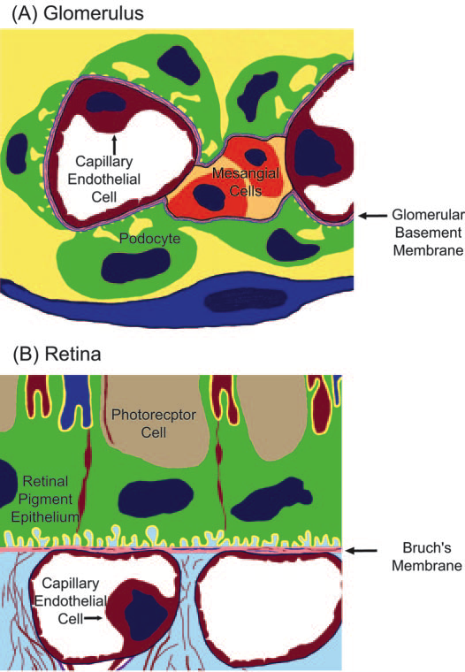
Basement membranes are particularly dependent on factor H to control alternative pathway activation
Atypical hemolytic uremic syndrome
C3 glomerulopathy
Macular degeneration
Appel GB, et al. J Am Soc Nephrol. 2005;16(5):1392-1403.

Slide 24
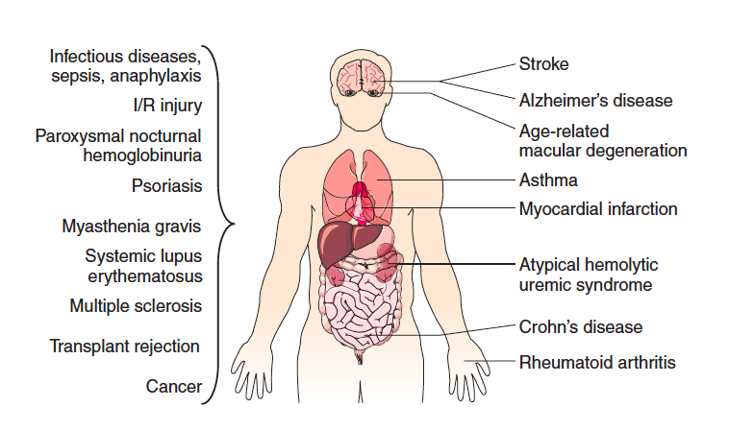
Complement and disease
Every organ
Acute and chronic diseases
Different types of diseases
Ricklin and Lambris, Nat Biotechnol 2007 25; 11, 1265-75.

Slide 25
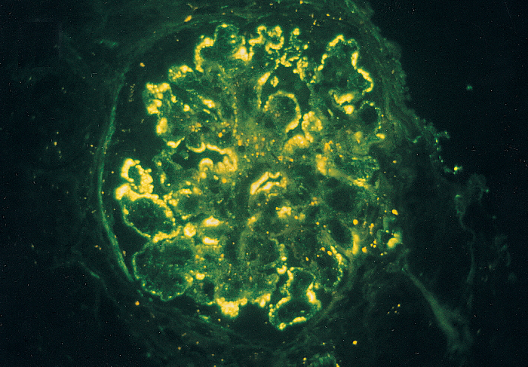
Complement and disease – three categories
Primary driver of disease
  Impaired regulation
C3 glomerulopathy
Immune-complex glomerulonephritis
2. Secondary mediator of injury
  Autoantibody-mediated disease
3. Tertiary mediator of disease
  Activated in damaged tissues (diabetes)

Slide 26
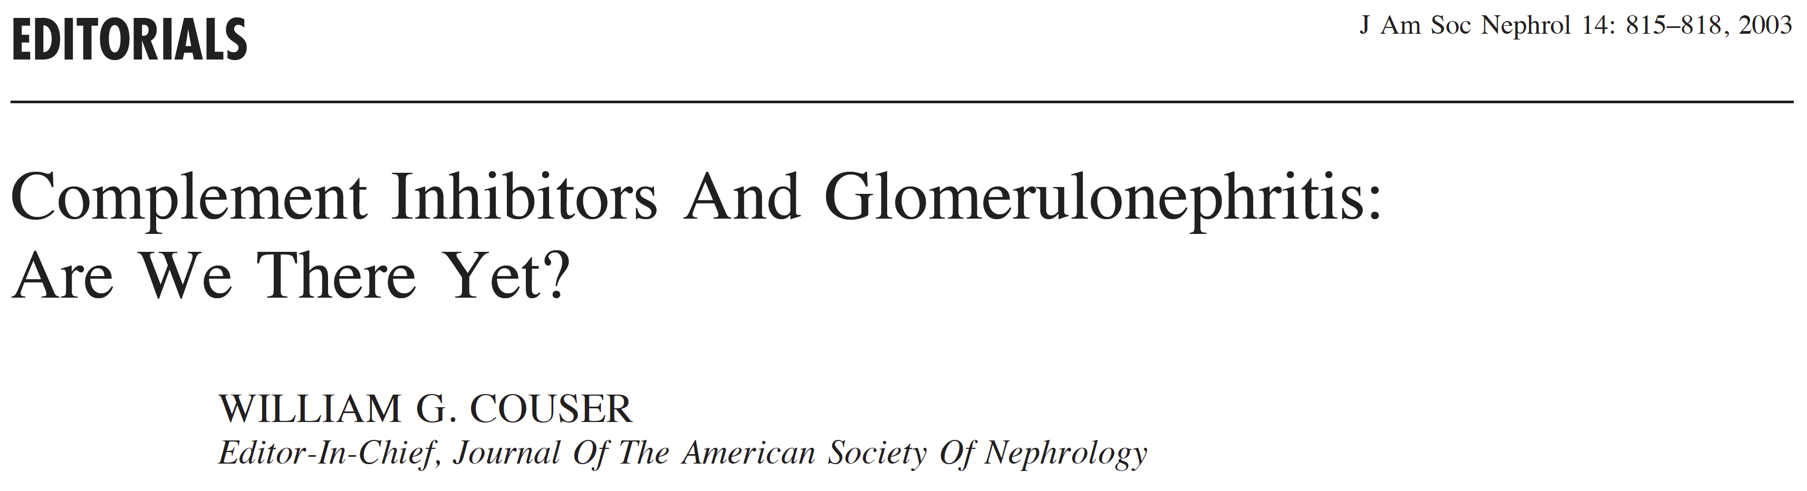
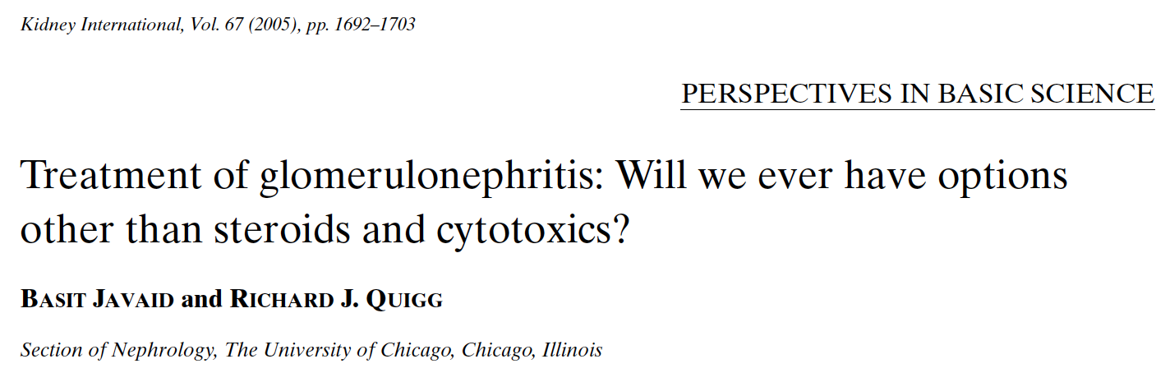
Complement inhibitory drugs – the long wait

Slide 27
Recently approved complement inhibitors
13 FDA-approved complement inhibitors
for 13 different disease indications
2026
2007
2021
Avacopan approved for AAV
Pegcetacoplan approved for C3G/IC-MPGN Iptacopan approved for C3G
2019
2024
Iptacopan approved for IgAN
2011
Eculizumab approved for aHUS
Ravulizumab approved for aHUS
2022
Sutimlimab approved for Cold agglutinin disease
2025
Eculizumab approved for PNH

Slide 28
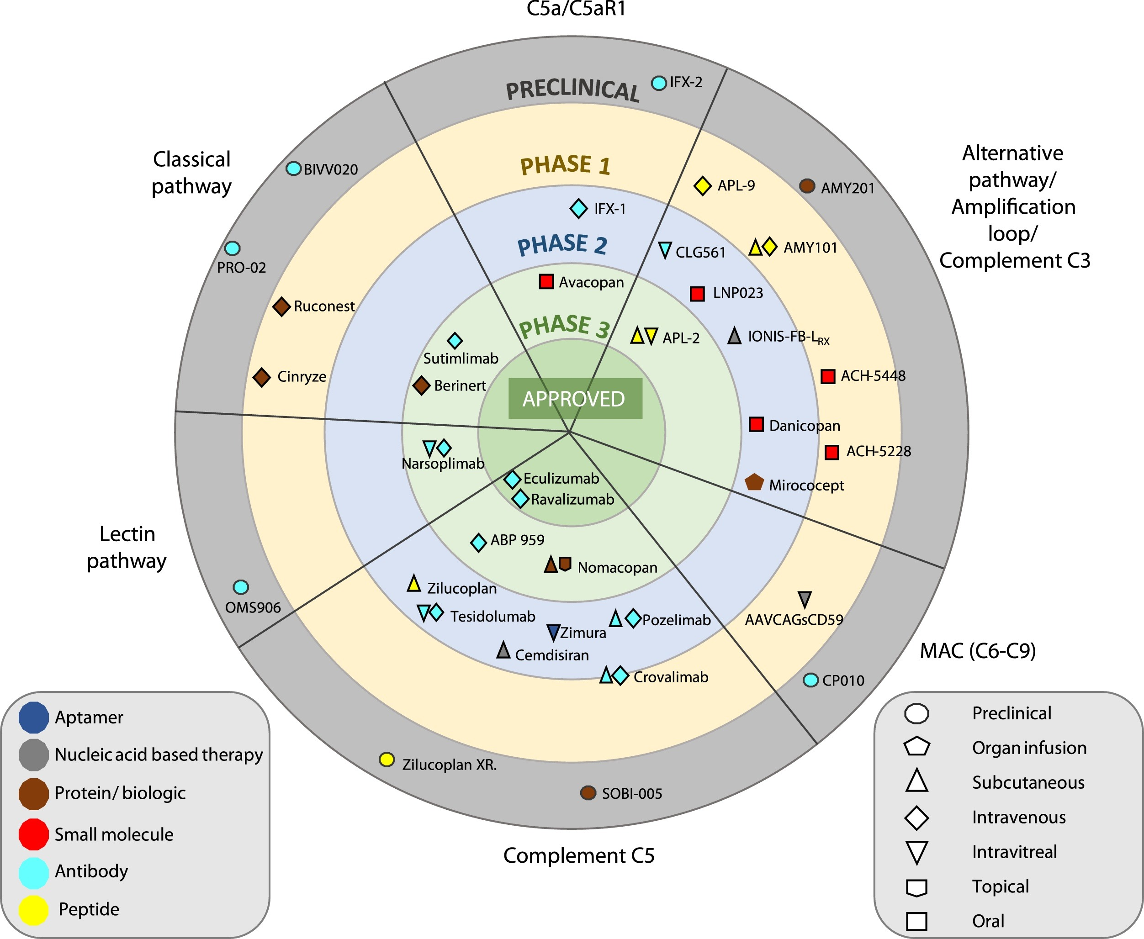
Complement drugs in development
Variety in:
Target
Molecule
Route of administration
Stage of development
Avacincaptad
Bkemv
Zelek et al. Mol Immunol, 114: 341-352, 2019

Slide 29
Approved indications:
Disease | Drug | Target | Type (administration)
Atypical haemolytic syndrome (aHUS) | Eculizumab Ravulizumab Bkemv | C5 C5 C5 | Monoclonal antibody (IV) Monoclonal antibody (IV) Monoclonal antibody (IV)
C3 glomerulopathy (C3G) | Iptacopan Pegcetacopoan | Factor B C3 | Small-molecule (PO) Pegylated peptide (SQ)
Anti-neutrophil cytoplasmic antibody (ANCA)-associated vasculitis | Avacopan | C5aR | Small-molecule (PO)
IgA Nephropathy (IgAN) | Iptacopan | Factor B | Small-molecule (PO)
Immune-complex membranoproliferative glomerulonephritis (IC-MPGN) | Pegcetacoplan | C3 | Pegylated peptide (SQ) Small-molecule (PO) Monoclonal antibody (IV)

Slide 30
Approved indications:
Disease | Drug | Target | Type (administration)
Paroxysmal nocturnal haemogobinuria (PNH) | Eculizumab Ravulizumab Bkemv Pegcetacoplan Iptacopan Danicopan | C5 C5 C5 C3 Factor B Factor D | mAb (IV) mAb (IV) mAb (IV) small-molecule (SC) small-molecule (PO) small-molecule (PO)
Neuromyelitis optica spectrum disorder (NMOSD) | Eculizumab Ravulizumab | C5 C5 | mAb (IV) mAb (IV)
Generalised myasthenia gravis (gMG) | Eculizumab Ravulizumab Zilucoplan | C5 C5 C5 | mAb (IV) mAb (IV) small-molecule (SC)
Cold agglutinin disease (CAD) | Sutimlimab | C1s | mAb (IV)
Coronavirus disease 2019 (COVID-19) | Vilobelimab | C5a | mAb (IV)
Geographic atrophy (GA) due to age-related macular degeneration (AMD) | Pegcetacoplan Avacincaptad | C3 C5 | small-molecule (IVI) RNA aptamer (IVI)
CD55 deficiency (CHAPLE) disease | Pozelimab | C5 | mAb (IV)

Slide 31
Approved indications:
Disease | Drug | Target | Type (administration)
Paroxysmal nocturnal haemogobinuria (PNH) | Eculizumab Ravulizumab Bkemv Pegcetacoplan Iptacopan Danicopan | C5 C5 C5 C3 Factor B Factor D | mAb (IV) mAb (IV) mAb (IV) small-molecule (SC) small-molecule (PO) small-molecule (PO)
Neuromyelitis optica spectrum disorder (NMOSD) | Eculizumab Ravulizumab | C5 C5 | mAb (IV) mAb (IV)
Generalised myasthenia gravis (gMG) | Eculizumab Ravulizumab Zilucoplan | C5 C5 C5 | mAb (IV) mAb (IV) small-molecule (SC)
Cold agglutinin disease (CAD) | Sutimlimab | C1s | mAb (IV)
Coronavirus disease 2019 (COVID-19) | Vilobelimab | C5a | mAb (IV)
Geographic atrophy (GA) due to age-related macular degeneration (AMD) | Pegcetacoplan Avacincaptad | C3 C5 | small-molecule (IVI) RNA aptamer (IVI)
CD55 deficiency (CHAPLE) disease | Pozelimab | C5 | mAb (IV)
Many diseases
Many compounds
Many targets within the cascade

Slide 32




Pegcetacoplan
C3G
IC-MPGN
Targets within the cascade
C1inh
Sutimlimab (anti-C1s)
Eculizumab
Ravulizumab
Bkemv
aHUS
Zilucoplan
Pozelimab-bbfg
Classical
Narsoplimab
Lectin
C3
C5
(C4)
Alternative
Iptacopan
IgAN
Avacopan
AAV
Modified from: Thurman and Le Quintrec, Kidney International, 2016.

Slide 33
Types of molecules used to inhibit complement
Molecular type | Example | Advantages | Disadvantages
Monoclonal antibody | Eculizumab | Defined target Duration weeks-months Safe (many mAbs in use) | Intravenous Abundance of complement proteins Cost
Small molecule | Avacopan | Can be administered orally Cost | Hepatotoxicity Cost Daily administration
Recombinant proteins | Conestat alfa (C1est inhib) ADX-097 | Can leverage naturally occurring complement inhibitors Targeted therapy Duration days/weeks | Intravenous/SQ Cost
siRNA | Cemdisiran | SQ Duration weeks/months | Long duration limits reversibility Incomplete reduction

Slide 34
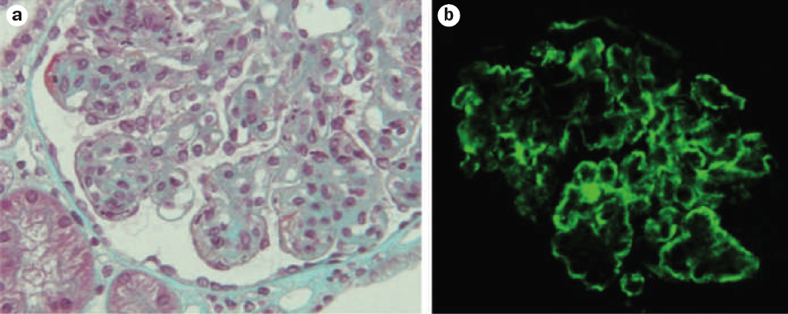
Complement as the primary disease driver
C3G
PNH
C3G/(IC-MPGN)
aHUS
Servais et al. Journal of medical genetics. 2007;44(3):193-9.
Complement-inhibitors as monotherapies
Conventional immunosuppression does not target the underlying pathophysiology

Slide 35
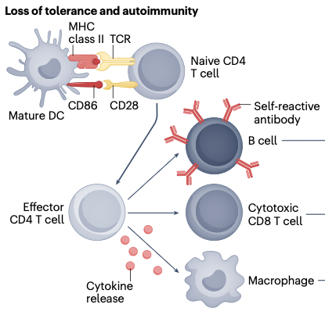
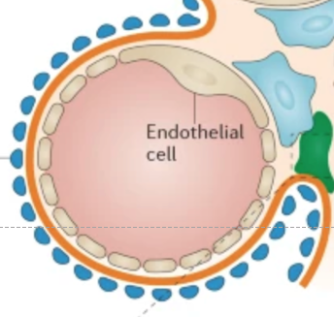
Complement as a secondary mediator of disease
Conventional immunosuppressive drugs
Cyclophosphamide
MMF
Rituximab
Glucocorticoids
Triggers
Cytokines
PAMPS/DAMPS
NETS, nucleic acids
Molecular mimicry
3) Tissue injury
Cellular immunity
Neutrophils
Macrophages
T cells/B cells
Molecular immunity
Antibodies
Complement
Cytokines
1) Loss of tolerance
2) Immune activation
Modified from:
Feldmann and Steinman, Nature, 2005, 435: 612
Petr and Thurman, Nature reviews Nephrology. 2023;19(12):771-87.
Theofilopoulos et al. Nat Immunol. 2017;18(7):716-24.

Slide 36
Complement as a secondary mediator of disease
Conventional immunosuppressive drugs
Cyclophosphamide
MMF
Rituximab
Complement inhibitors
Triggers
Cytokines
PAMPS/DAMPS
NETS, nucleic acids
Molecular mimicry
3) Tissue injury
Cellular immunity
Neutrophils
Macrophages
T cells/B cells
Molecular immunity
Antibodies
Complement
Cytokines
1) Loss of tolerance
2) Immune activation
Modified from:
Feldmann and Steinman, Nature, 2005, 435: 612
Petr and Thurman, Nature reviews Nephrology. 2023;19(12):771-87.
Theofilopoulos et al. Nat Immunol. 2017;18(7):716-24.

Slide 37
Risks and limitations of complement inhibitory drugs:
Infections
  Infectious prophylaxis needed
Expense
Route of administration (IV, SC)
Many of the diseases require chronic or life-long therapy

Slide 38
Complement Biomarkers
Soluble
Proteins (C3, C4): decrease during active disease
Activation fragments: increase during active disease
Functional
CH50/AH50:
  Screen for deficiency
  Monitor complement inhibition
Tissue
C3 and C4 are covalently bound to target tissues during activation
  Biopsies are often immunostained for these proteins
Genetics
Genetic sequencing can identify risk factors for aHUS, C3G

Slide 39
Complement activation generates soluble and tissue-bound biomarkers
C3
C3a + C3b
C5a and sC5b-9
Ba + Bb
C3c
C5b-9
C3b
C3bBb
C3bBbC3b
C3b
iC3b
C3dg

Slide 40
Complement activation generates soluble and tissue-bound markers
Complement activation generates soluble and tissue-bound biomarkers
Detected in body fluids by ELISA
Detected by tissue staining
C3
C3a + C3b
C5a and sC5b-9
Ba + Bb
C3c
C5b-9
C3b
C3bBb
C3bBbC3b
C3b
iC3b
C3dg

Slide 41
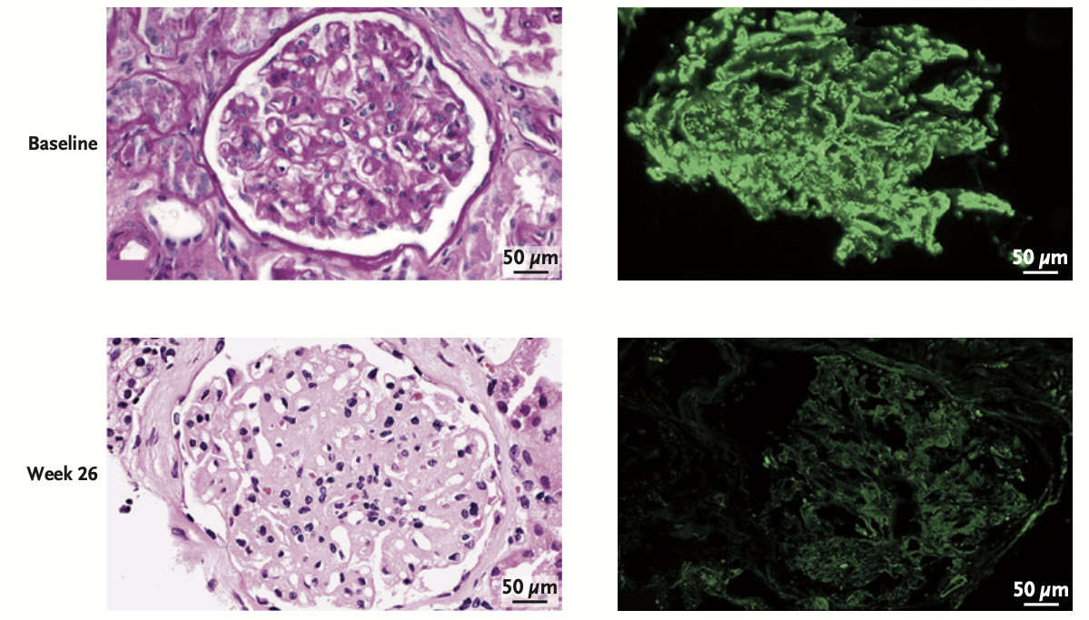
Tissue immunostaining demonstrates efficacy of complement inhibition
C3 immunofluorescence
Fakhouri et al. N Engl J Med 2025 Vol. 393 Issue 22 Pages 2210-2220

Slide 42
Key Conclusions:
The complement cascade is an important part of the immune system
  Fights infections
  Facilitates removal of apoptotic and injured cells
Complement causes tissue injury in many diseases
  Primary driver of several diseases
  Secondary activation is common in autoimmune and inflammatory diseases
Complement inhibitory drugs have been approved, and more are in development
Complement biomarkers can help guide therapy

Slide 43
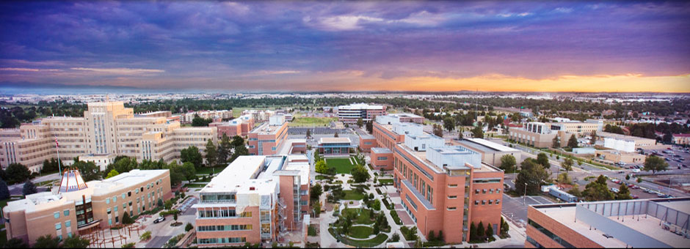

Thank you!

