Slide 1
Immune Regulation in
Tumor Progression
and Therapy
An Introduction to Cancer Immunology & CAR T Cell Therapy
Focus: Hematologic Malignancies
Monica L. Guzman, Ph.D.
Associate Professor of Pharmacology in Medicine
Meyer Cancer Center
Weill Cornell Medicine

Slide 2

What We Will Cover
01
02
03
The Immune System
Cancer & Immune Evasion
The Tumor Microenvironment
Innate & adaptive immunity basics
How tumors escape detection
A complex immunosuppressive niche
04
05
06
Hematologic Malignancies
Immunotherapy Strategies
CAR T Cell Therapy
Focus on Acute Myeloid Leukemia
Checkpoint blockade & beyond
Engineering immune cells to fight cancer

Slide 3
The Body's Defense System
The immune system has two interconnected arms that work together to detect and destroy threats
First line of defense — rapid response
Non-specific: attacks any foreign threat
Key cells: NK cells, macrophages, dendritic cells, neutrophils
NK cells kill cells missing self-identity markers (MHC-I)
Alerts and activates the adaptive system
Slower but highly specific and targeted
Recognizes specific antigens on threat cells
Key cells: T cells (CD8+, CD4+), B cells
CD8+ T cells directly kill cancer cells
Has memory — faster response on re-exposure
INNATE IMMUNITY
ADAPTIVE IMMUNITY
↔

Slide 4
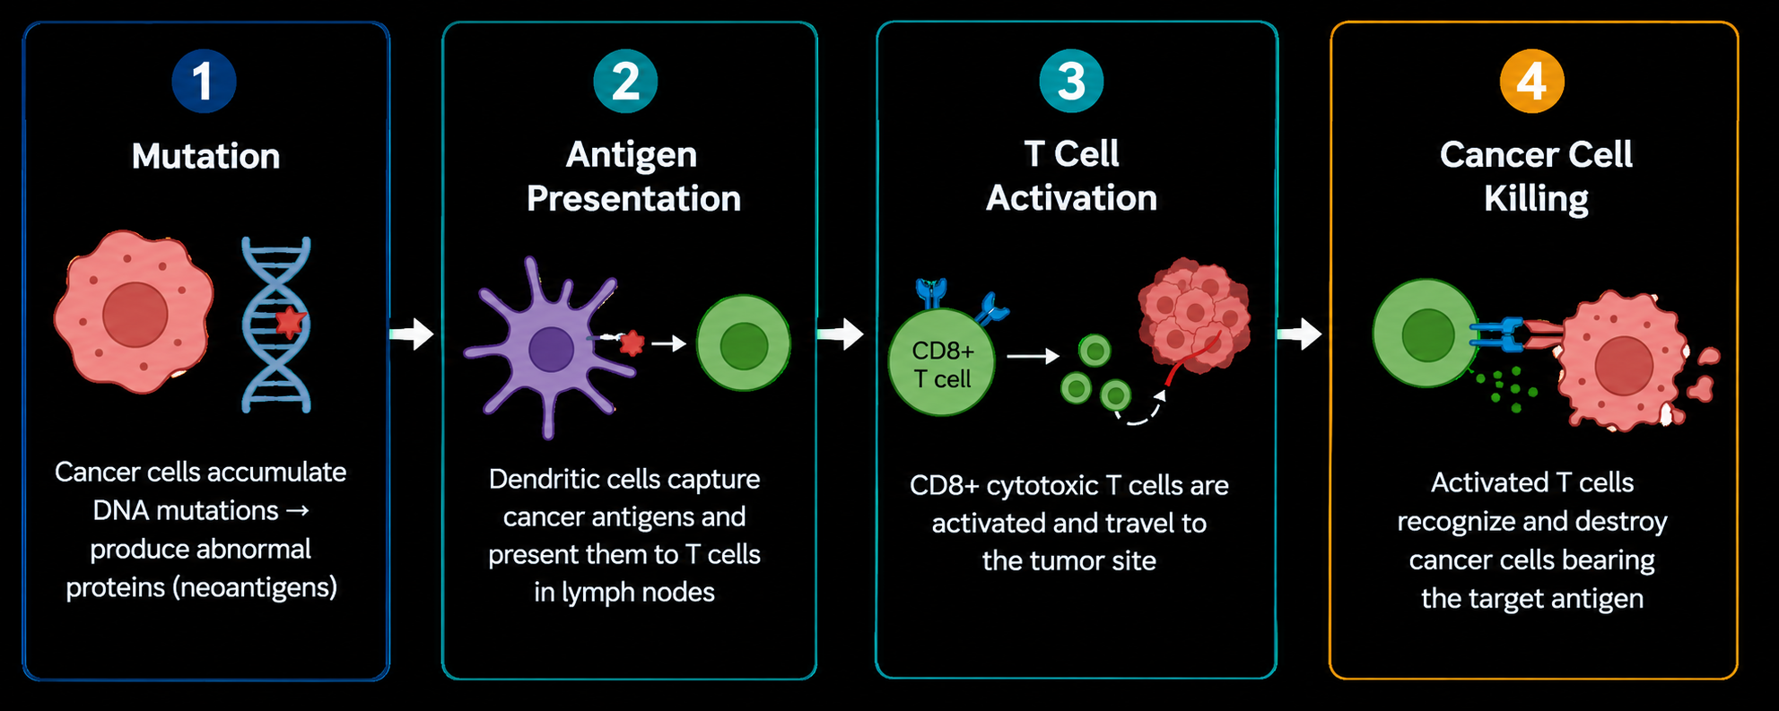
How the Immune System Detects Cancer
This process is called Cancer Immunosurveillance — the immune system constantly scans for and eliminates early cancer cells.

Slide 5
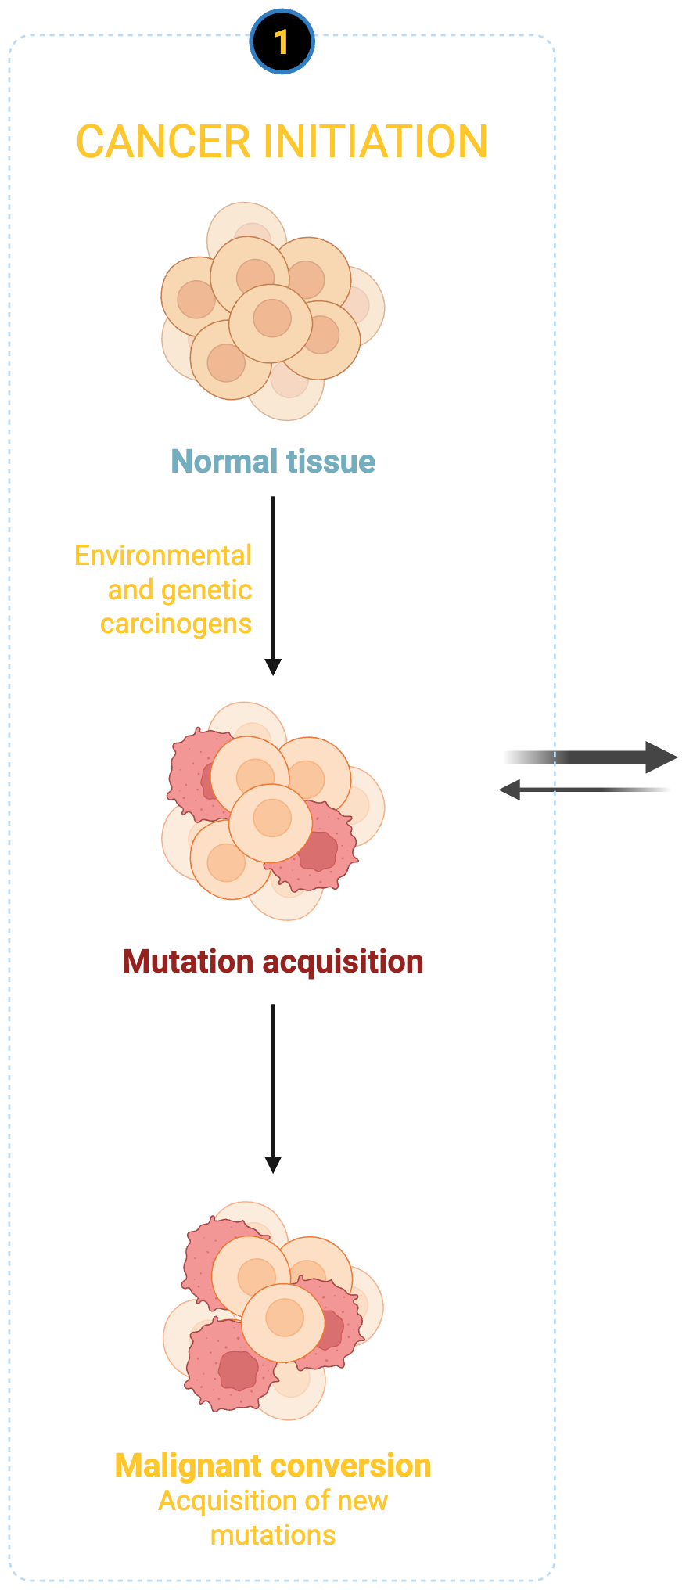















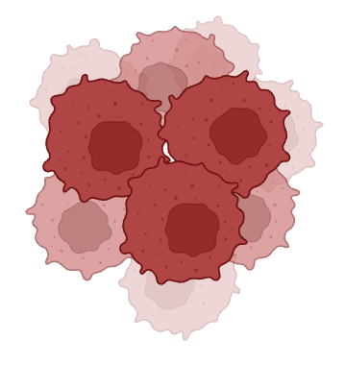

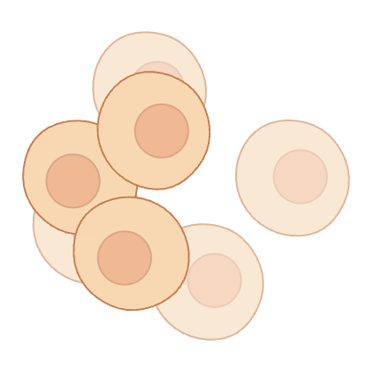










Cancer Immunosurveillance
ELIMINATION
EQUILIBRIUM
ESCAPE
Suppression of transformed cells
Tumor dormancy
Selective immune pressure
Tumor progression
Treg
MDSC
CD8+ T cell
NK cell
IL-12
CD4+ T cell
IFNγ
Healthy cell
Highly immunogenic tumor cell
Poorly immunogenic tumor cell

Slide 6
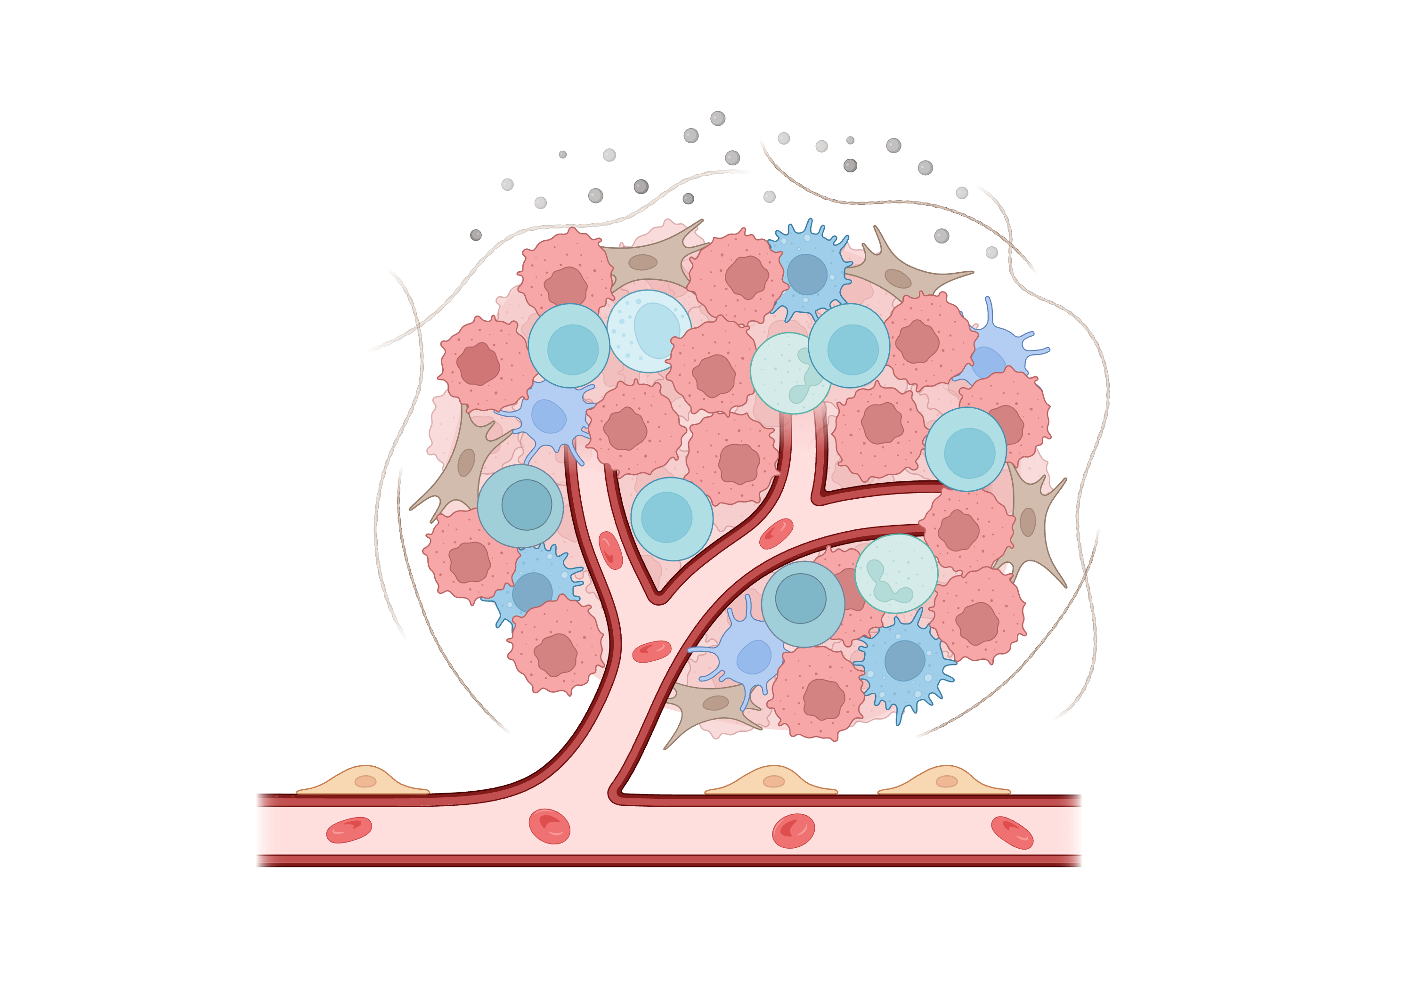
The Tumor Microenvironment (TME)
A tumor is not just cancer cells — it's a complex ecosystem that suppresses immune activity
Regulatory
T cells (Tregs)
Myeloid-Derived
Suppressor Cells
Tumor-Associated
Macrophages (TAMs)
Exhausted
CD8+ T cells
Cytokines &
Chemokines
All these components work together to create an immunosuppressive 'cold' tumor environment that shuts down anti-cancer immune responses.

Slide 7
How Tumors Escape the Immune System
Downregulate Self-Markers
Express 'Don't Kill Me' Signals
Recruit Suppressor Cells
Cancer cells reduce MHC-I expression, making them invisible to CD8+ T cells.
Upregulate PD-L1 on their surface, which sends an OFF signal to attacking T cells. CD47 triggers an inhibitory signal that tells the macrophage to back off
Secrete signals that recruit Tregs and macrophages that block immune activation.
Exhaust T Cells
Alter the Metabolism
Produce Immunosuppressive Factors
Chronic antigen exposure leads to T cell exhaustion — they become dysfunctional over time.
Deplete nutrients (glucose, oxygen) in the TME, starving immune cells of energy.
Secrete TGF-β, IL-10, and VEGF which dampen immune responses and block T cell infiltration.

Slide 8
Hematologic
Malignancies
Blood cancers as a model for understanding tumor immune evasion

Slide 9
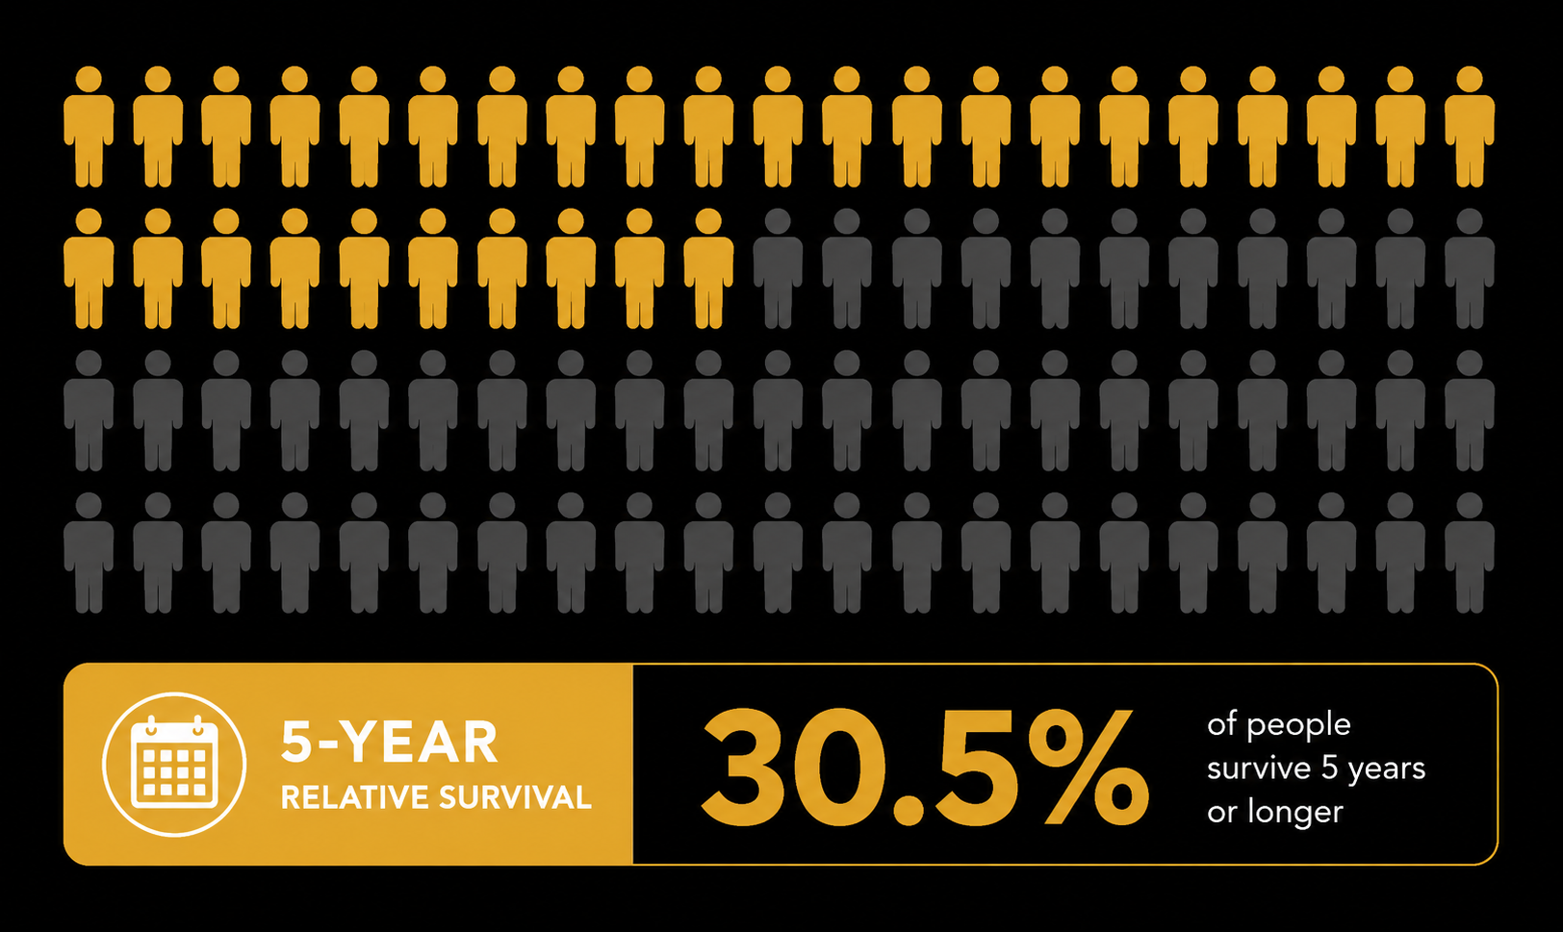
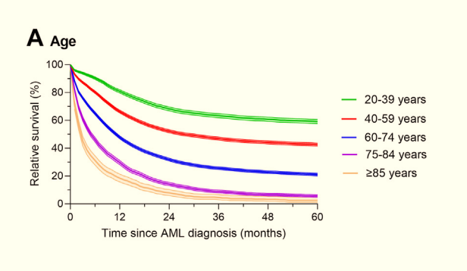
Acute Myeloid Leukemia
Linet M, Curtis R, Schonfeld S et al.eClinicalMedicine, 2024; 71

Slide 10

Hematopoiesis

Slide 11
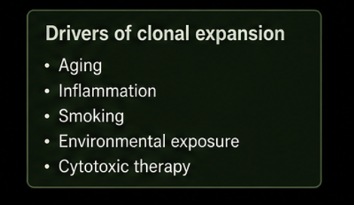
Clonal Hematopoiesis

Slide 12
Breaking Immune Equilibrium
WHAT TIPS THE BALANCE IN AML
Mutation accumulation and the collapse of immune surveillance · AML as a model
Somatic mutation burden
DNMT3A, TET2, IDH1/2, FLT3, NPM1 alter epigenome & signaling; reduce immunogenicity
Neoantigen depletion
Immunoediting selects MHC-low, neoantigen-poor variants invisible to T cells (Van Galen, Cell 2019)
Myeloid skewing
Checkpoint upregulation
Mutant clones preferentially generate immunosuppressive myeloid cells (MDSCs, TAMs) over functional effectors
PD-L1, TIM-3, CD47 upregulated on AML blasts to silence effector T and NK cells (Daver, Leukemia 2021)
Van Galen P, et al. Cell. 2019;176:1265–1281 ·
Daver N, et al. Leukemia. 2021;35:1843–1863 ·
Wang et al. Heliyon. 2024;10:e39731 ·
Behl D, et al. Leukemia. 2006;20:29–34

Slide 13
T Cell Dysfunction and AML Progression
Quantitative loss and qualitative failure of anti-leukemia immunity
T CELL EXHAUSTION CASCADE IN AML
AML-SPECIFIC IMMUNE LANDSCAPE
1
Chronic antigen exposure
Blast immunophenotype
Persistent blast antigen stimulation without co-stimulation drives T cells toward exhaustion; TCF1+ progenitor pool depleted
PD-L1, CD47, CD200, Galectin-9, HLA-DR downregulation on AML blasts — multi-mechanism T and NK cell evasion
2
Inhibitory receptor upregulation
Myeloid suppressor network
Sequential co-expression: PD-1 → TIM-3 → LAG-3 → TIGIT
TIM-3+ CD8+ T cells are terminally exhausted and mark AML relapse risk (Haubner, Leukemia 2018)
MDSCs, M2-polarized macrophages, mast cells, plasmacytoid DCs — collectively inhibit priming and effector phases (Daver, Leukemia 2021)
3
Effector function loss
Treg expansion
↓ IFN-γ, TNF-α, granzyme B production
↓ Proliferative capacity; Tregs suppress residual effectors via IL-10, TGF-β (Rutella, JCI 2022)
FOXP3+ Tregs enriched in BM; secrete IL-10, TGF-β; consume IL-2 depriving effector T cells; correlate with worse OS (Rutella, JCI 2022)
4
Quantitative T cell depletion
Clinical Consequence: AML Progression
Absolute CD4+ and CD8+ lymphopenia documented at diagnosis; inversely correlates with CR rate (Le Dieu, Blood 2009; Feucht, Oncotarget 2016)
Immune-incompetent BM niche permits unchecked blast expansion → full AML. Degree of T cell exhaustion at diagnosis independently predicts CR duration and OS. Immune dysfunction precedes morphologic relapse.
Knaus HA, et al. JCI Insight. 2018;3:e120974 · Haubner S, et al. Leukemia. 2018;33:64–74 · Rutella S, et al. JCI. 2022;132:e159579 · Feucht J, et al. Oncotarget. 2016;7:76902 · Le Dieu R, et al. Blood. 2009;114:3909 · Mazziotta et al. Blood. 2024;144:1168–1182

Slide 14
Immune Recovery & Maintaining Remission in AML
Restoring immune surveillance is essential — not optional — for durable responses

Slide 15
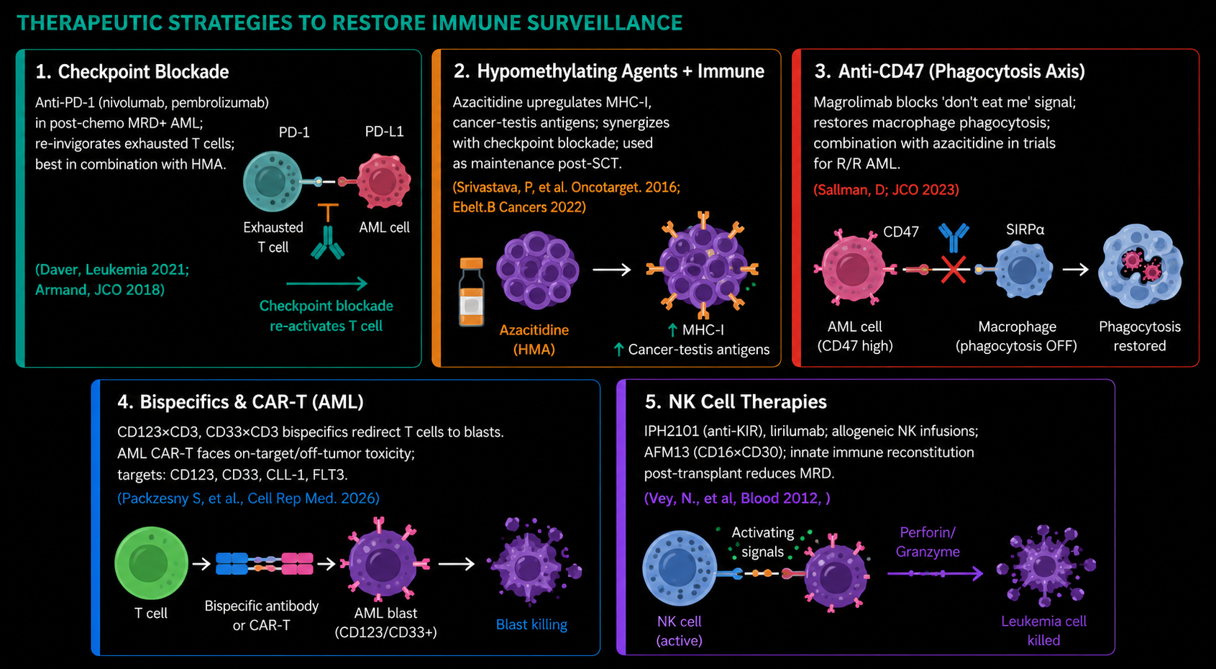
Therapeutic strategies to restore immune surveillance

Slide 16
Examples
Checkpoint inhibitors
CAR T cells

Slide 17
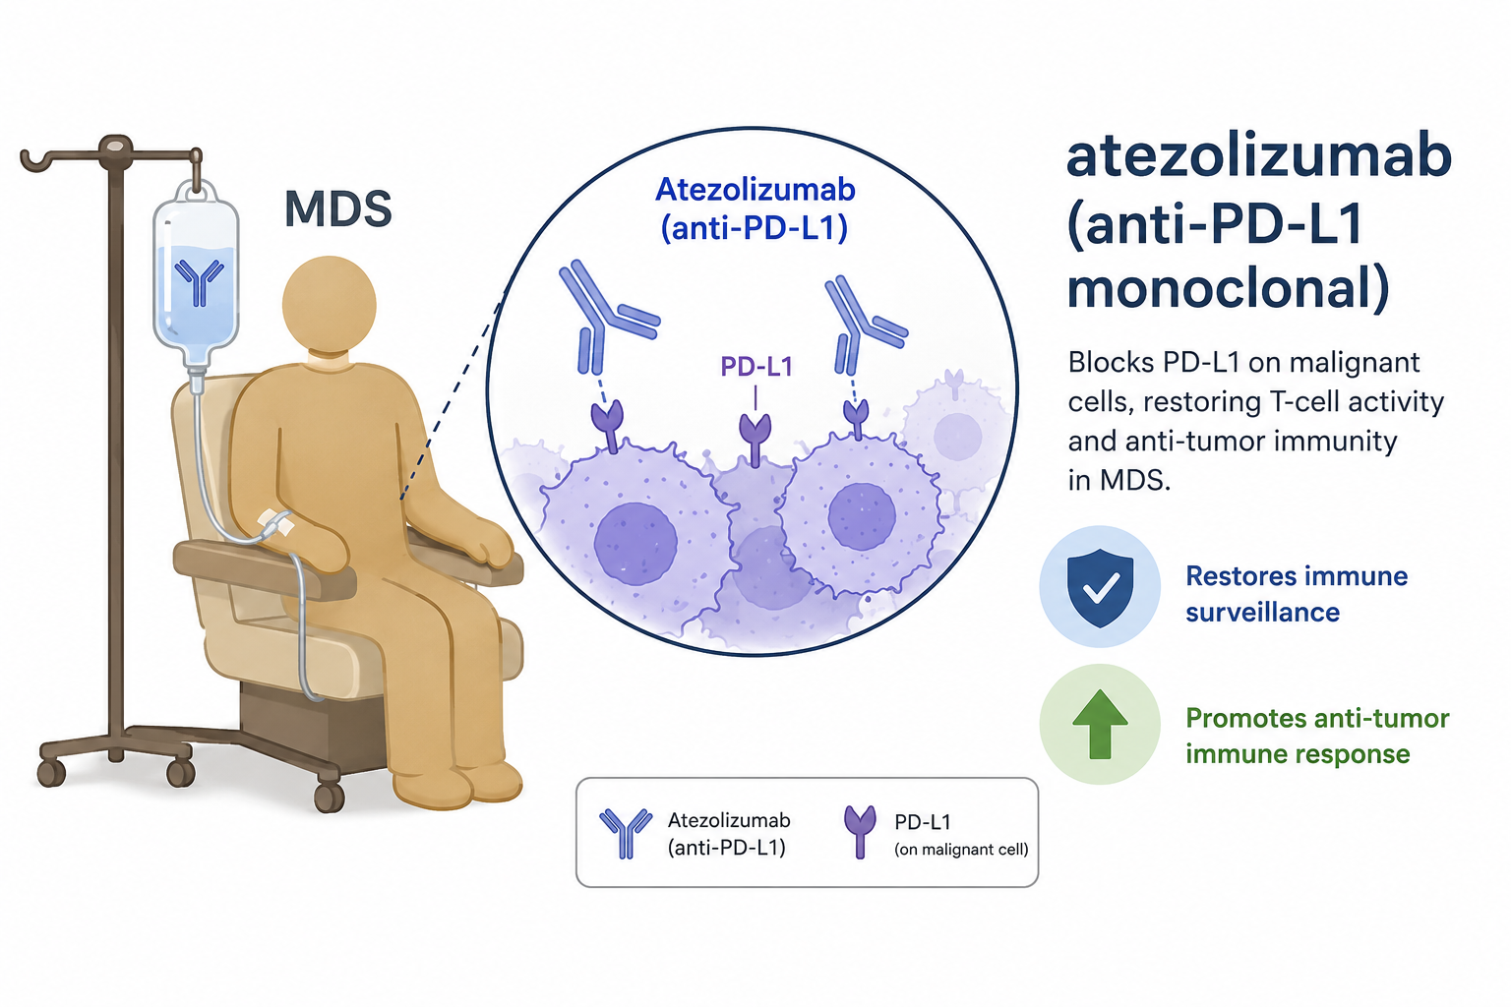
Checkpoint blockade
Response rate: 33% (7 CR, 1 PR)
Median overall survival: 15.1 months — better than historical outcomes (~4–6 months)
Median progression-free survival: 7.2 months
The trial demonstrated potential enhanced responsiveness to atezolizumab in patients with the ASXL1 mutation in their T cells
Clin Cancer Res (2022) 28 (24): 5306–5316.

Slide 18
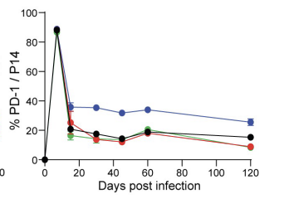
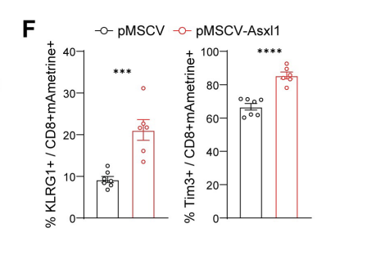
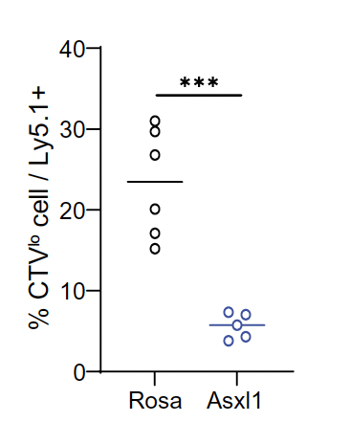
ASXL1 mutant has increased PD-1 expression and controls stemness
PD-1 expression is increased in
Asxl1 KO
Asxl-1 OE increases effector
differentiation
Potent effector response in
Asxl1 KO CD8 T cells
pMSCV
ASXL-
OE
pMSCV
ASXL-
OE
Kang et al., Science 386, 4492 (2024)

Slide 19
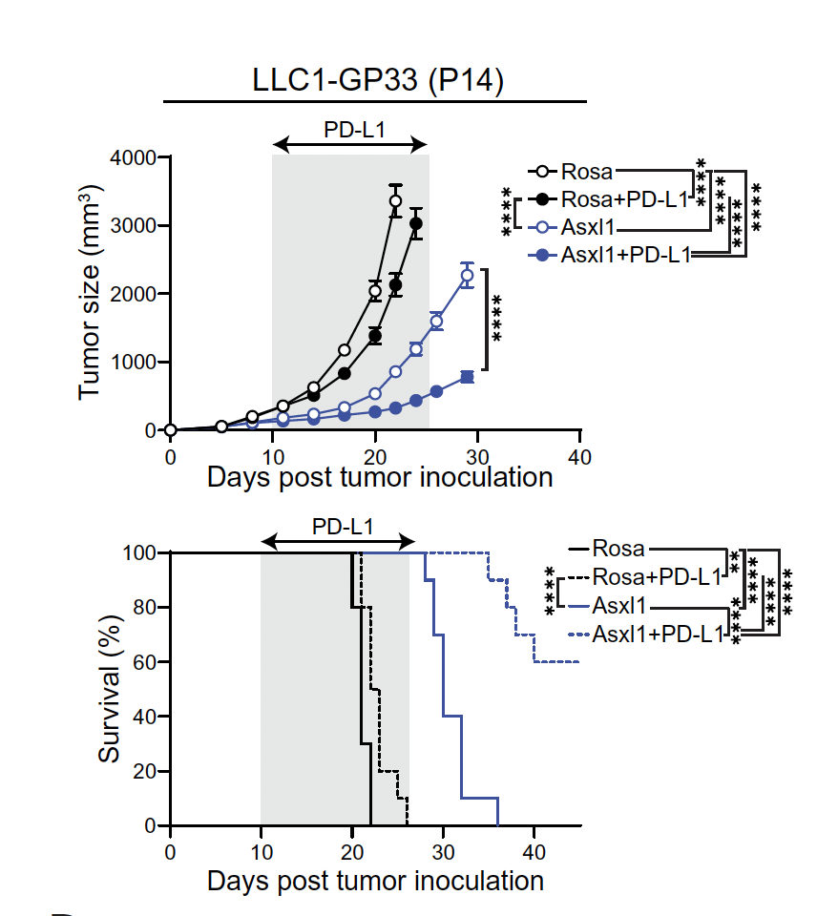
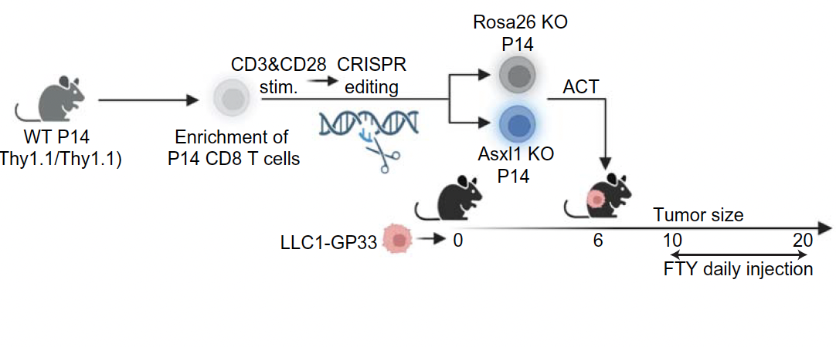
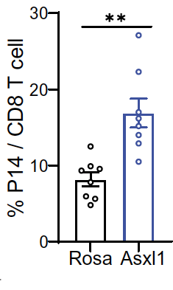
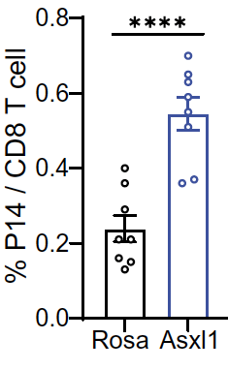
Asxl1 KO improves tumor control during anti-PD-L1 treatment
Tumor
LN
PD-L1 injection
Validated with
B16-OVA (OT-I)
B16F10 (Pmel-1)
Kang et al., Science 386, 4492 (2024)
Kang et al., Science 386, 4492 (2024)

Slide 20
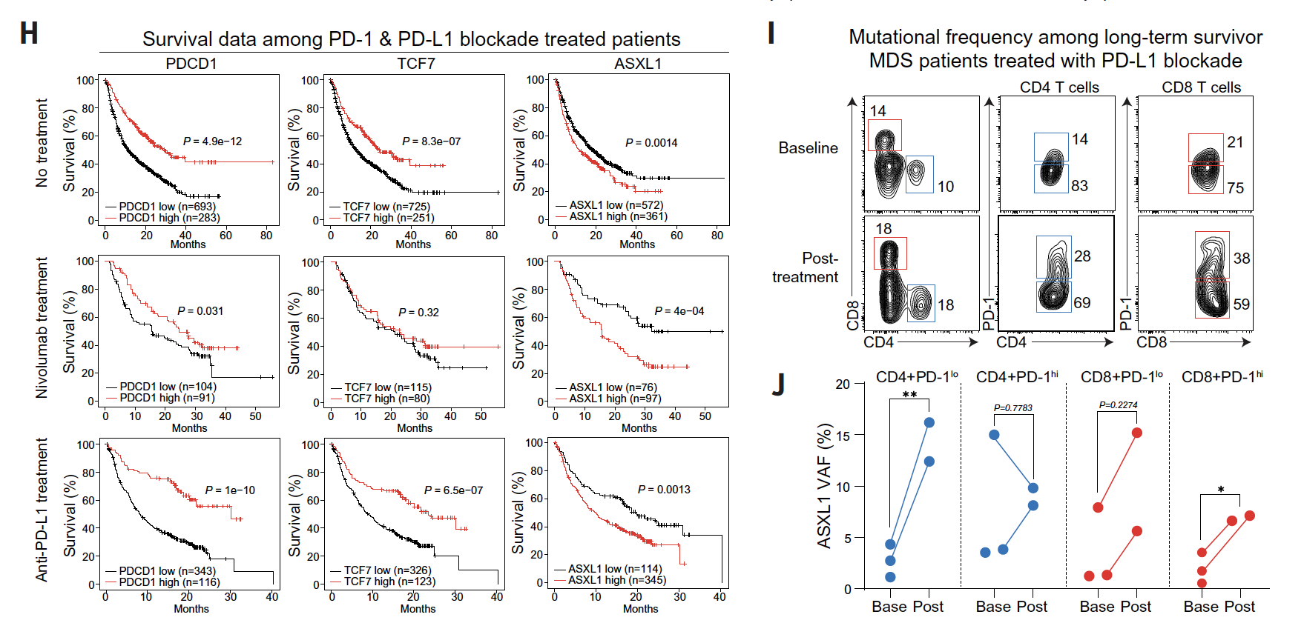
Asxl1 disruption signatures is associated with improved response to immunotherapy in humans
Kang et al., Science 386, 4492 (2024)
Kang et al., Science 386, 4492 (2024)

Slide 21
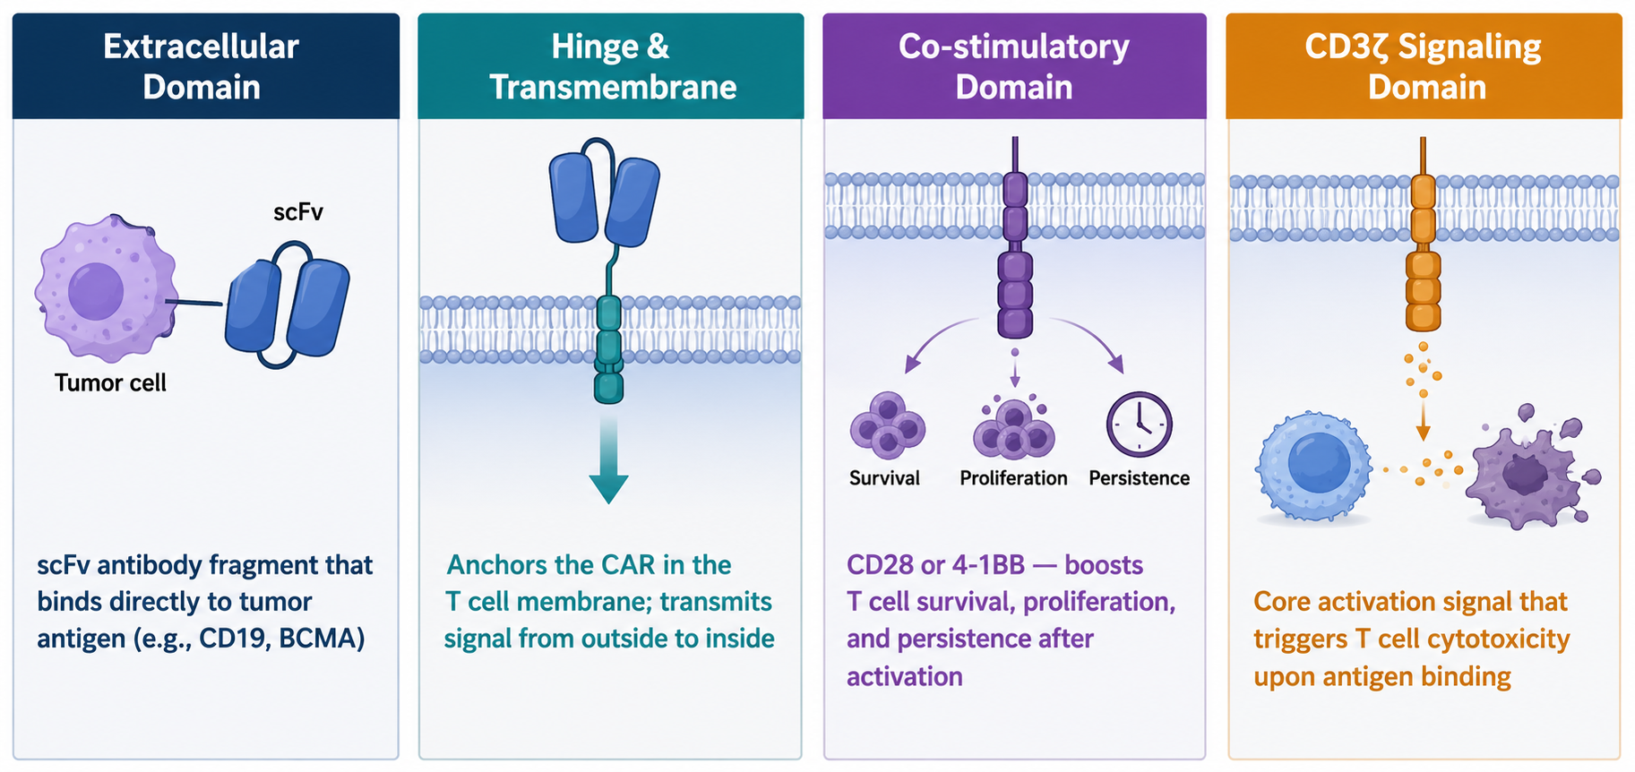
CAR T cell therapy
CAR = Chimeric Antigen Receptor — a synthetic receptor engineered into a patient's T cells that allows them to recognize and kill specific cancer cells, regardless of MHC presentation.

Slide 22
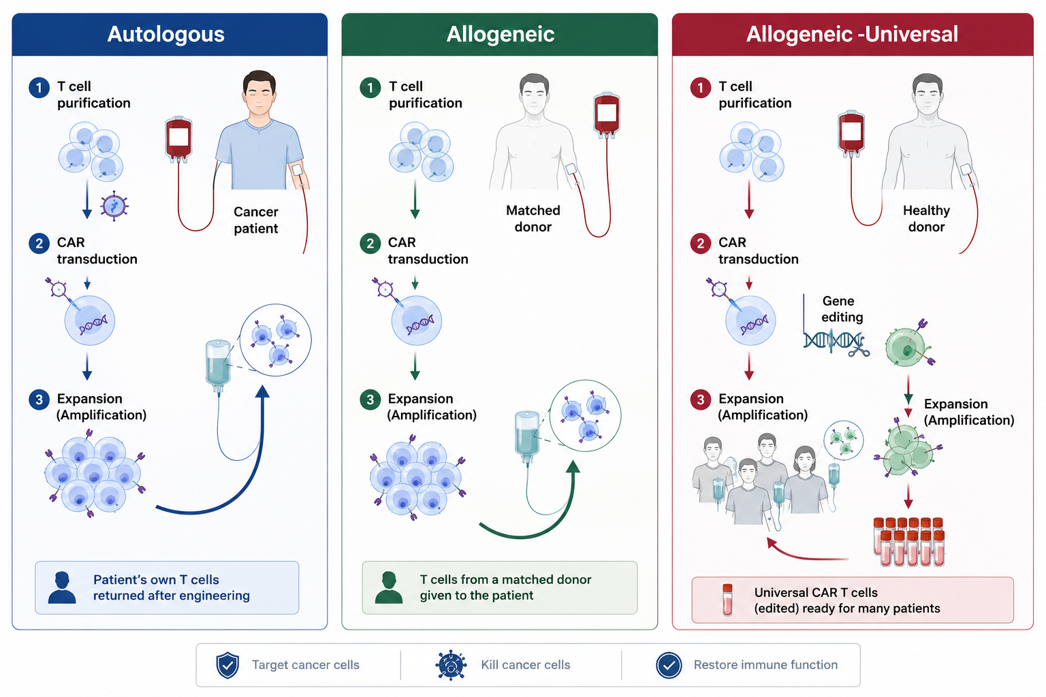
CAR T process

Slide 23
Targeting CD123 with Allogeneic TCRα/β Deficient CAR T-Cells
scFv against the target of interest
Anti-CD123 scFv
Co-stimulatory domains
2nd Generation CAR: 4-1BB + CD3z
TCRab knock-out using TALEN® Gene Editing (TRAC KO)
Safety feature: RQR8 + (renders cells sensitive to rituximab)
T-cells were generated and provided by Cellectis SA

Slide 24
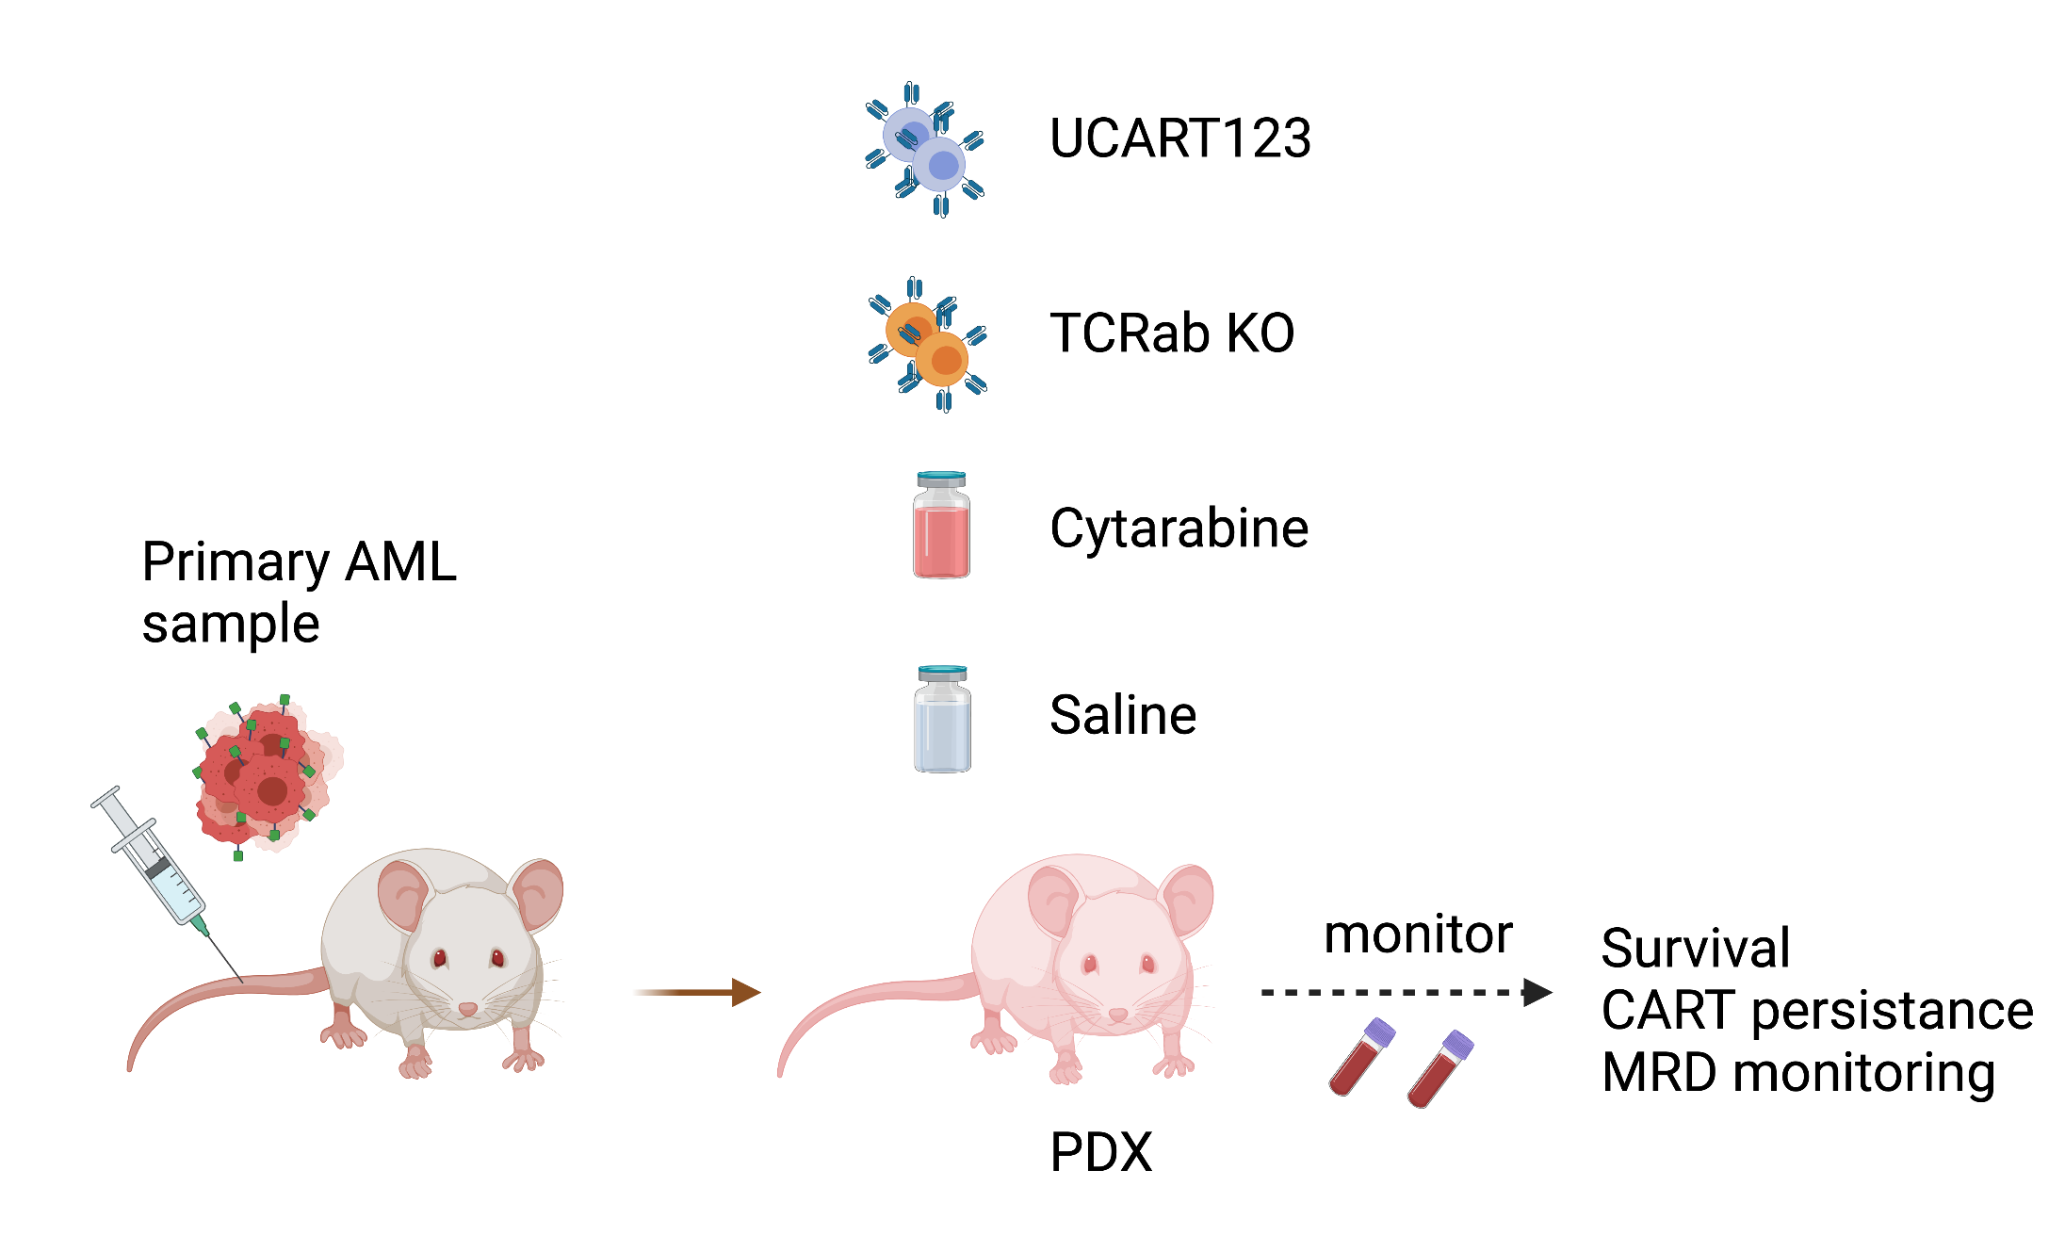
Primary derived xenotransplants (PDX) were generated to test in vivo activity of UCART123
NPM1 mutant,
FLT3-ITD+
Sugita et. al., Nat. Comm. 13, 2227 (2022)

Slide 25
UCART123 cells significantly decrease tumor burden and improves overall survival
Peripheral blood evaluation
Overall Survival
PBS
UCART123 2.5M
Ara-C
UCART123 1M
TCRa/b KO
Ara-C
144days
UCART123 2.5M
UCART123 1M
TCRa/b KO
126 days
NPM1 mutant, FLT3-ITD+
PBS
124 days
Sugita et. al., Nat. Comm. 13, 2227 (2022)

Slide 26
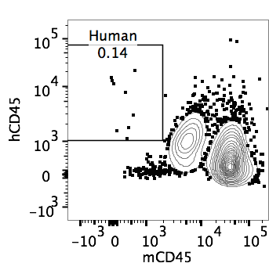
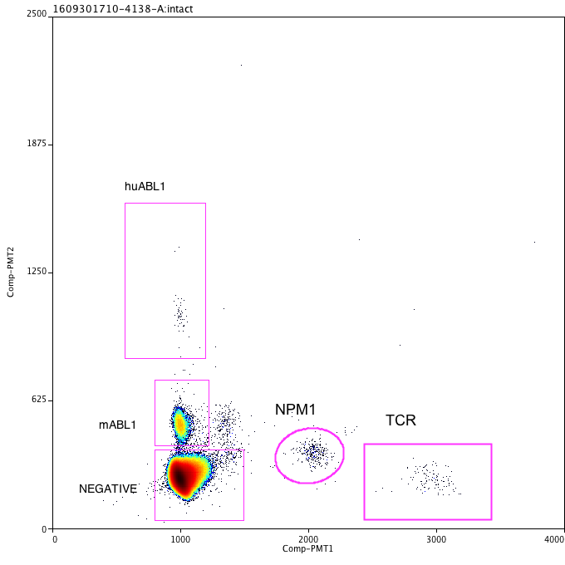
Novel multiplex digital PCR assays were developed to monitor residual AML and CART in PDX mice
Peripheral blood evaluation
Human
Flow cytometry
PBS
c
Ara-C
hCD45
TCRα/β KO
mCD45
c
UCART123 2.5M
ddPCR
UCART123 1M
hABL
NPM1 mutant, FLT3-ITD+
NPM1
UCART
mABL
Negative
Sugita et. al., Nat. Comm. 13, 2227 (2022)

Slide 27
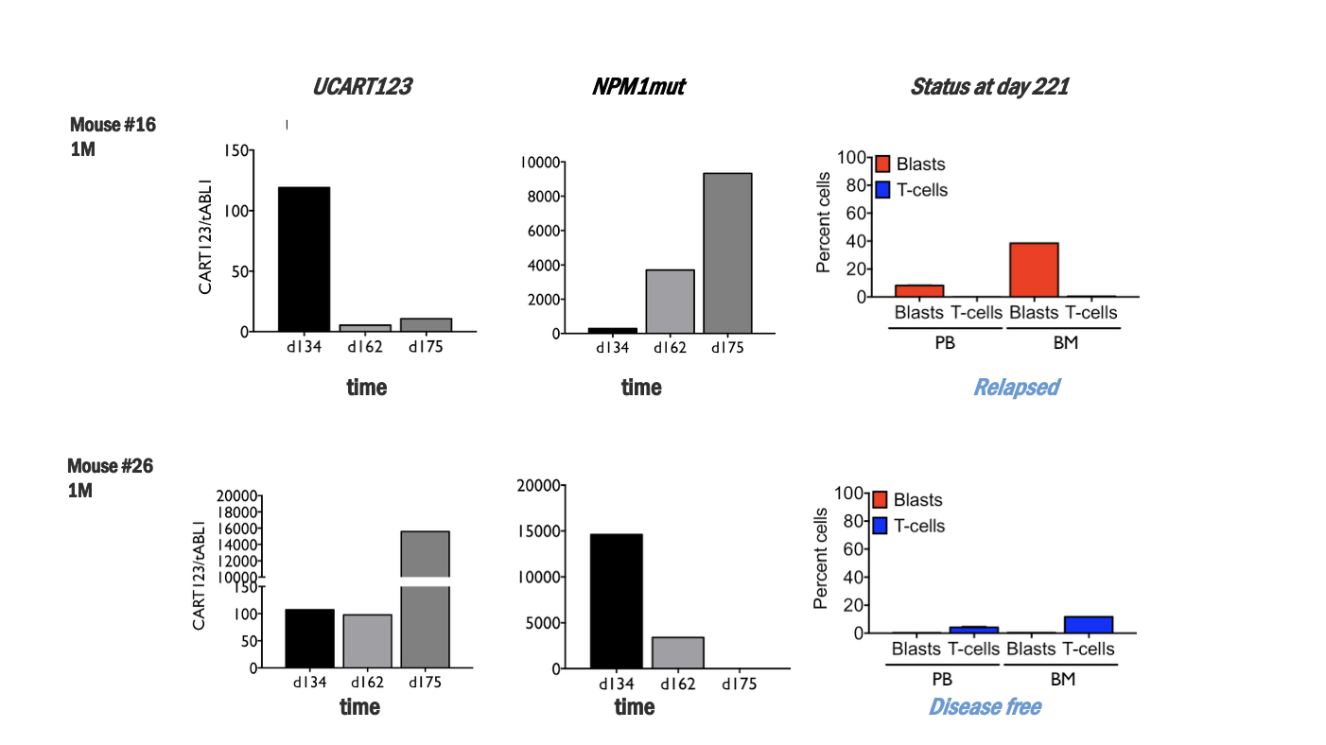
Novel multiplex digital PCR assays were developed to monitor residual AML and CART in PDX mice
Sugita et. al., Nat. Comm. 13, 2227 (2022)

Slide 28
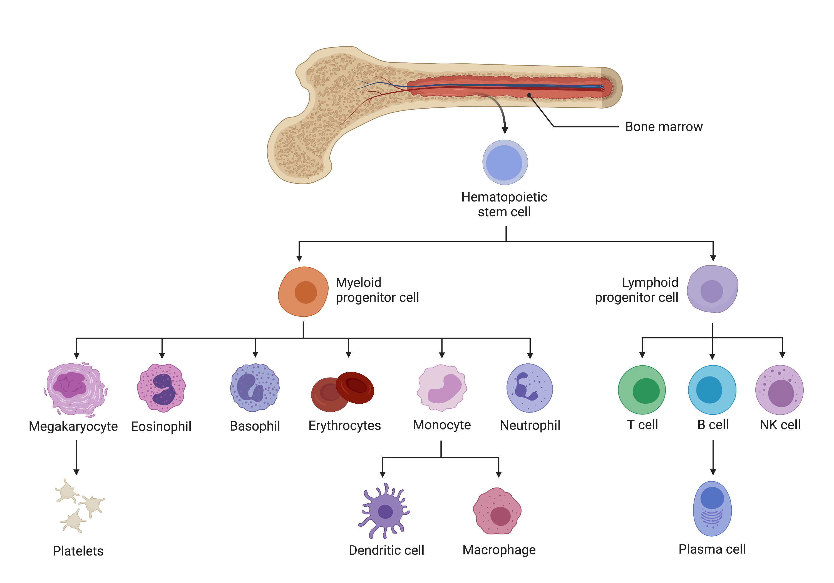
Important considerations for target selection
CD123
CD123
CD123
Created with BioRender.com

Slide 29
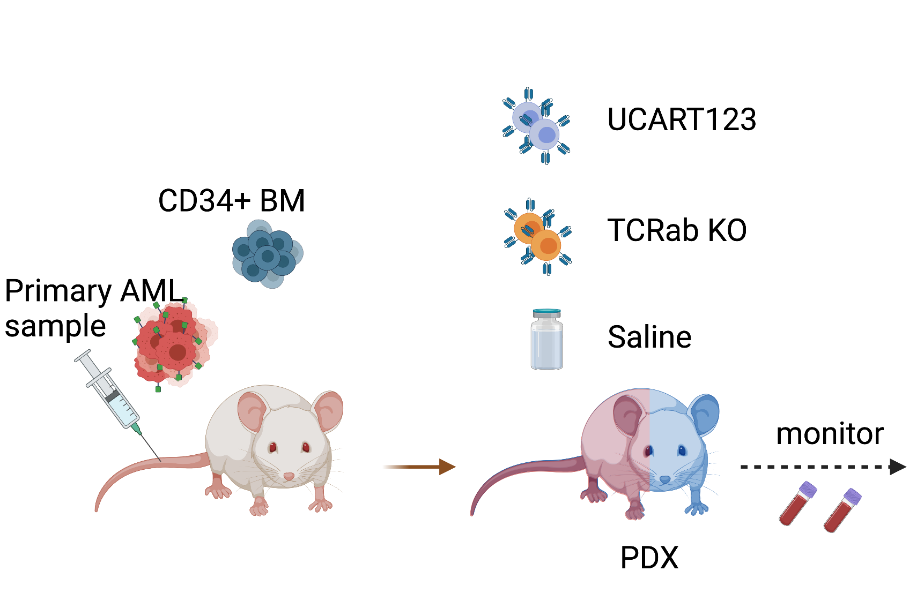
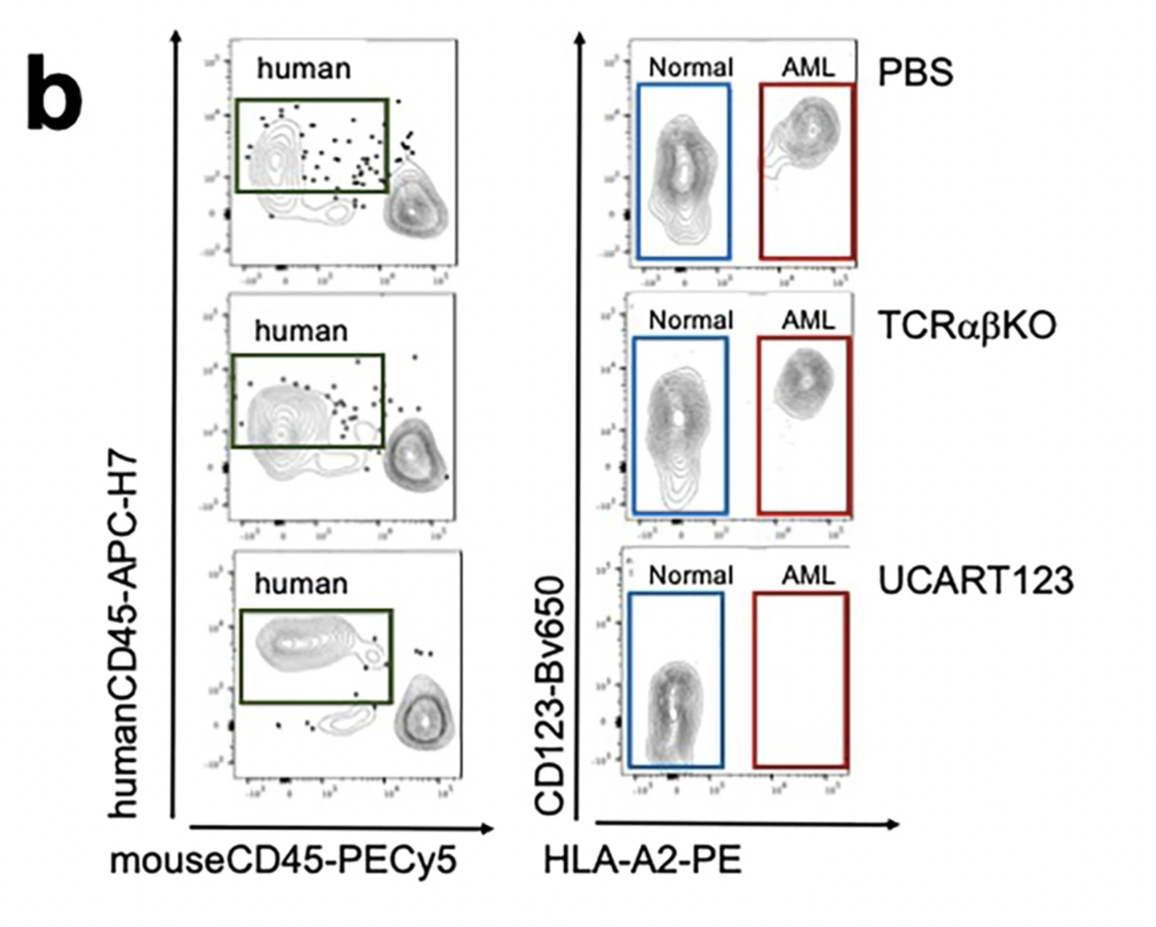
Competitive BM/AML xenografts were generated to test in vivo selectivity of UCART123
HLA-A2+
Sugita et. al., Nat. Comm. 13, 2227 (2022)

Slide 30
Approved CAR T cell therapies
Other Hematologic Malignancies

Slide 31
FDA-Approved CAR T Products
Seven CAR T products are currently approved — all for hematologic malignancies
Product
Target
Indication
Approved
Kymriah
(tisagenlecleucel)
CD19
B-cell ALL, DLBCL
2017
Yescarta
(axicabtagene ciloleucel)
CD19
DLBCL, FL, MCL
2017
Tecartus
(brexucabtagene autoleucel)
CD19
MCL, B-cell ALL
2020
Breyanzi
(lisocabtagene maraleucel)
CD19
DLBCL, CLL, FL
2021
Abecma
(idecabtagene vicleucel)
BCMA
Multiple Myeloma
2021
Carvykti
(ciltacabtagene autoleucel)
BCMA
Multiple Myeloma
2022
Aucatzyl
(obecabtagene autoleucel)
CD19
B-cell ALL
2024

Slide 32
CAR T in Blood Cancers: Clinical Results
Transformative outcomes in patients who had exhausted all other options
80–90%
~65%
~70%
42%
Complete remission rate
Overall response rate
Response rate
Complete response rate
CD19 CAR T in pediatric ALL
CD19 CAR T in aggressive DLBCL
BCMA CAR T in relapsed myeloma
Aucatzyl in adult B-cell ALL (2024)
Important Context
These are patients who had already received 2 or more prior lines of therapy — including chemotherapy and stem cell transplants. These response rates represent a major advance in oncology. Many achieving complete remission had 'no other options.'

Slide 33
Challenges & Limitations
CAR T is powerful but comes with significant hurdles to overcome
Cytokine Release Syndrome (CRS)
High Toxicity
Neurotoxicity (ICANS)
High Toxicity
Antigen Escape
Resistance
Rapid CAR T activation releases a flood of cytokines → fever, hypotension, organ damage. Can be life-threatening. Managed with tocilizumab (anti-IL-6 antibody).
Immune effector cell-associated neurotoxicity syndrome — confusion, aphasia, seizures in some patients. Mechanism not fully understood.
Tumor cells downregulate or lose the target antigen (e.g., CD19 loss in 20-30% of relapsed ALL), rendering CAR T ineffective. Solution: dual-target CARs.
CAR T Exhaustion
Resistance
Manufacturing Complexity
Access
Limited Use in Solid Tumors
Scope
Chronic antigen exposure causes CAR T cells to exhaust over time, reducing durability of response. 4-1BB co-stimulatory domains improve persistence.
Each product is made individually for each patient — 2-4 weeks, specialized facilities, ~$400K–500K cost. Supply chain and access remain major barriers.
Most successes are in blood cancers. Solid tumors have physical barriers, hostile TME, and limited unique antigens — CAR T approvals remain restricted to hematologic malignancies.

Slide 34
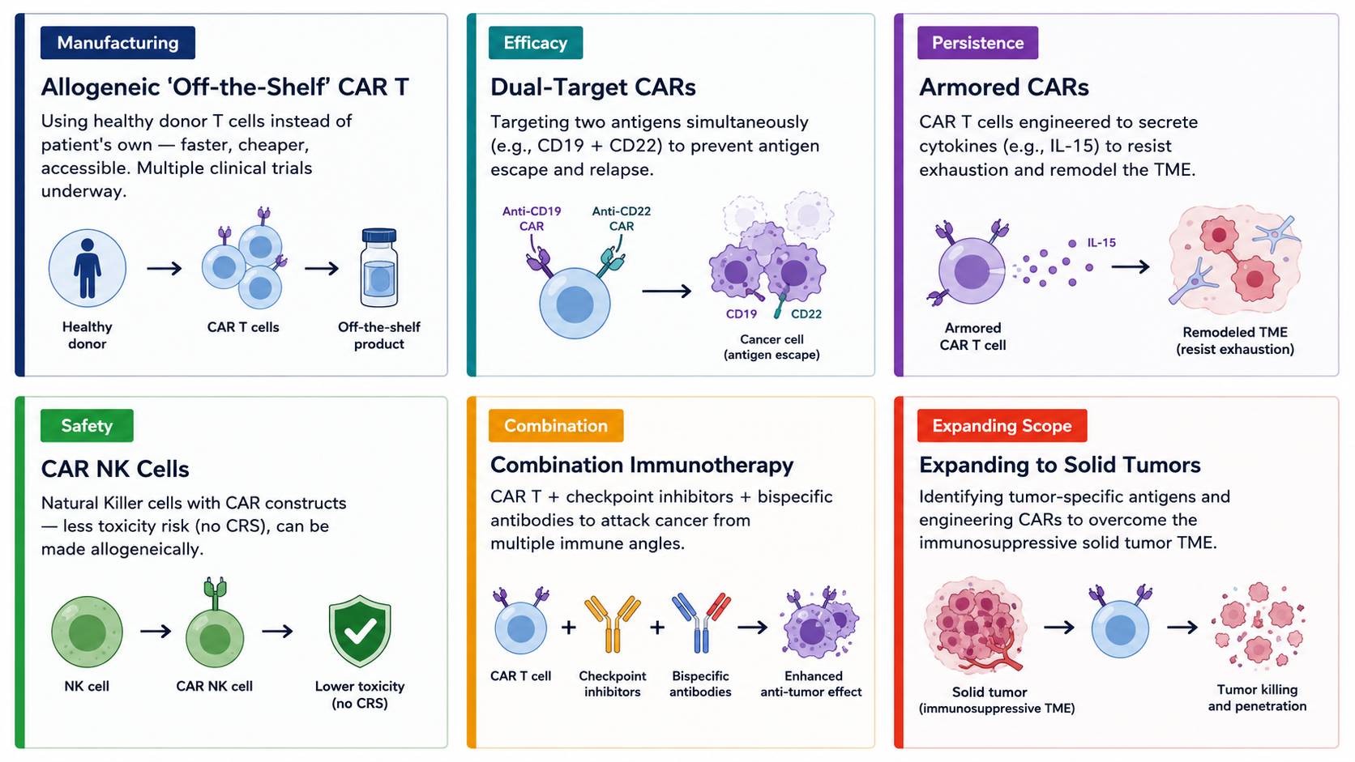
Additional therapeutic avenues

Slide 35
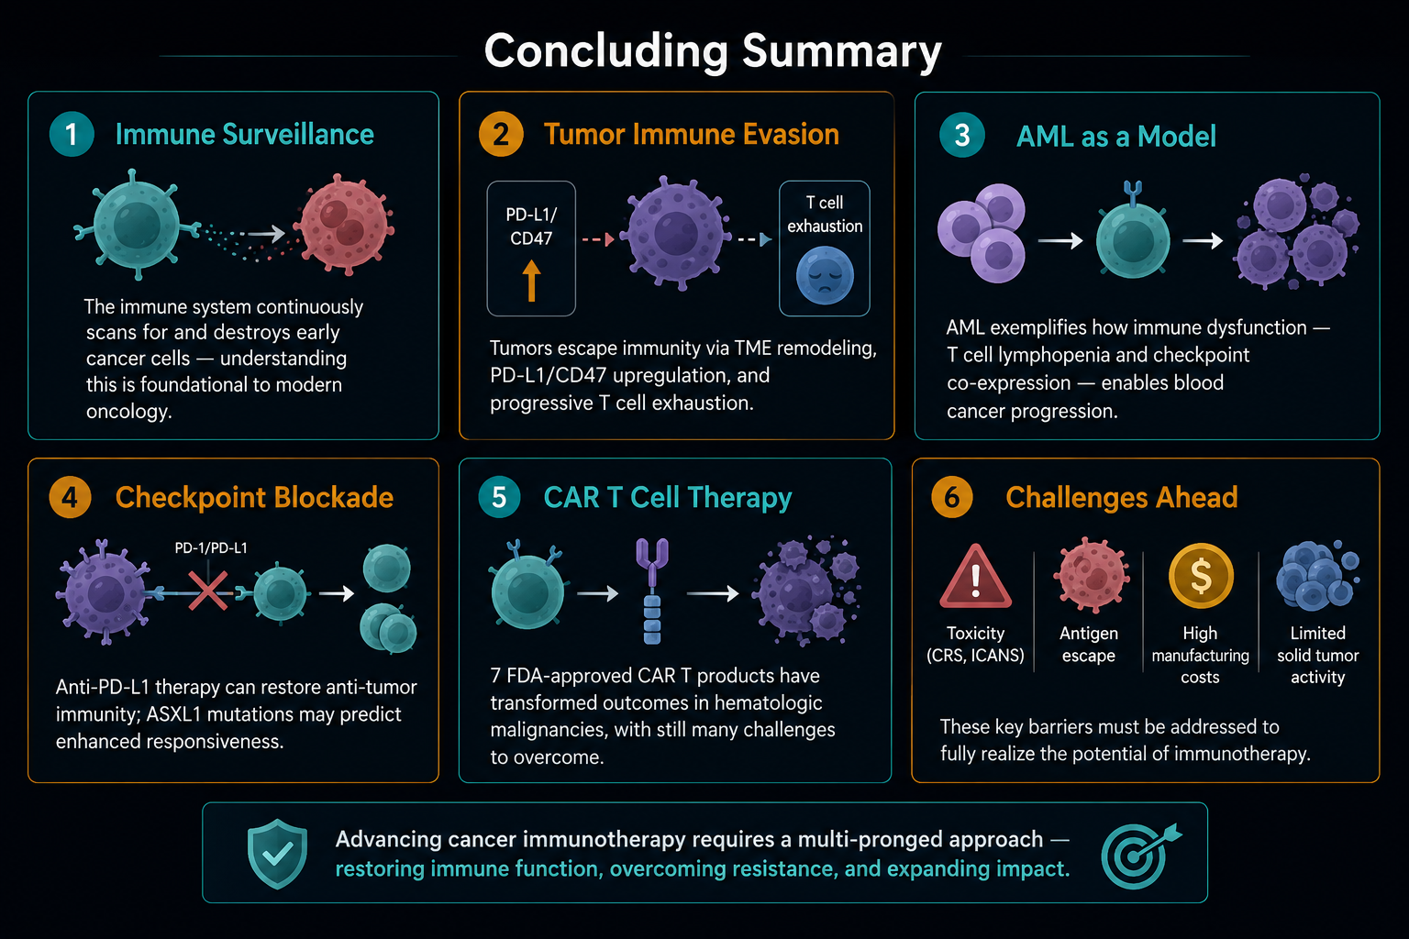
Take home messages

