Slide 1
T cell Tolerance and Autoimmunity
Mark Anderson, MD, PhD
UCSF Diabetes Center
Director, Immune Tolerance Network

Slide 2
Lecture outline
Self-tolerance: concept, significance
Mechanisms of central and peripheral tolerance: deletion, anergy, regulatory T cells
Pathogenesis of autoimmunity: roles of susceptibility genes and environmental factors

Slide 3
The immunological equilibrium: balancing lymphocyte activation and control
Activation →
Effector and memory T cells
Tolerance
Regulatory T cells
Normal: reactions against pathogens
Pathologic: inflammatory
disease, e.g. caused by reactions against self
No response to self
Controlled response to pathogens

Slide 4
The problem of self-nonself discrimination
The immune system responds to many foreign (microbial) antigens but not to self antigens
Developing lymphocytes express a large number of antigen receptors, not biased by specificity
Therefore, all individuals produce lymphocytes with the ability to recognize self antigens
Self antigens have access to the immune system
Therefore, self-reactive lymphocytes must be selected against (eliminated or inactivated) to prevent autoimmunity

Slide 5
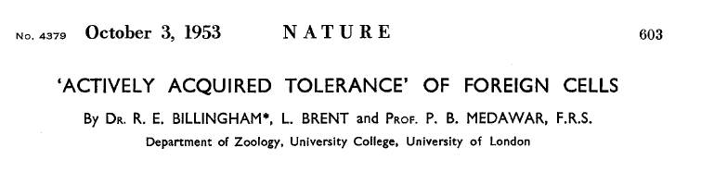
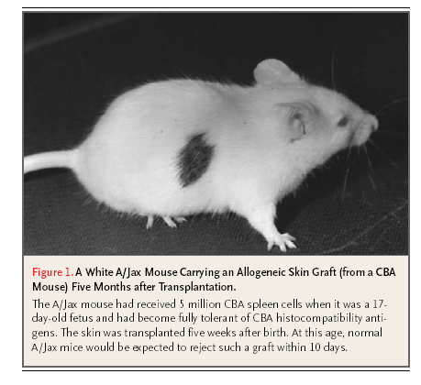
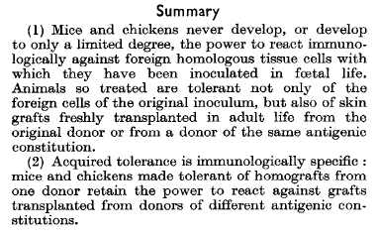
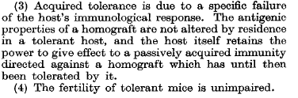

Slide 6
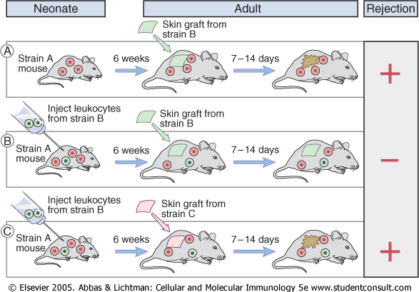

Slide 7
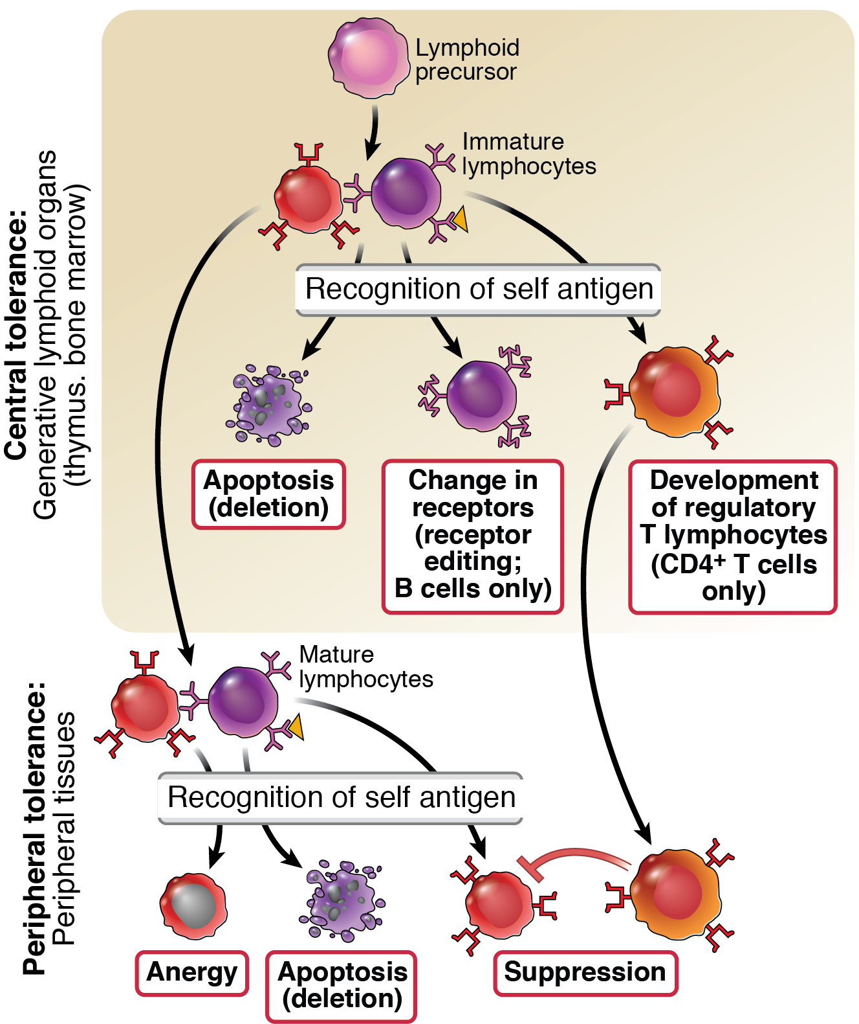
Central and peripheral tolerance
The principal fate
of lymphocytes that
recognize self antigens
in the generative organs
is death (deletion), BUT:
Some B cells may change
their specificity (called
“receptor editing”)
Some T cells may
differentiate into
regulatory (suppressor)
T lymphocytes

Slide 8
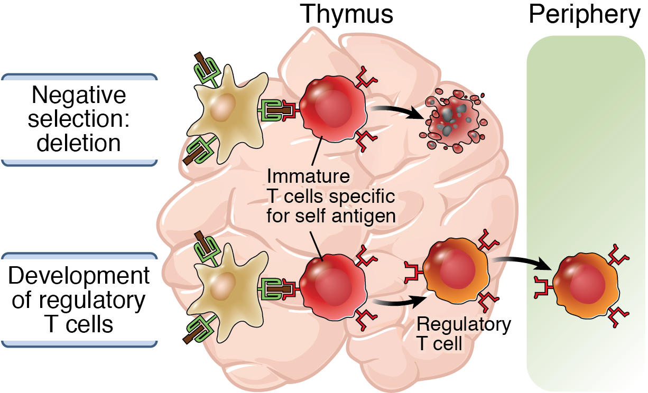
Central T cell tolerance

Slide 9
What self antigens are seen in the thymus?
Ubiquitous cell-associated and circulating proteins
The thymus has a special mechanism for displaying peripheral tissue antigens in thymic medullary epithelial cells, where they signal self-reactive thymocytes for death

Slide 10
Consequences of AIRE mutation
Human disease: autoimmune polyendocrinopathy with candidiasis and ectodermal dysplasia (APECED), also called autoimmune polyendocrine syndrome (APS-1)
  Associated gene identified by positional cloning, named AIRE (“autoimmune regulator”)
Mouse knockout: autoantibodies against multiple endocrine organs, retina
  Failure to express many self antigens in the thymus --> failure of negative selection

Slide 11
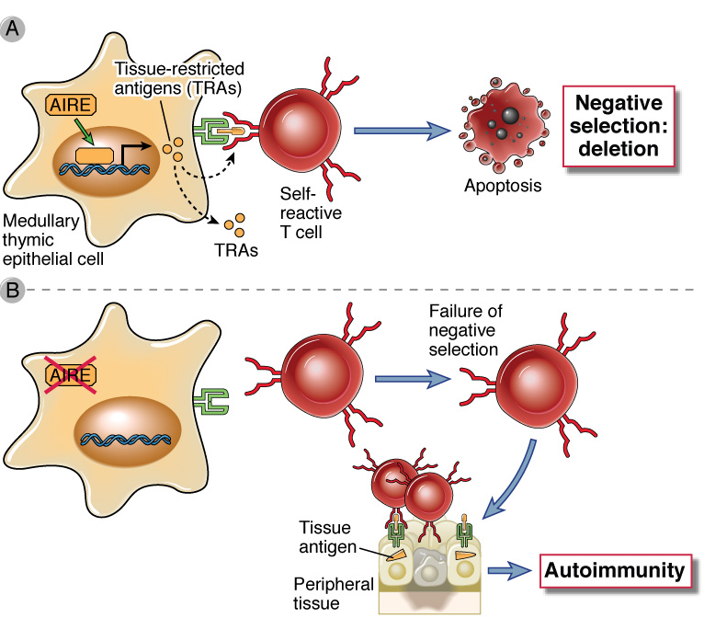
Deletion of self-reactive T cells in the thymus:
how are self antigens expressed in the thymus?
AIRE (autoimmune regulator) is a regulator of gene transcription
that stimulates thymic expression of many self antigens which are largely restricted to peripheral tissues

Slide 12
Peripheral tolerance
Costimulation
(signal 2)
Immunogenic antigen (microbe, vaccine)
APC
Naïve
T cell
TCR
Antigen (peptide + HLA): signal 1
Effector and memory cells
Tolerogenic antigen (e.g. self)
Tolerance: functional inactivation or cell death, or sensitive to suppression

Slide 13
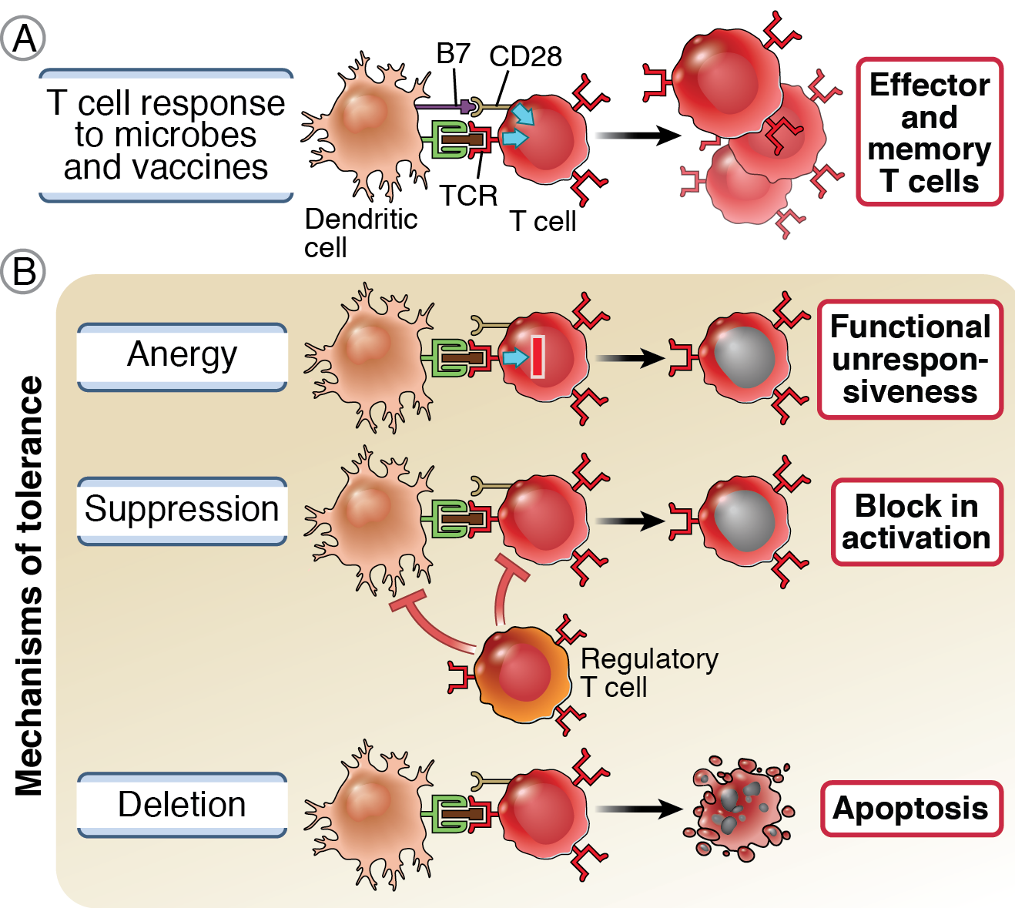
Peripheral tolerance

Slide 14
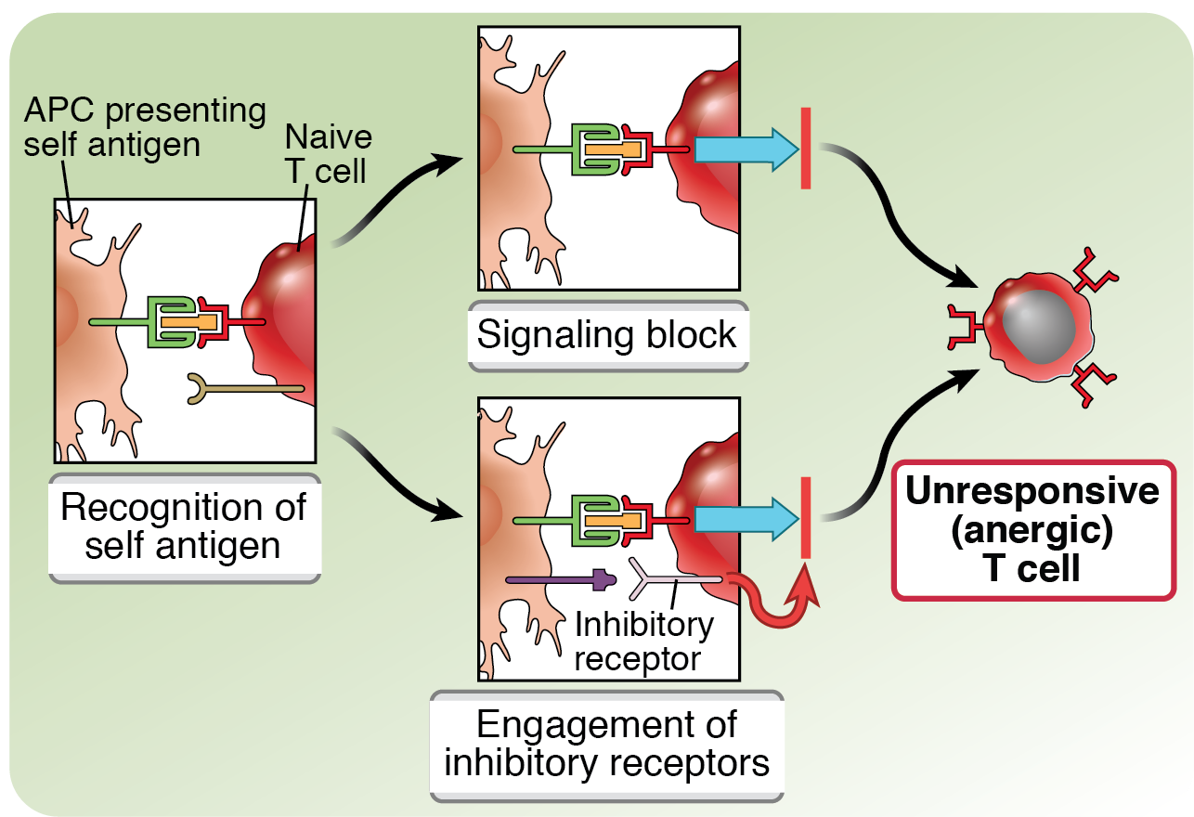
T cell anergy

Slide 15
The opposing functions of CD28 and CTLA-4
B7
CD28
B7-CD28
interaction
APC
Naïve
T cell
TCR
Proliferation,
differentiation
CTLA-4
B7-CTLA-4
interaction
Functional
inactivation
Inhibitory receptors evolved to prevent responses to self antigens: demonstrated by the finding that blocking or eliminating these receptors (CTLA-4, PD-1) and mutations in CTLA4 cause autoimmune disease
Inhibitory receptors are preferentially engaged when self (or tumor) antigens are being recognized

Slide 16
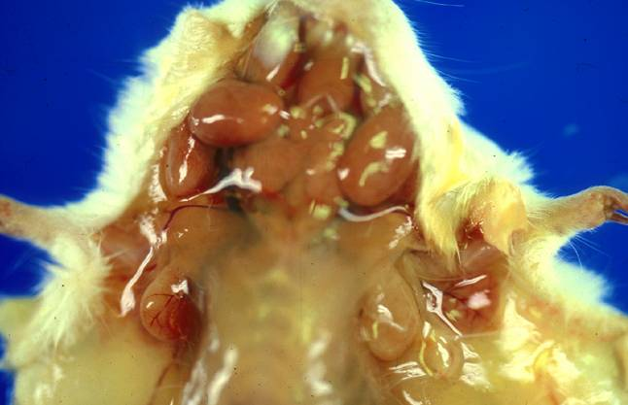
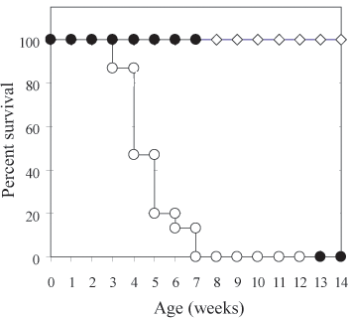
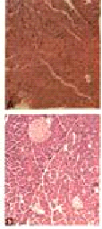
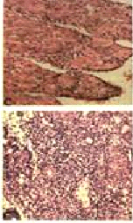
CTLA-4 – Master regulator of T cell activation

Slide 17
The inhibitory functions of CTLA-4
Role in self-tolerance:
  Autoimmunity and lymphoproliferation in knockout mice and humans
  Polymorphism associated with autoimmune diseases in humans
  Blockade or deletion makes T cells resistant to tolerance, exacerbates autoimmune diseases (EAE, type 1 diabetes)

Slide 18
The PD-1 inhibitory pathway
PD-1 recognizes two ligands (PD-L1, PD-L2)
Upregulated on T cells after activation
Knockout of PD-1 leads to autoimmune disease (different manifestations in different strains)
Role of PD-1 in T cell suppression in chronic infections?

Slide 19
T cell activating and inhibitory receptors
Inhibitory receptors
Activating receptors
(costimulators)
CTLA-4
CD28
PD-1
ICOS
TIM-3
T cell
OX40
TCR
TIGIT
GITR
LAG-3
CD137 (4-1BB)
BTLA
CD27

Slide 20
Combining PD-1 and CTLA-4 blockade in metastatic melanoma
PD-1 + CTLA-4
PD-1 antibody
CTLA-4 antibody
Wolchock et. al. 2017. NEJM
N Engl J Med. 2017 Oct 5;377(14):1345

Slide 21
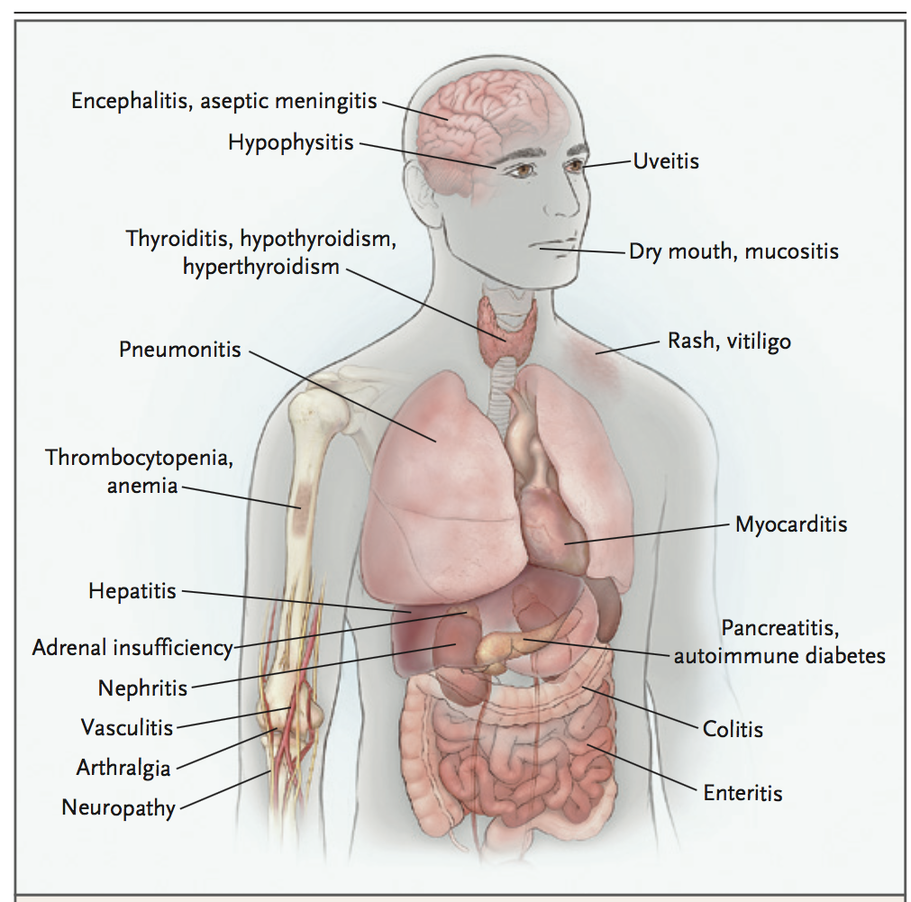
Side Effects: “immune-related Adverse Events”
Postow et al, NEJM 2018
Notes:
While allowing improving the immune system’s ability to fight cancer, it also allows for new onset autoimmunity, which is called immune-related adverse events.

Slide 22
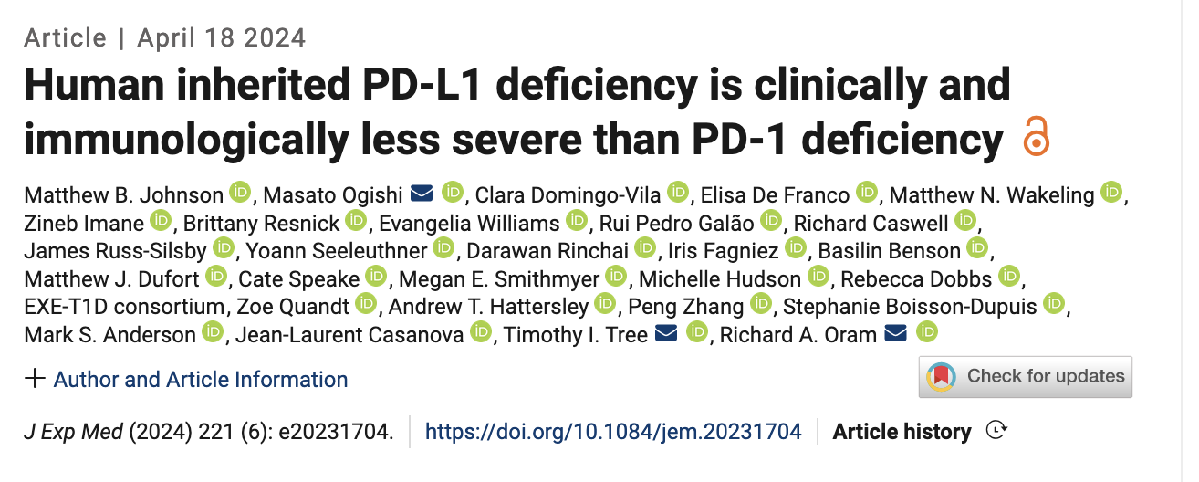
Two siblings with type 1 diabetes in first few weeks of life!
One of siblings also had thyroiditis and asthma

Slide 23
Peripheral tolerance

Slide 24
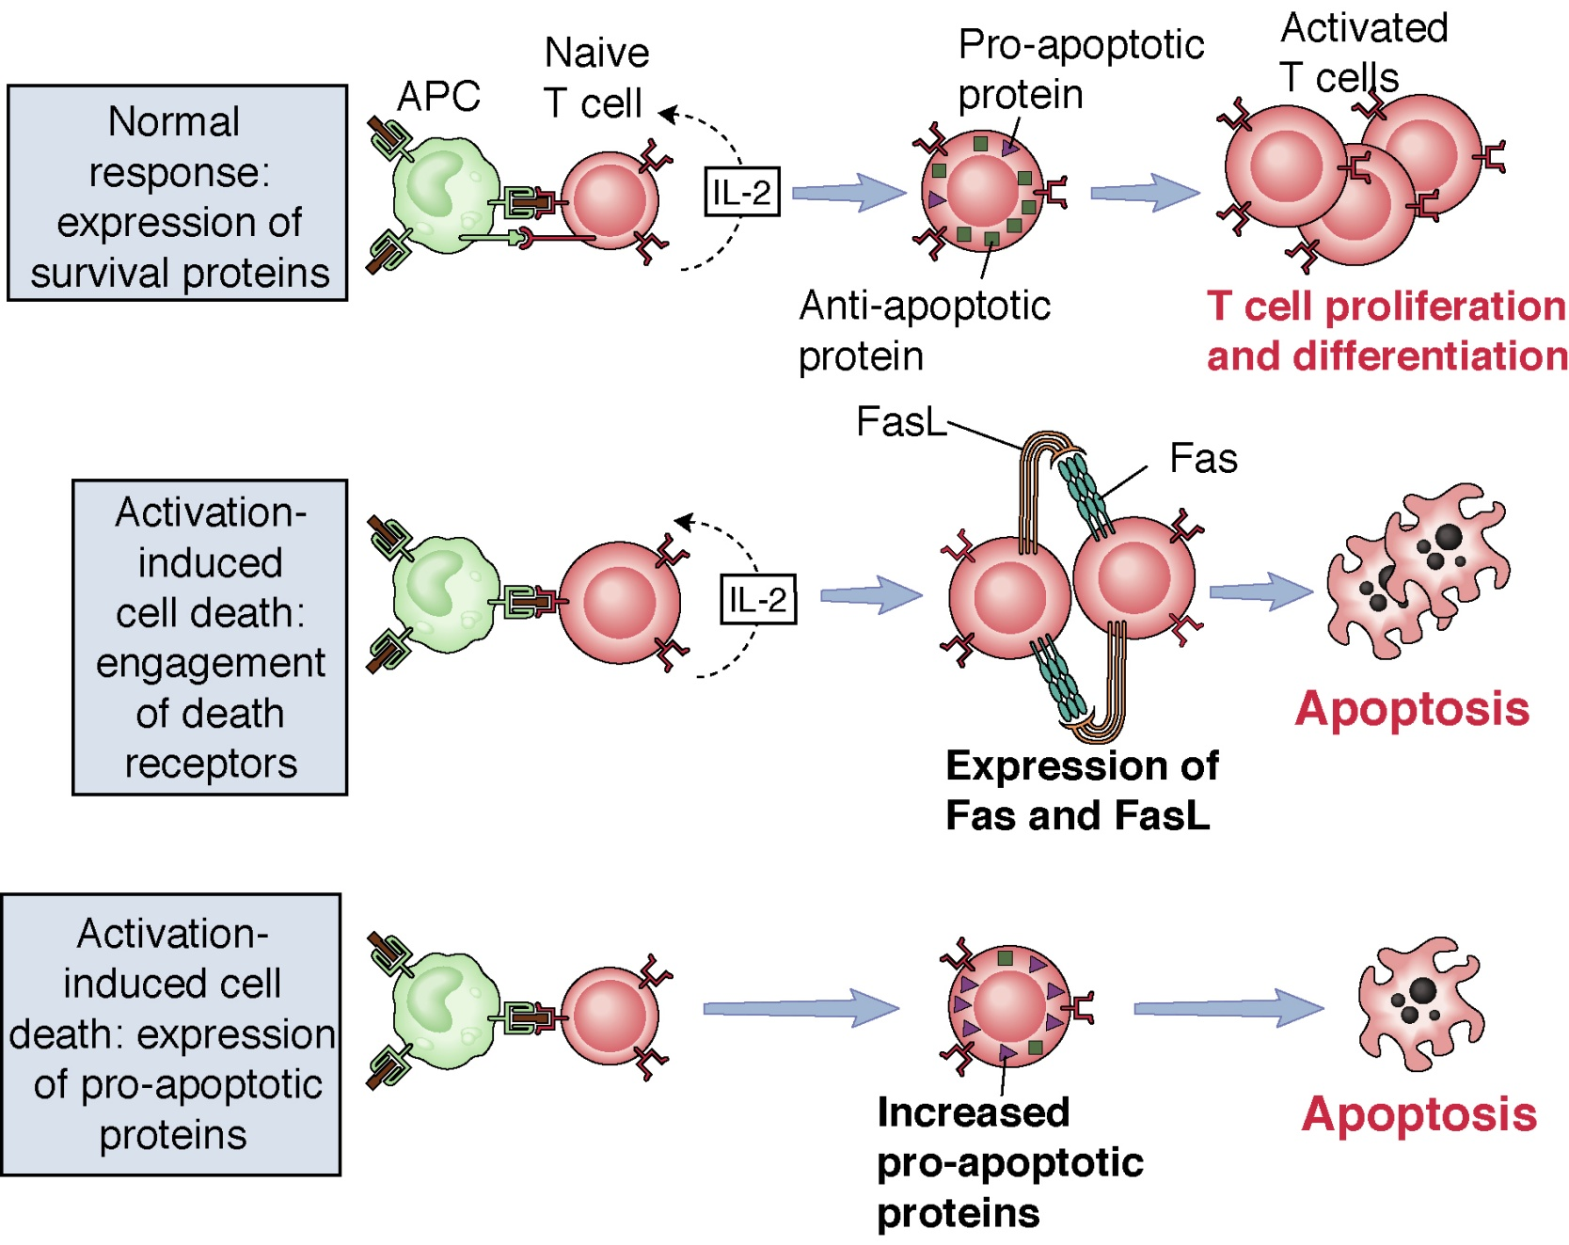
“Activation-induced cell death”: death of mature
T cells upon recognition of self antigens
From Abbas and Lichtman. Basic Immunology 2nd ed, 2006

Slide 25
ALPS Patient 2: An unusual mutation
Healthy female - at 18 months developed cervical adenopathy. Biopsy showed ‘reactive hyperplasia’
Pt developed anemia with hypersplenism, hematuria, proteinuria and renal insufficiency due to mesangial glomerulonephritis, then primary biliary infiltration.
Evaluation at NIH: lymphadenopathy persists, ANA (+) 1:320, CD4⁻CD8⁻ cells 25% of αβ T cells, increased B cells; Fas surface expression is normal
Heterozygous Fas splice mutation resulting in loss of exons 3, 4 (AA 52-96)
WT Fas
TM
28
66
128
174
214
298
PT 2
TM
51 97
del 52-96

Slide 26
Peripheral tolerance

Slide 27
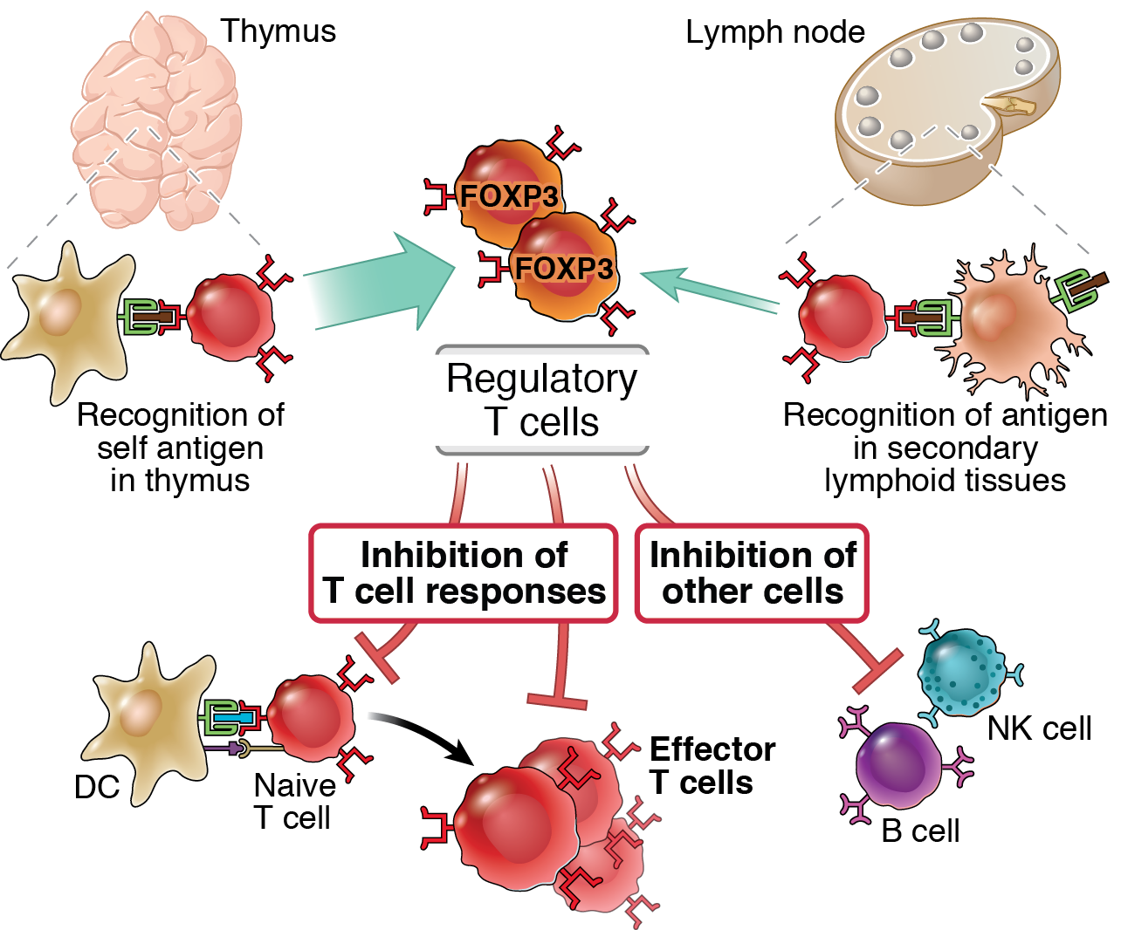
Regulatory T cells

Slide 28
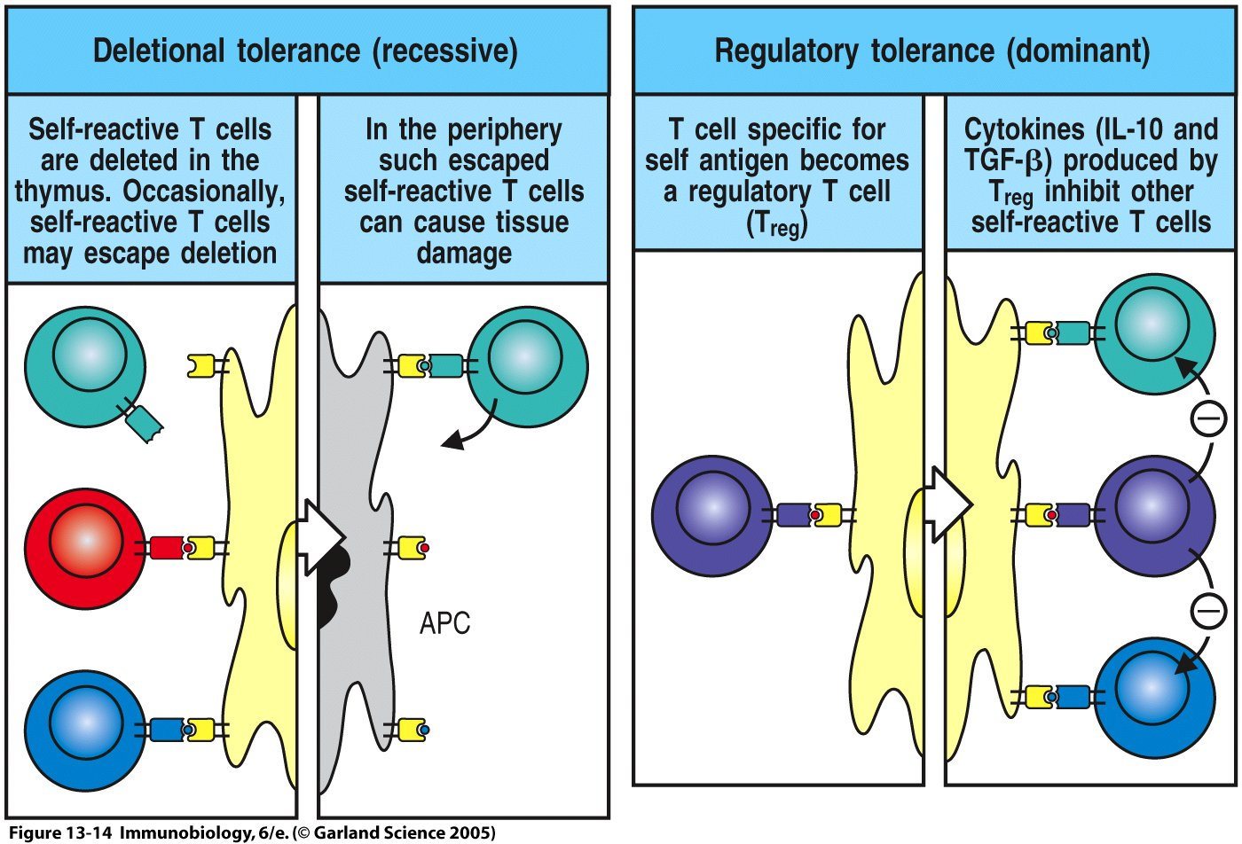
Regulatory T cells protect against autoimmunity
Treg’s co-express CD4 and CD25 and are reactive to self-antigens
FoxP3 is a transcription factor expressed by Treg’s
FoxP3-deficient humans and mice develop severe autoimmune disease

Slide 29
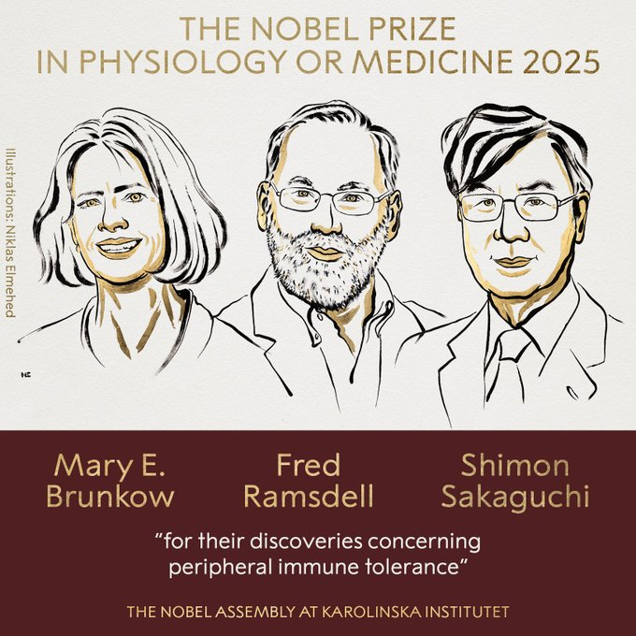

Slide 30
Regulatory T cells
Regulatory T cells are CD4+ cells that express high levels of CD25 (IL-2 receptor α chain)
Mechanism of action: may be multiple
  Secretion of immune-suppressive cytokines
  CTLA-4 on Tregs blocks or removes B7 on APCs
Significance for self-tolerance:
  Some autoimmune diseases may be associated with defects in regulatory T cells or resistance of responding cells to suppression
  Therapeutic potential of cellular therapy (autoimmune diseases, graft rejection, etc)

Slide 31
31
Regulatory T cells
Explosion of information about the generation, properties, functions and significance of these cells
Will Treg targeted therapy become a reality?
Therapeutic goal: induction or activation of Treg in immune diseases

Slide 32
Autoimmunity
Definition: immune response against self (auto-) antigen, by implication pathologic
General principles:
  Pathogenesis: The development of autoimmunity reflects a combination of susceptibility genes and environmental triggers (usually infections)
  Different autoimmune diseases may be systemic or organ-specific; may be caused by different types of immune reactions (antibody- or T cell-mediated)

Slide 33
Autoimmunity
Definition: immune response against self (auto-) antigen
General principles:
  Significant health burden, 5% of population
  Multiple factors contribute to autoimmunity, including genetic predisposition, infections
  Fundamental problem is the failure of self-tolerance
Problems:
  Failure to identify target antigens, heterogeneous disease manifestations, disease usually presents long after initiation

Slide 34
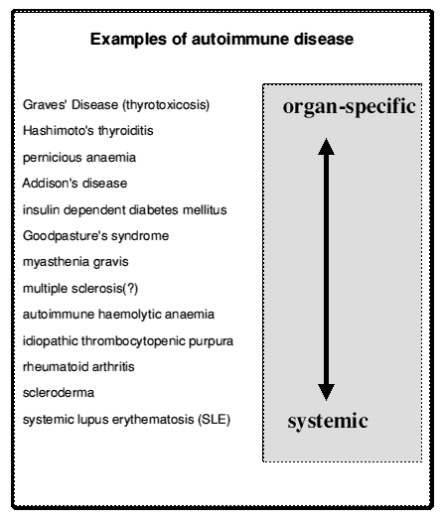

Slide 35
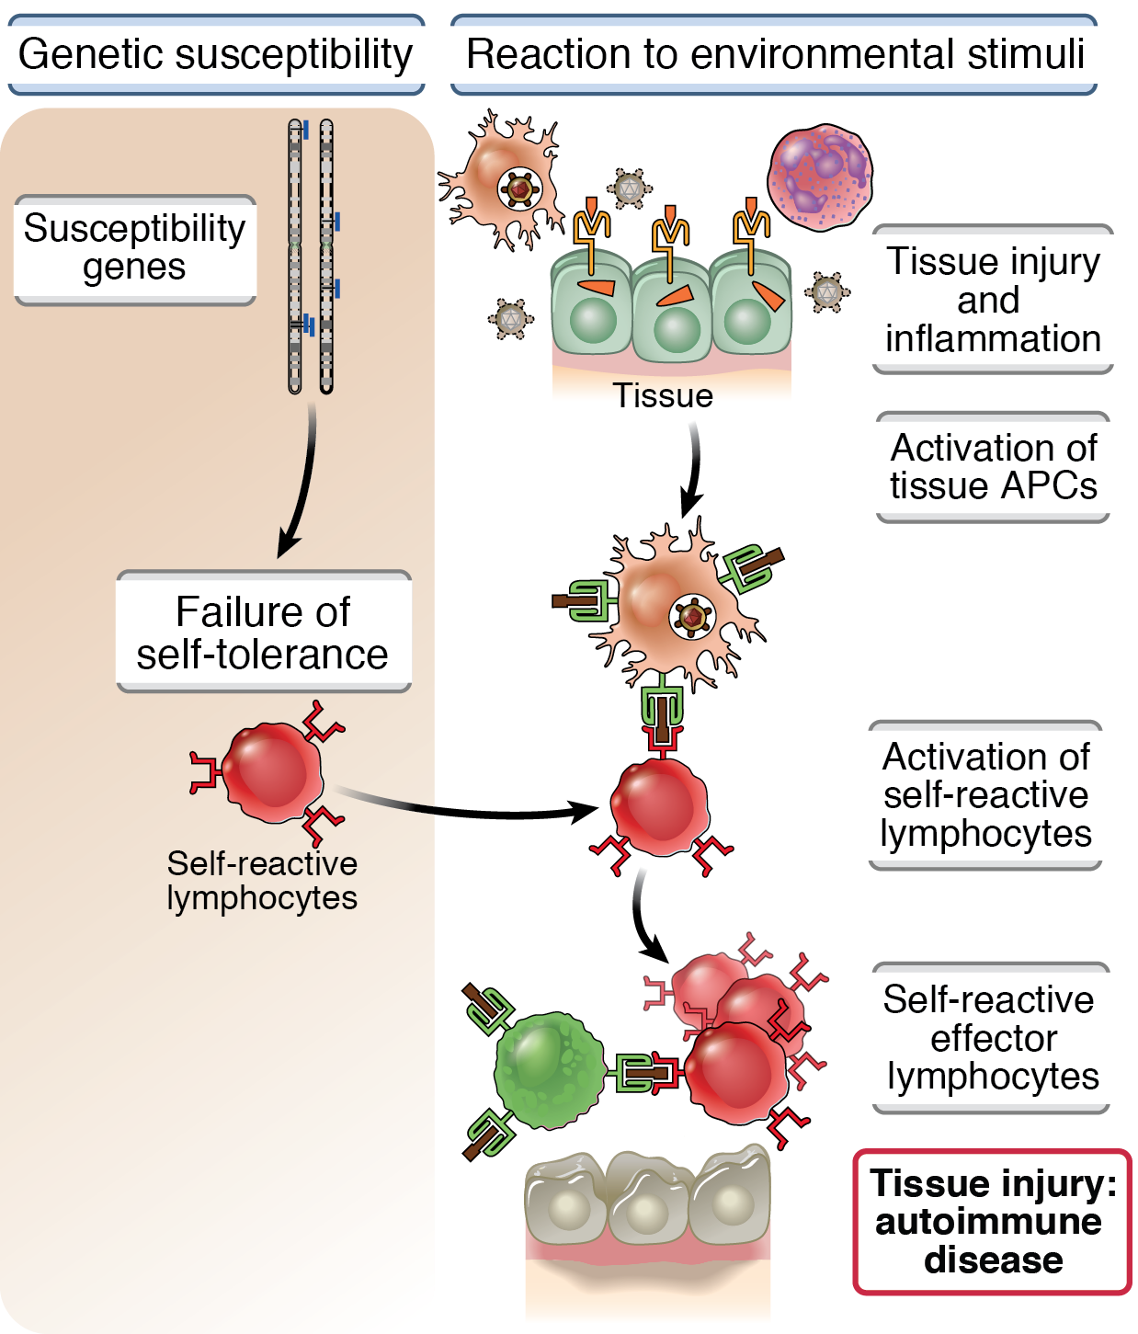
Pathogenesis of autoimmunity

Slide 36
Because Autommunity is so complex, how can we figure out how it happens?
Answer:
Use genetics
Animal models

Slide 37
Genetic basis of autoimmunity -- 1
Genetic predisposition of autoimmune diseases
  Increased incidence in twins (more in monozygotic than in dizygotic twins)
  Identification of disease-associated genes by breeding and genomic approaches
Multiple genes are associated with autoimmunity
  Most human autoimmune diseases are multigenic
  Single gene mutations and mouse knockouts reveal critical pathways

Slide 38
Genetic basis of autoimmunity -- 2
MHC genes
  Major genetic association with autoimmune diseases (relative risk of disease in individuals with particular HLA haplotypes)
  Disease-associated alleles are present in normal individuals
Non-MHC genes:
  Many gene variants identified by genome-wide association and linkage studies
  Many of these variant genes individually have small effects on disease susceptibility, may influence disease when present in combination
  Interactions with environmental factors difficult to define

Slide 39
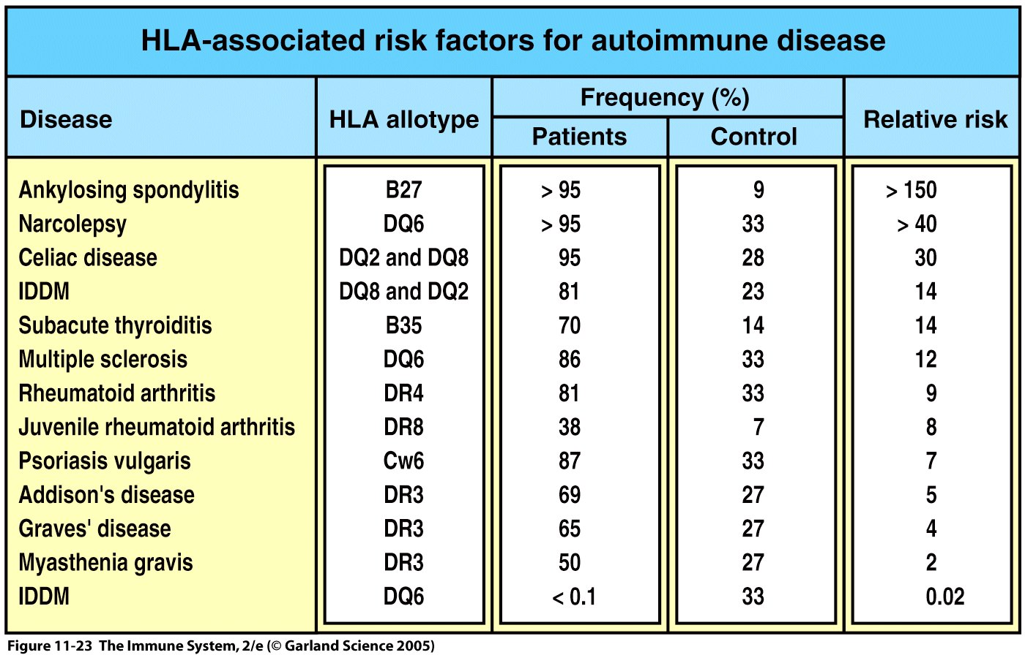
HLA (or MHC) is the strongest genetic factor for susceptibility to autoimmune disease
Parham P. The Immune System, 2nd Edition. 2005, Garland Science

Slide 40
Genetic basis of autoimmunity -- 3
Genome wide association studies are revealing non-MHC genetic polymorphisms associated with autoimmune diseases
  Crohn’s disease:
    NOD-2: microbial sensor in intestinal epithelial and other cells
    IL-23 receptor: involved in TH17 responses
  Rheumatoid arthritis, others:
    PTPN-22 (tyrosine phosphatase): may control kinase-dependent lymphocyte activation
  Multiple sclerosis, others:
    CD25 (IL-2 receptor): role in T cell activation and maintenance of regulatory T cells

Slide 41
Genetics of autoimmunity: challenges
Each gene makes such a small contribution is that it is difficult to understand its role in the pathogenesis of the disease, or to use genetics to predict who will develop autoimmunity
  Also difficult to elucidate how multiple genes function cooperatively

Slide 42
Animal models of autoimmunity
NOD mouse- model of type 1 diabetes
NZBxNZW mouse-model of Lupus
KBxN mouse-model of rheumatoid arthritis
EAE- induced model of multiple sclerosis whereby disease is induced by injecting proteins of the myelin sheath with adjuvant
Knockouts that get autoimmunity

Slide 43
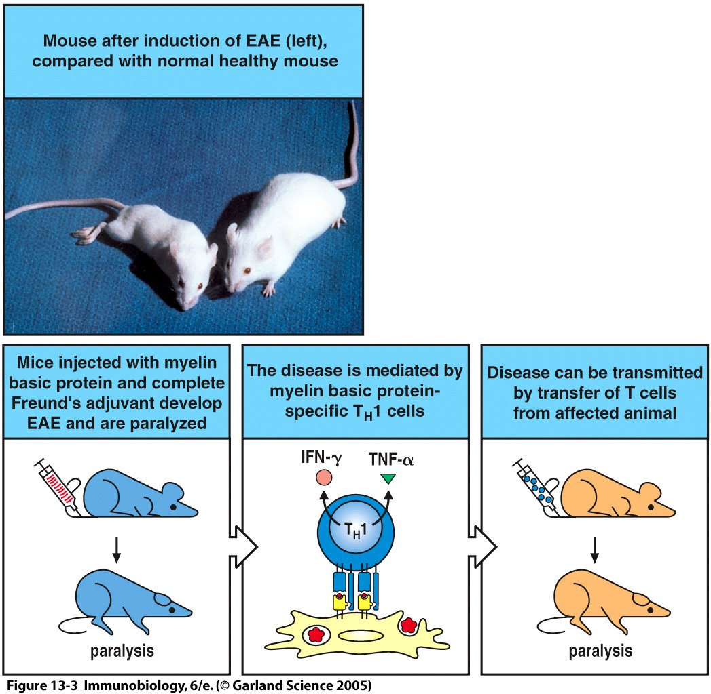
Figure 13-3

Slide 46
Infections and autoimmunity
Infections trigger autoimmune reactions
  Clinical prodromes, animal models
  The autoimmune disease may be precipitated by infection but is not directly caused by the infection.
  The contribution of the microbiome?

Slide 47
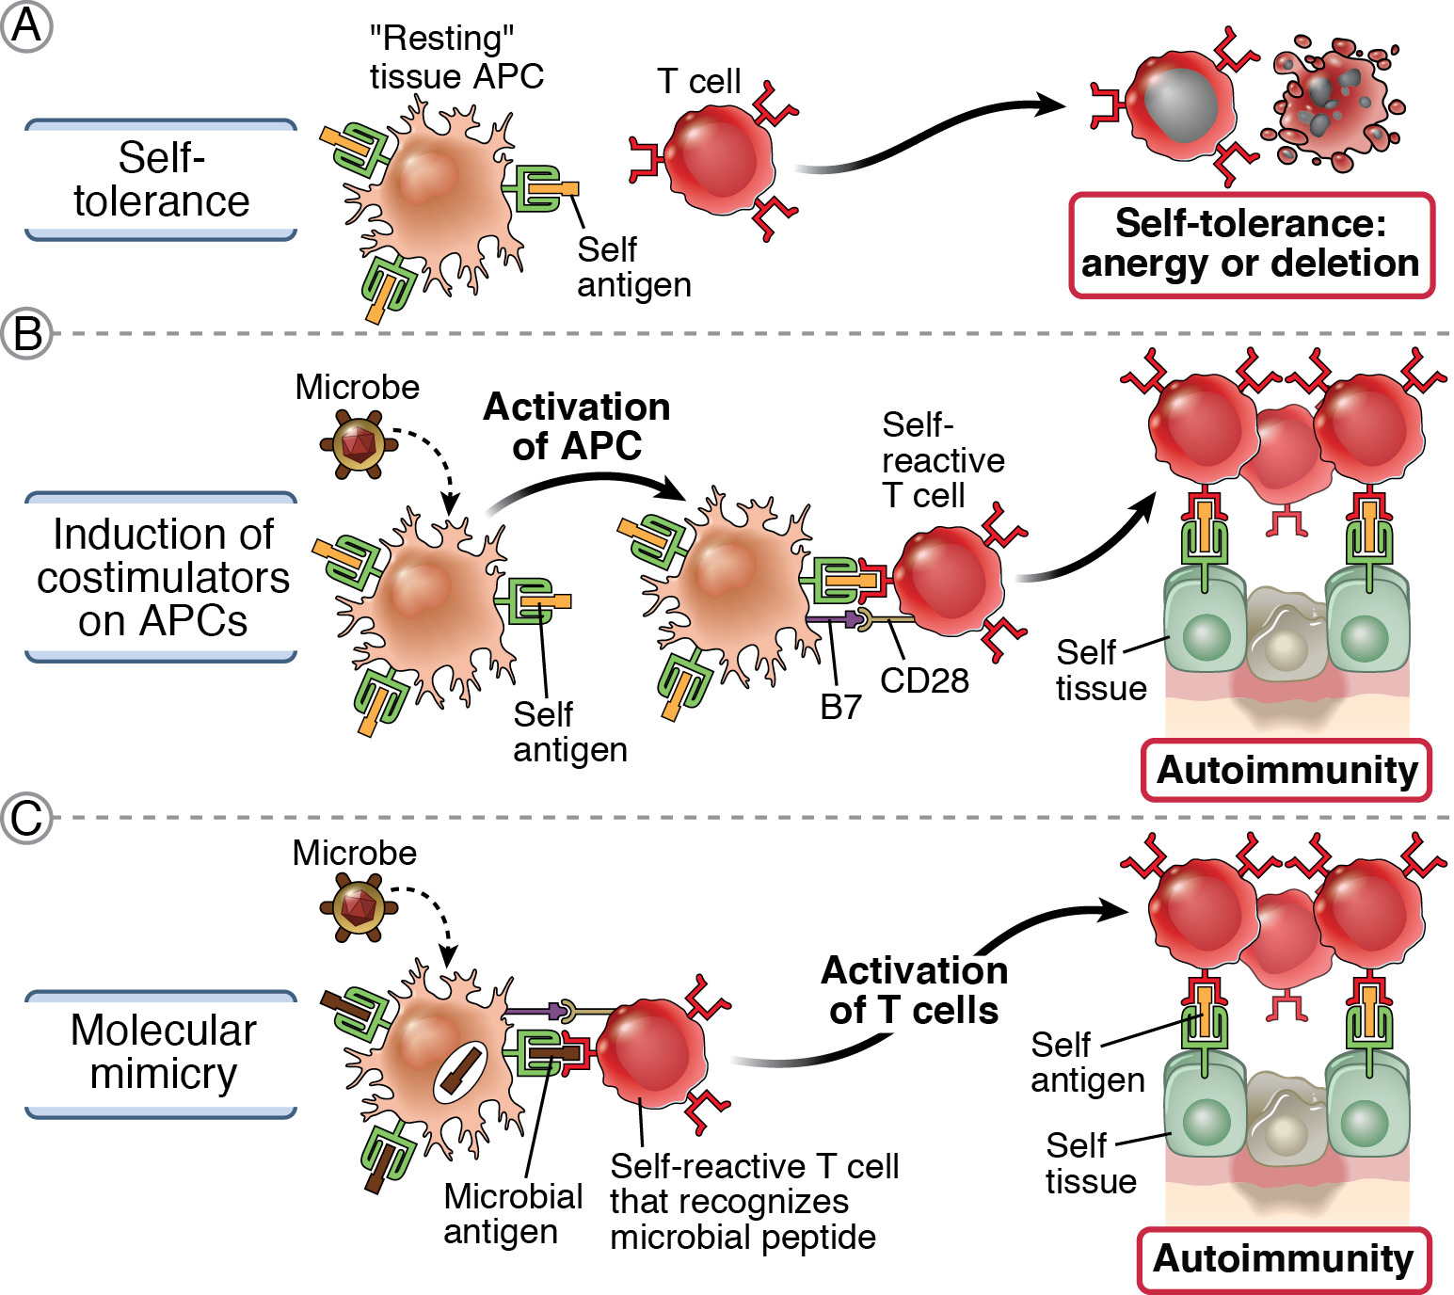
Mechanisms by which infections may promote autoimmunity

Slide 48
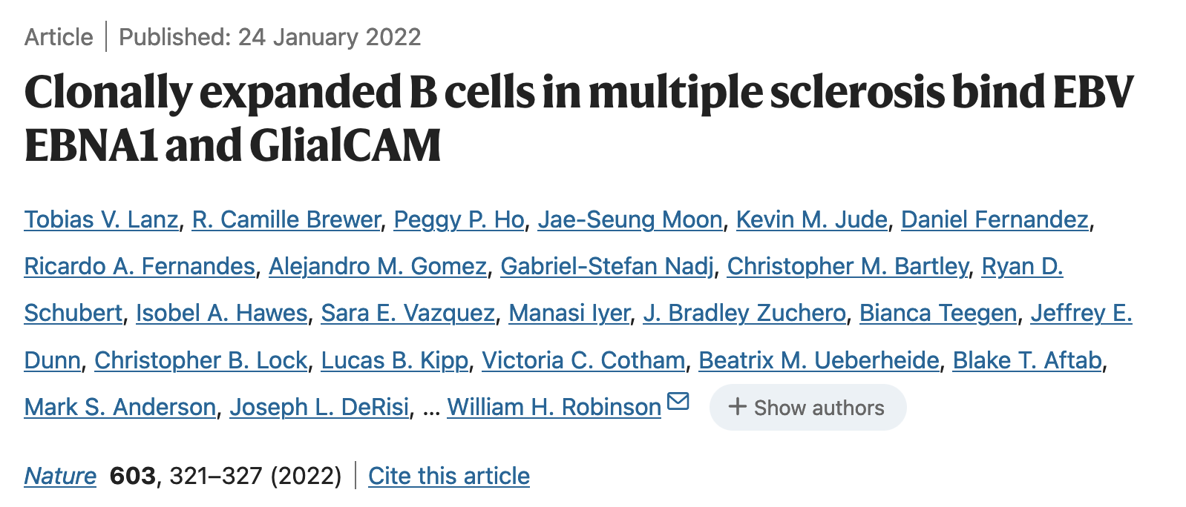
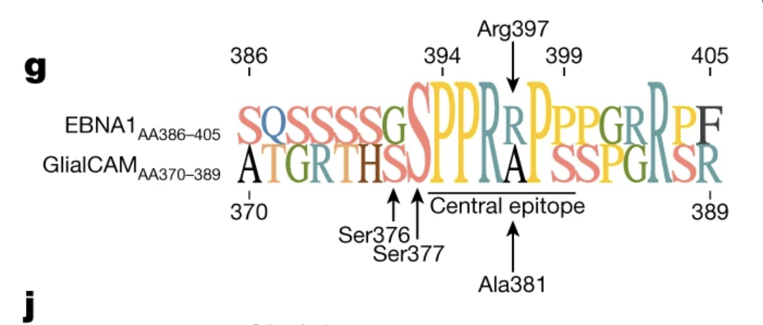

Slide 49
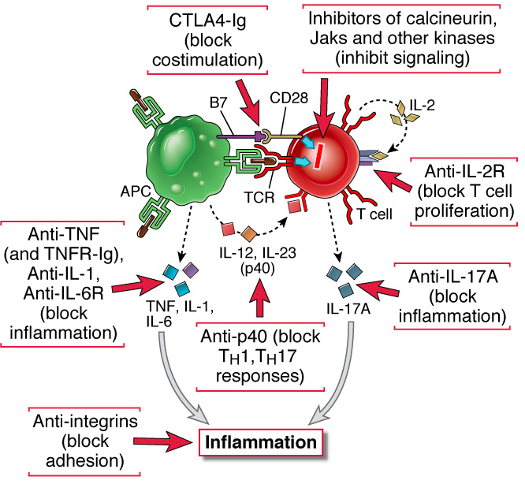
Therapy of immune disorders: rational approaches target lymphocyte activation and subsequent inflammation

Slide 50
Molecularly targeted therapies for immunological diseases: the rational approach
Target the molecular basis of lymphocyte activation and effector functions: rationally designed therapies
  Based on understanding of lymphocyte biology
  Risks -- reactivation of infections
Induce antigen-specific immunological tolerance: requires identification of target antigens
  Being tried in MS, type 1 diabetes (in which the major autoantigens are known)
  Based on successes in allergic diseases

Slide 52
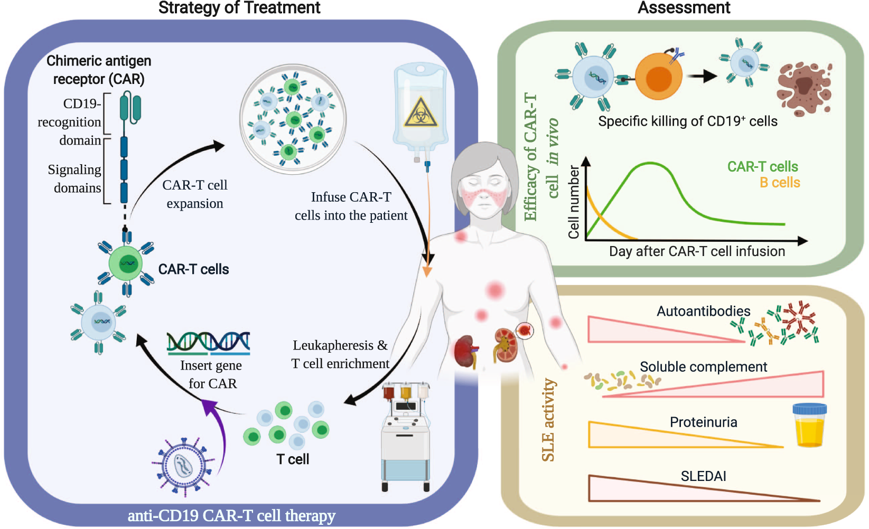
Cell Mol Immunol 18, 2581–2582 (2021).

Slide 53
Autoimmune diseases
Experimental models are revealing pathways of immune regulation
  But experimental animals are often inadequate models of human diseases
Improving technologies for human genetic and phenotypic analyses are enabling studies of patients
Challenges:
  Defining which mechanisms of immune tolerance fail in different autoimmune diseases
  Using this knowledge to develop therapies
Take home messages

