Slide 1

Allergy as a Disorder of Immune Regulation
Stephanie Eisenbarth MD, PhD
FOCIS Clinical Immunology Course 2026
FOCIS Meeting San Franciso
June 2026
Images from Abbas textbook
unless otherwise noted

Slide 2
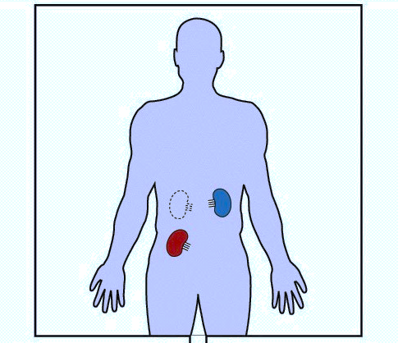

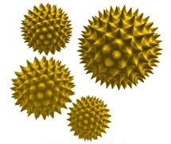
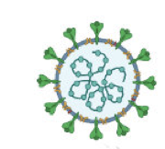
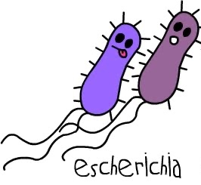
Types of immunity
Immunity
  Pathogens
Auto-immunity
  Self tissue
Allo-immunity
  Not quite self (transplanted tissue)
Allergy
  Non-pathogen, -self, -transplant targets
  Typically proteins in environmental substances
Notes:
Does this form of immunity follow classic rules of induction of adaptive responses?

Slide 3
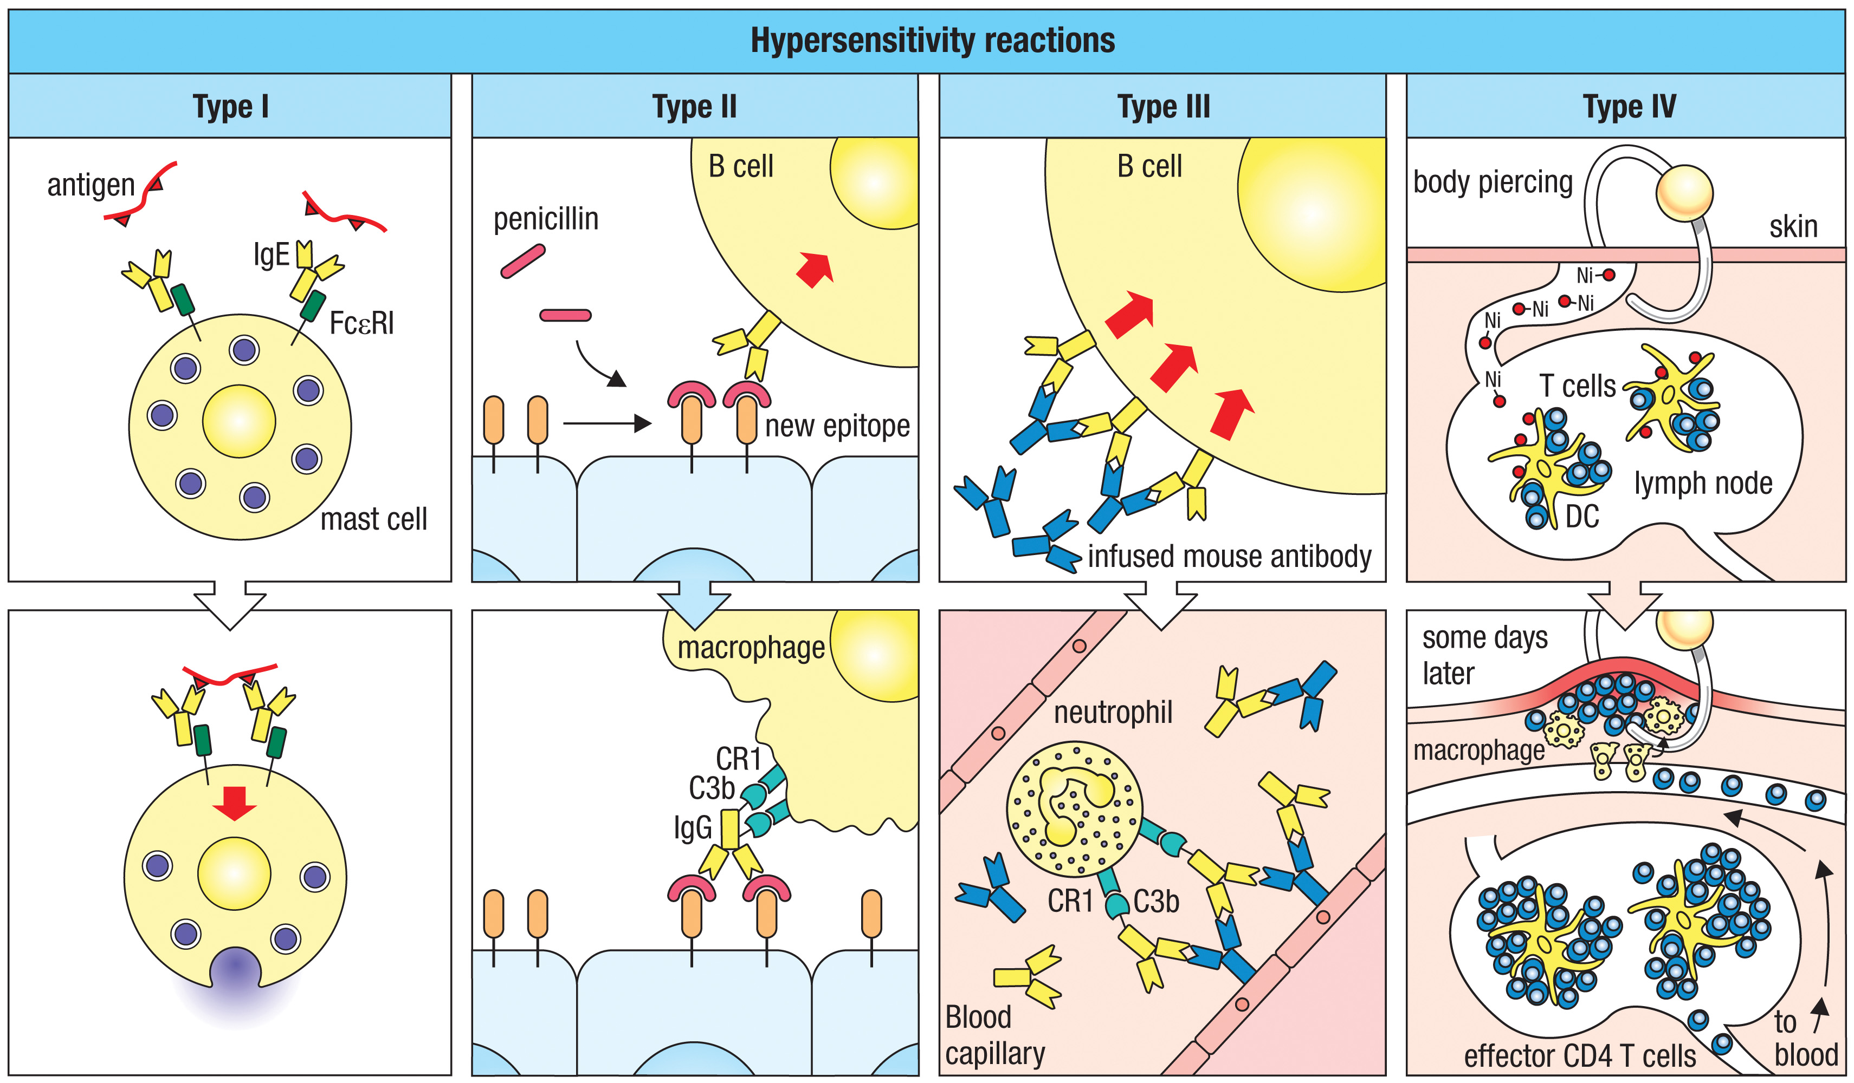
Four types of hypersensitivity reactions caused by different mechanisms were defined in 1963
Allergic reaction
CD4 or CD8 T cells
IgG
Janeway
Notes:
Figure 14.2 Four types of hypersensitivity reaction are caused by different mechanisms. Type I hypersensitivity reactions involve the interaction of soluble allergens with specific IgE, causing mast-cell degranulation (first panels). Type II hypersensitivity reactions are mediated by IgG recognizing new epitopes of altered human proteins. Penicillin is shown forming a new epitope by chemically modifying a cell-surface protein (second panels). Type III hypersensitivity reactions are caused by IgG made against a foreign soluble protein, such as a therapeutic mouse monoclonal antibody. These form immune complexes that deposit in tissues, fix complement, and induce inflammation mediated by phagocytes (third panels). Type IV hypersensitivity reactions are caused by a CD4 or CD8 T-cell response to complexes of MHC class II and peptide antigens derived from foreign proteins or from chemically modified human proteins. A CD4 T-cell response to nickel (Ni)-modified peptides is shown here (fourth panels).

Slide 4
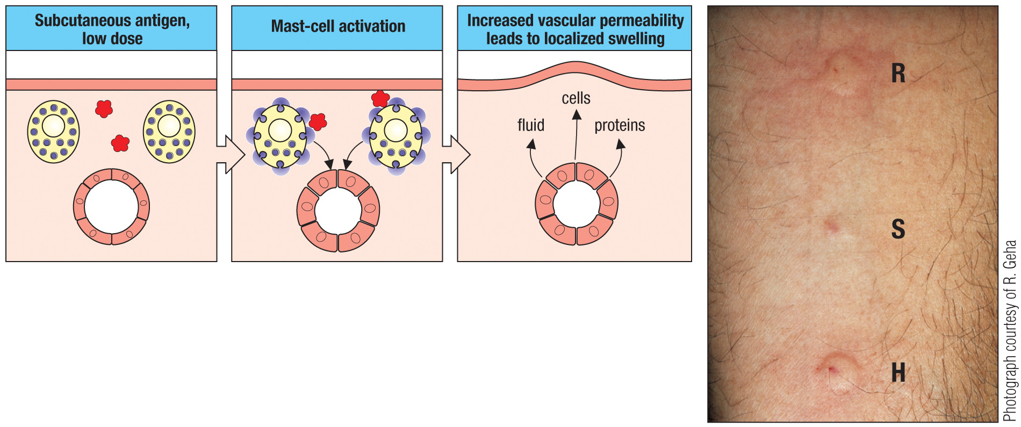
Allergen-induced release of histamine by skin mast cells causes localized swelling (acute urticaria wheal and flare, allergy testing)
agweed
aline
istamine
Janeway
Notes:
Figure 14.35 Allergen-induced release of histamine by skin mast cells causes localized swelling. As shown in the three left panels, allergen in the skin of a sensitized individual causes armed connective tissue mast cells to degranulate. The histamine released dilates local blood vessels, causing rapid swelling due to the leakage of fluid and proteins into tissues. The photograph shows the raised swellings (wheals) that appear 20 minutes after intradermal injections of ragweed pollen antigen (R) or histamine (H) into a person who is allergic to ragweed. The small wheal at the site of saline injection (S) is due to the fluid injected into the dermis. Photograph courtesy of R. Geha.

Slide 5
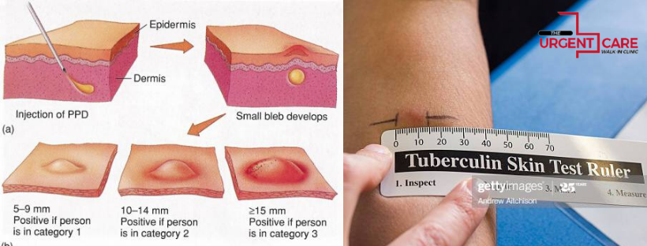
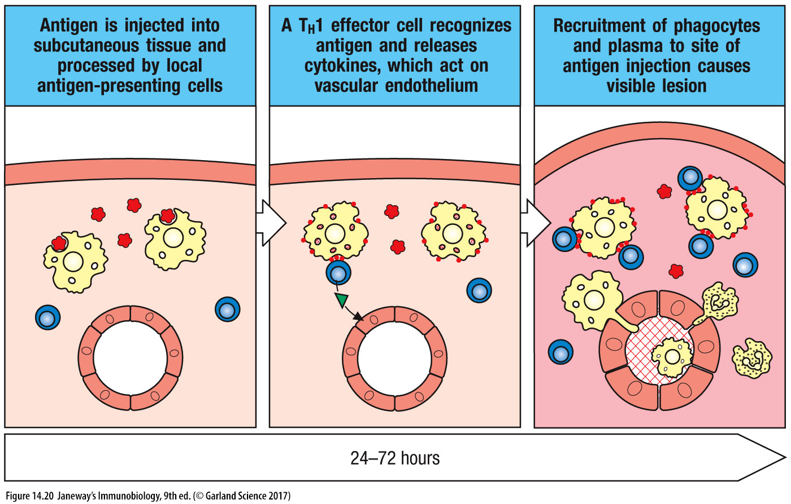
The Mantoux (PPD) test for exposure to tuberculosis elicits a cellular hypersensitivity reaction in the skin (type IV) – but it is NOT an allergic response
Janeway

Slide 6
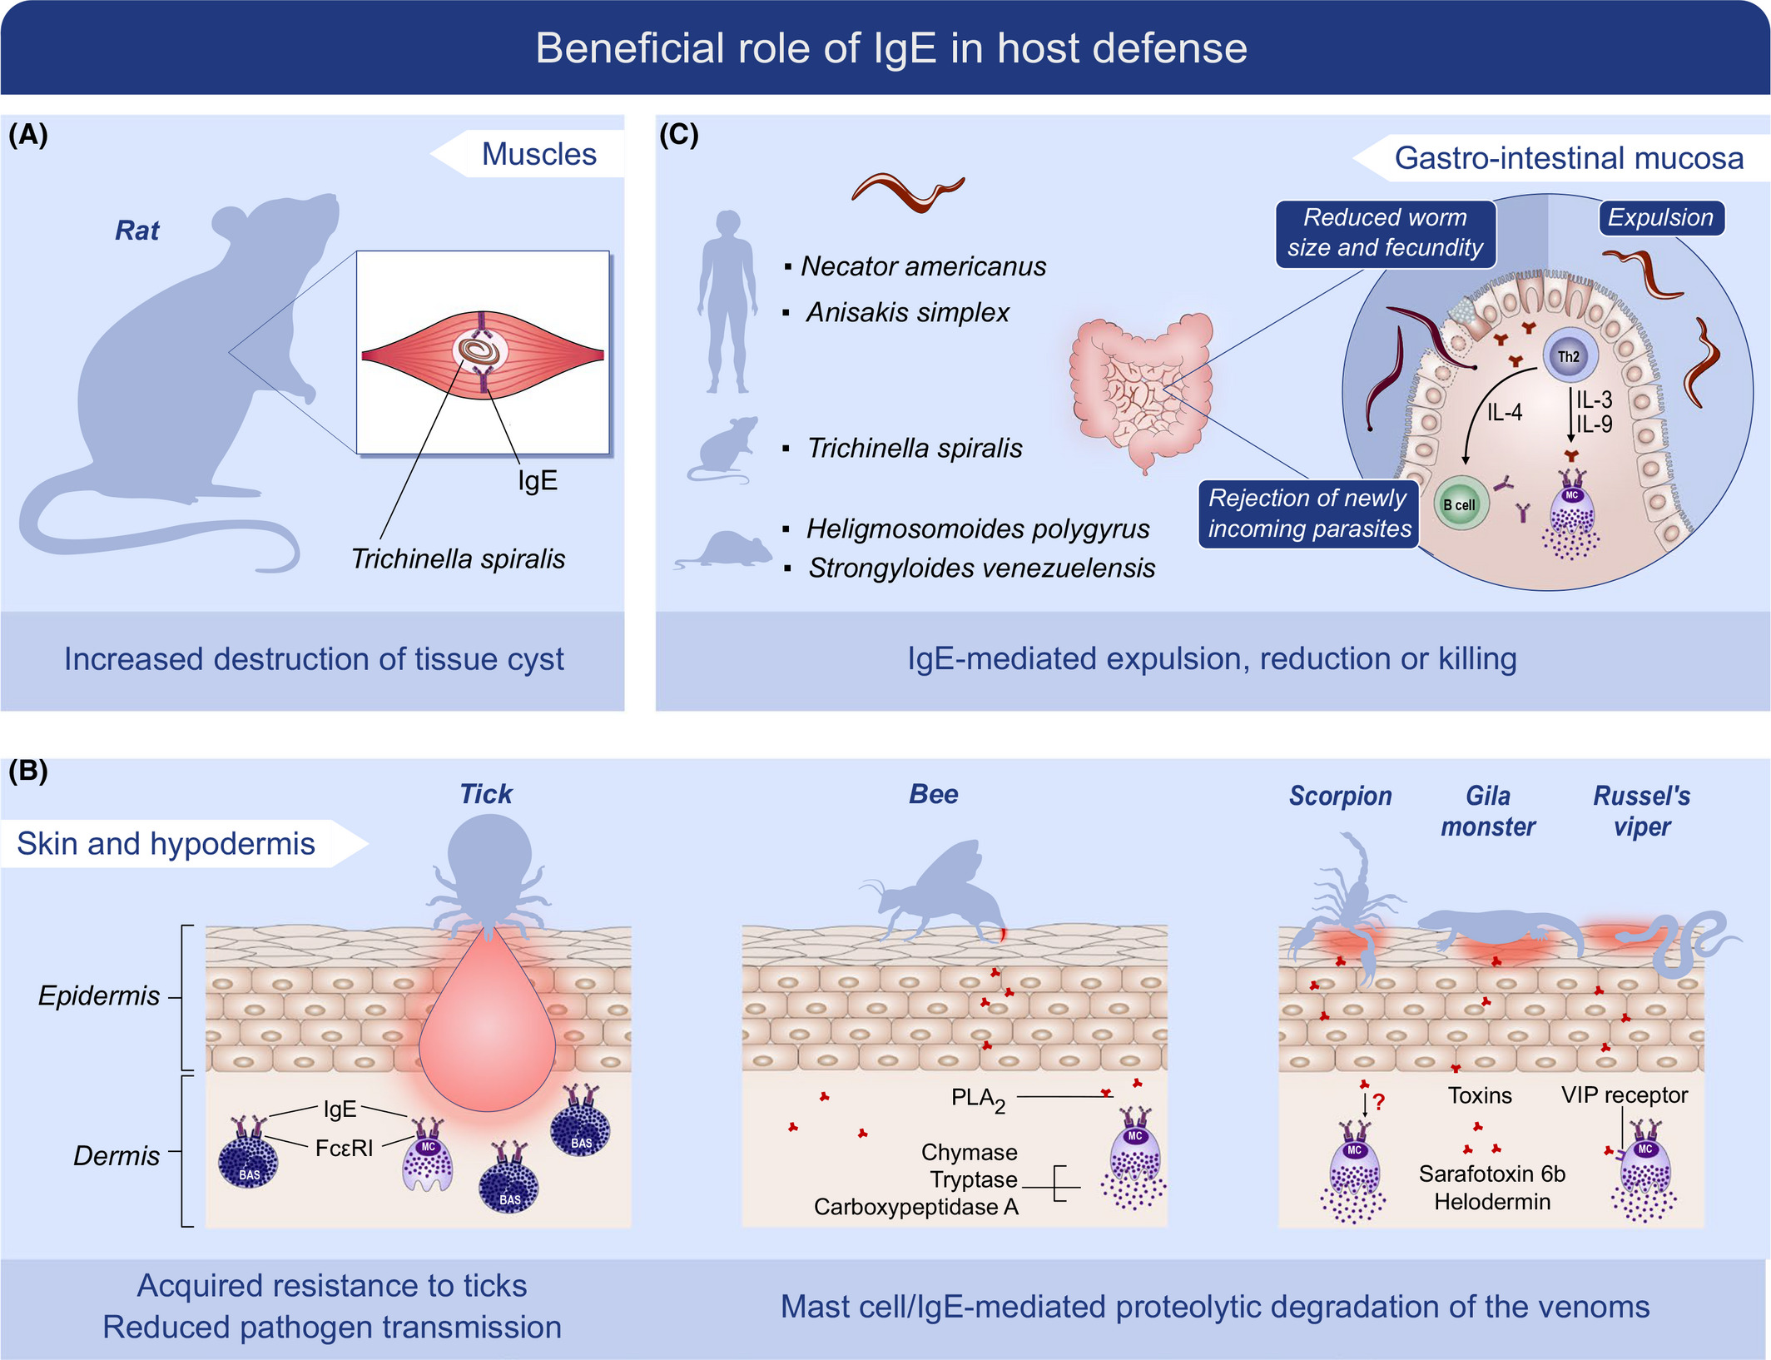
IgE protects against toxic venoms – “toxin hypothesis of allergy”
Pritchard et al Allergy, 2020

Slide 7
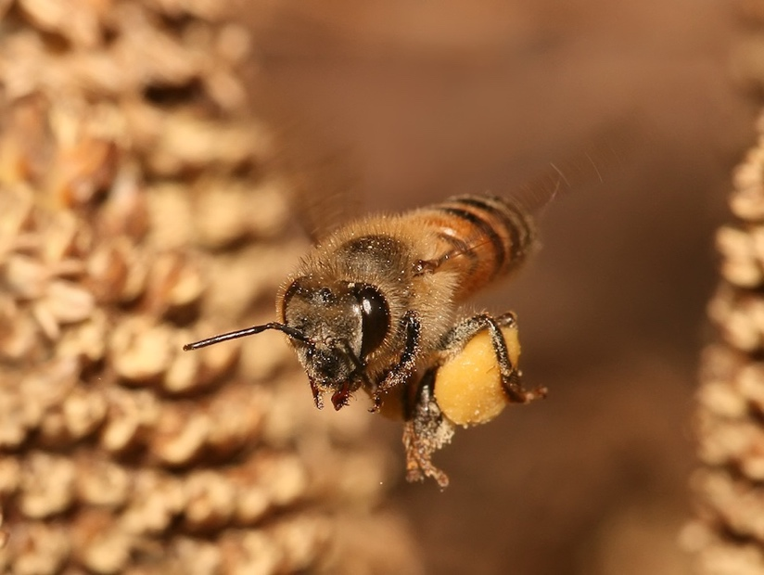
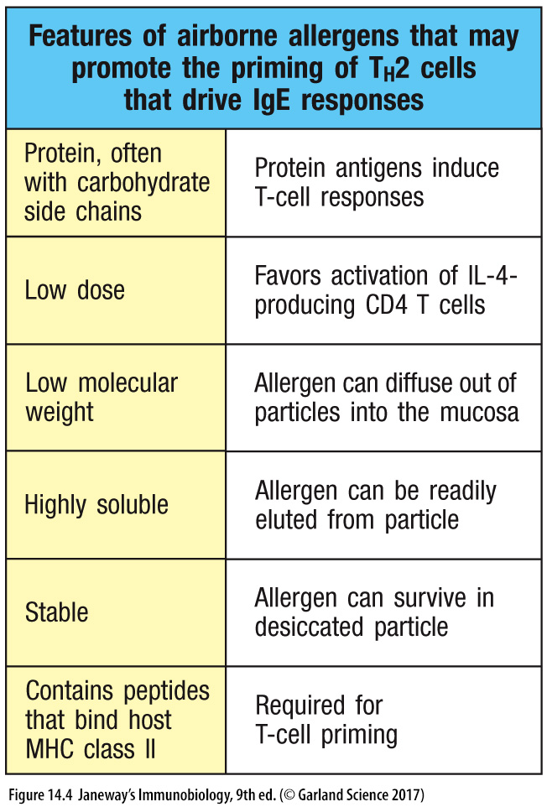

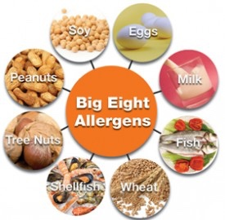
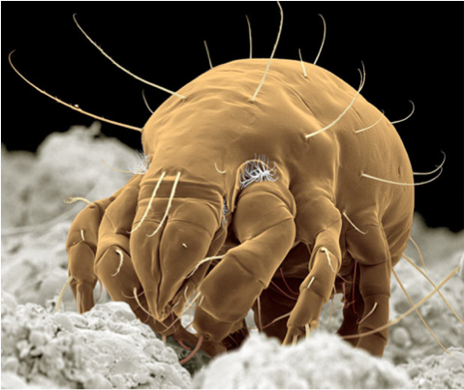
Although there is no single unifying theme many allergens share some properties
fur and dander
cockroach
wool
house dust mite
drugs
celery
corn or maize
eggs
fruit
peanuts
soybeans
milk
seafood
sesame
soy
tree nuts
venoms
mold spores
nickel
latex
metal
wood
plant pollens
Many allergens have common feature of being irritants (enzymatic activity)
Ability to cross epithelium: low molecular weight (5-70kD), stable, protease activity, highly soluble, stable/heat & digestion-resistant, highly glycosylated
Janeway

Slide 8
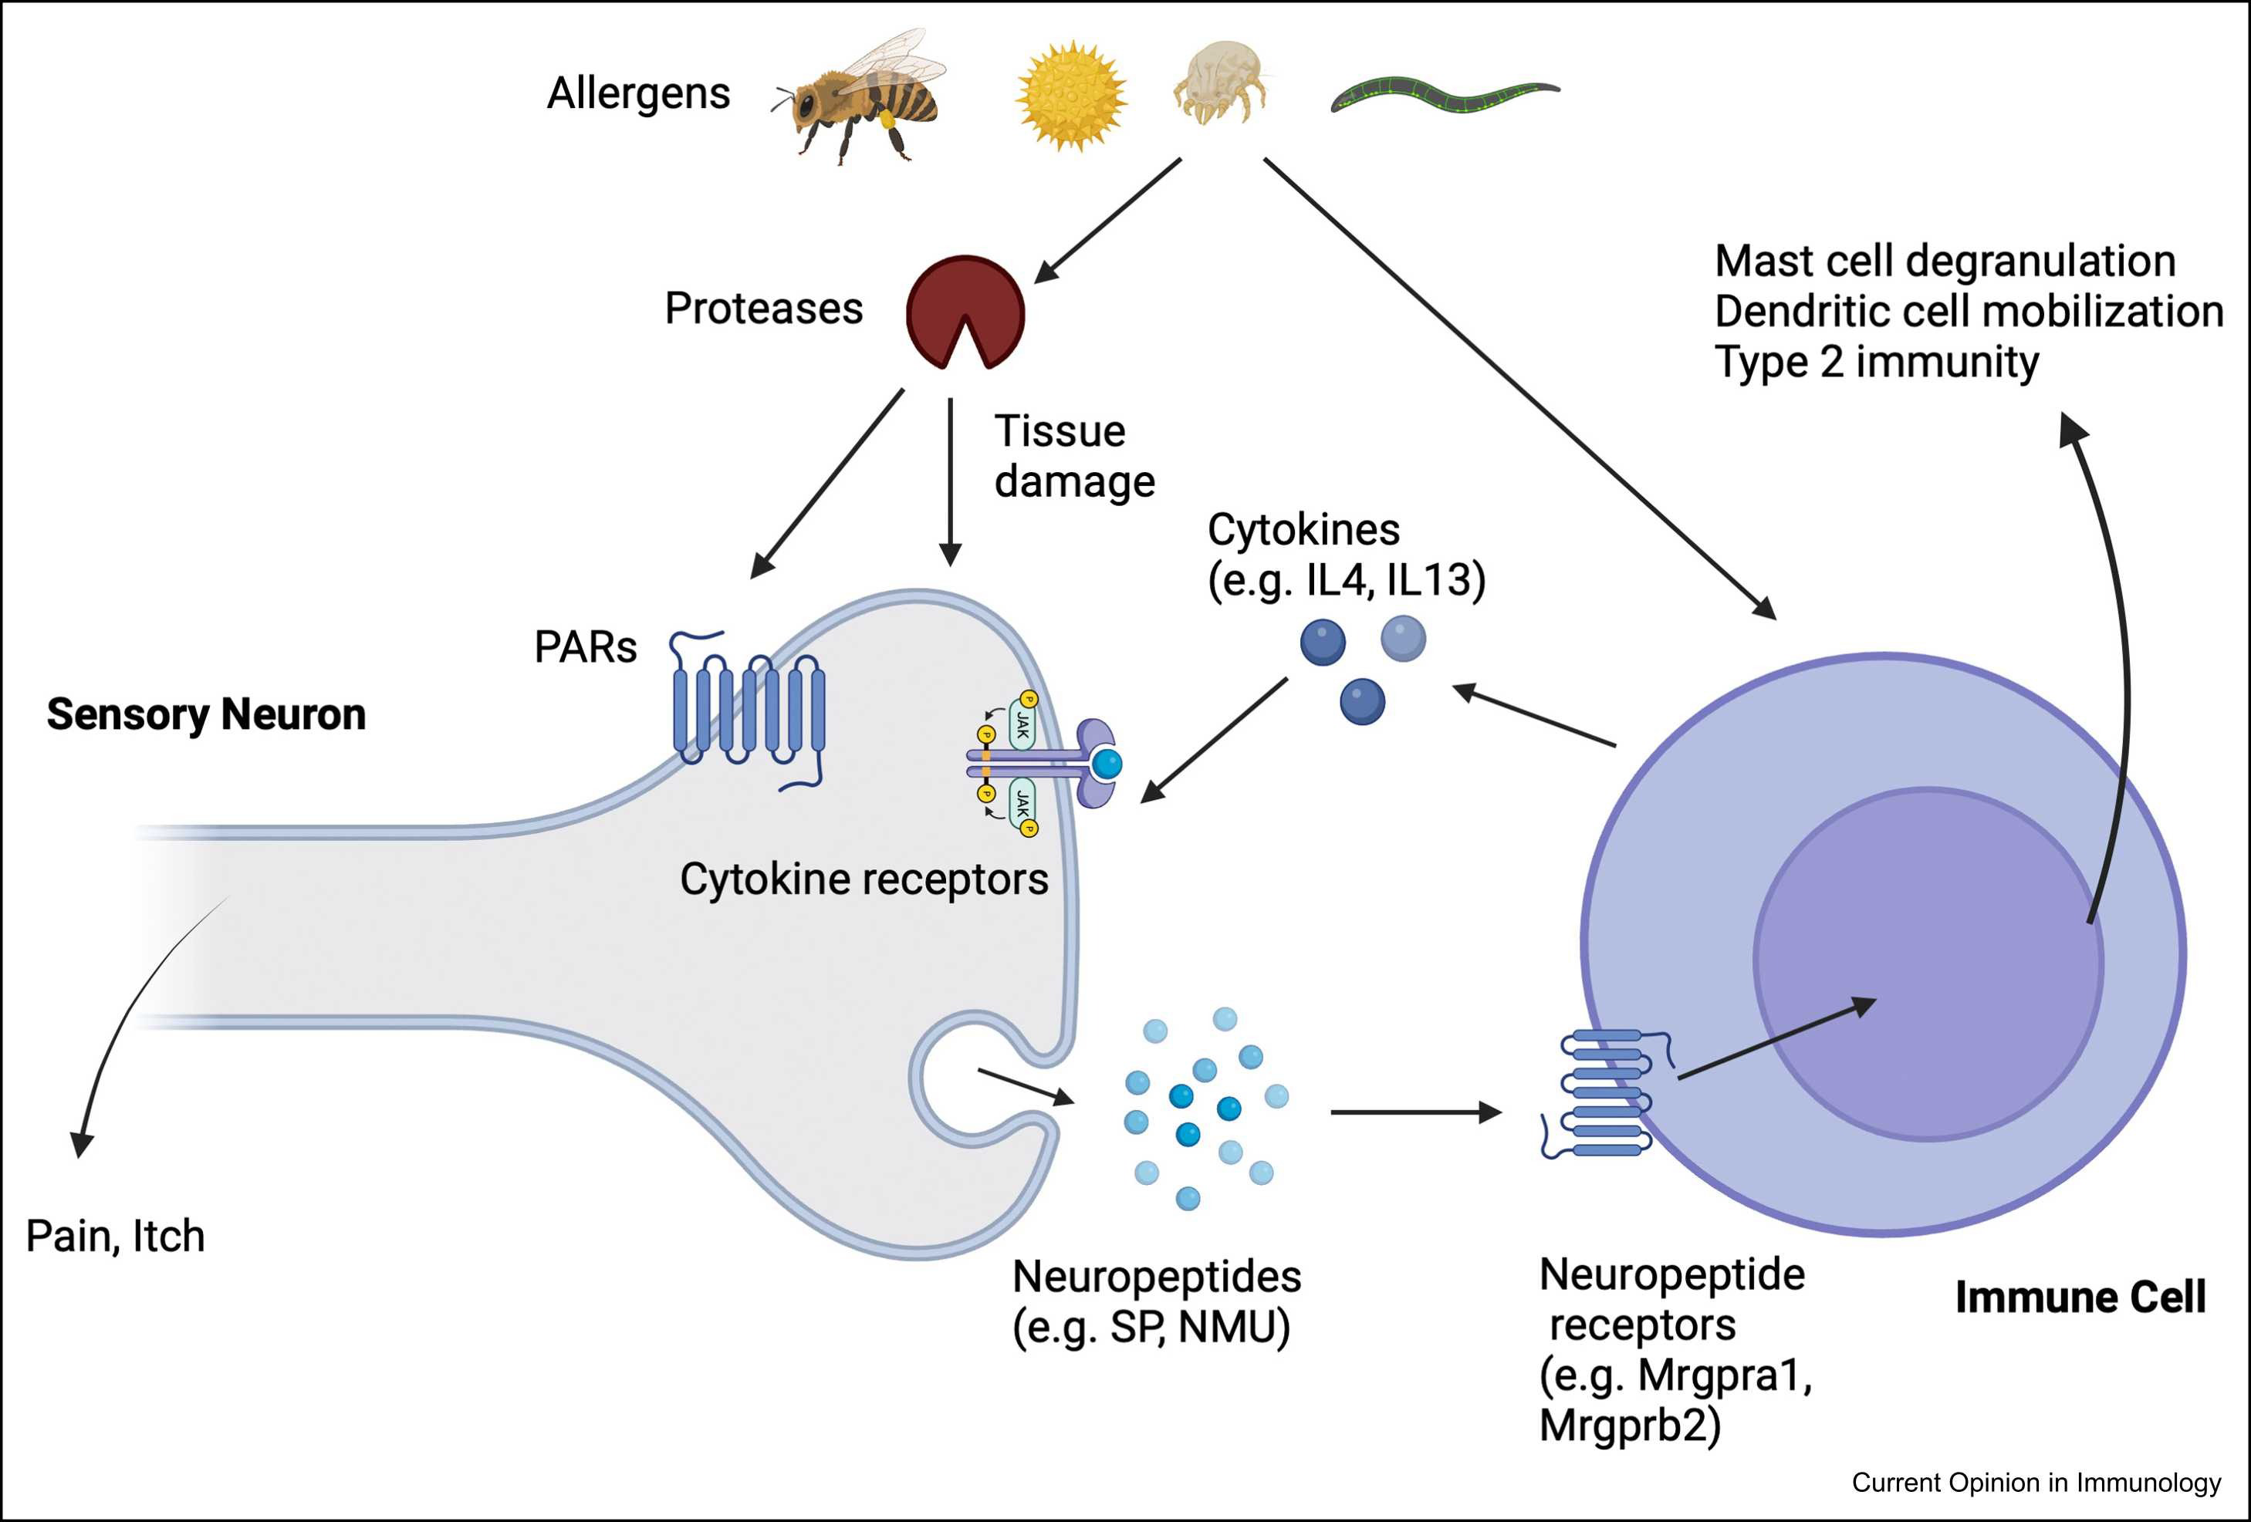
Diverse types of allergens stimulate both neurons and immune cells
to crosstalk and amplify type II immunity
Chiu, I. and Sokol, C. Current Opinion in Immunology 2024; 90: 102458

Slide 9
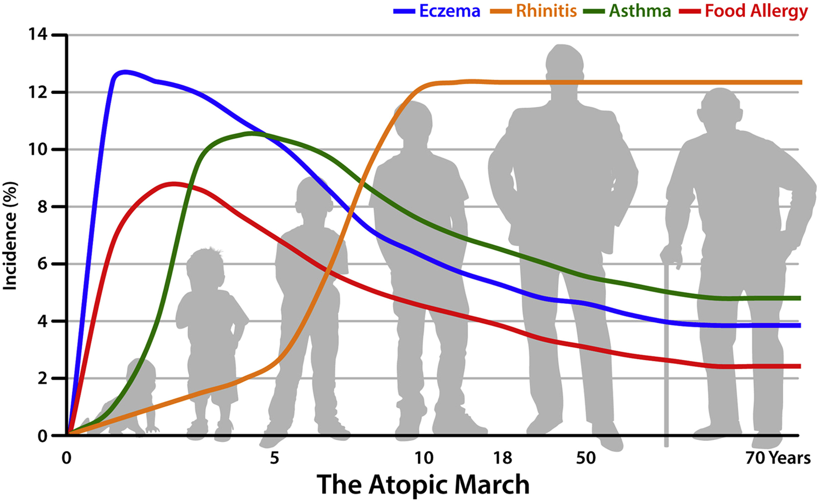
Atopy is a genetic predisposition to allergic disease
Davidson, W. et al JACI 2019, 143; 894

Slide 10
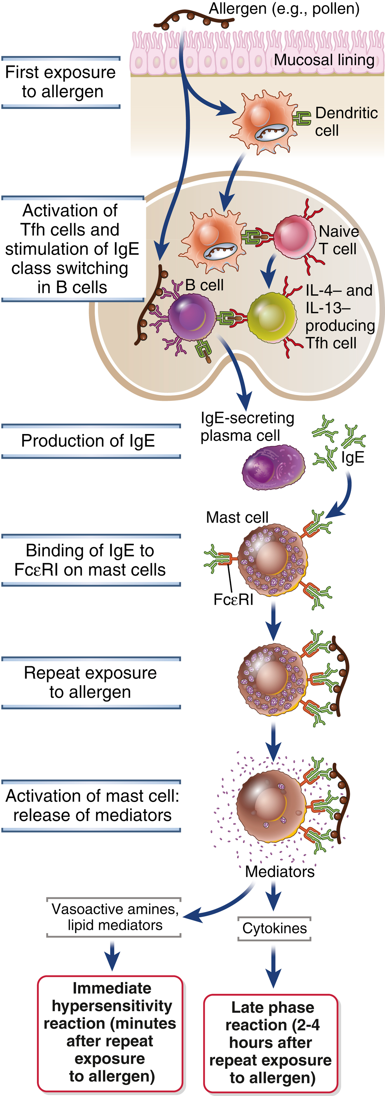
Allergen (antigen) uptake and presentation
Sensitization
Elicitation

Slide 11
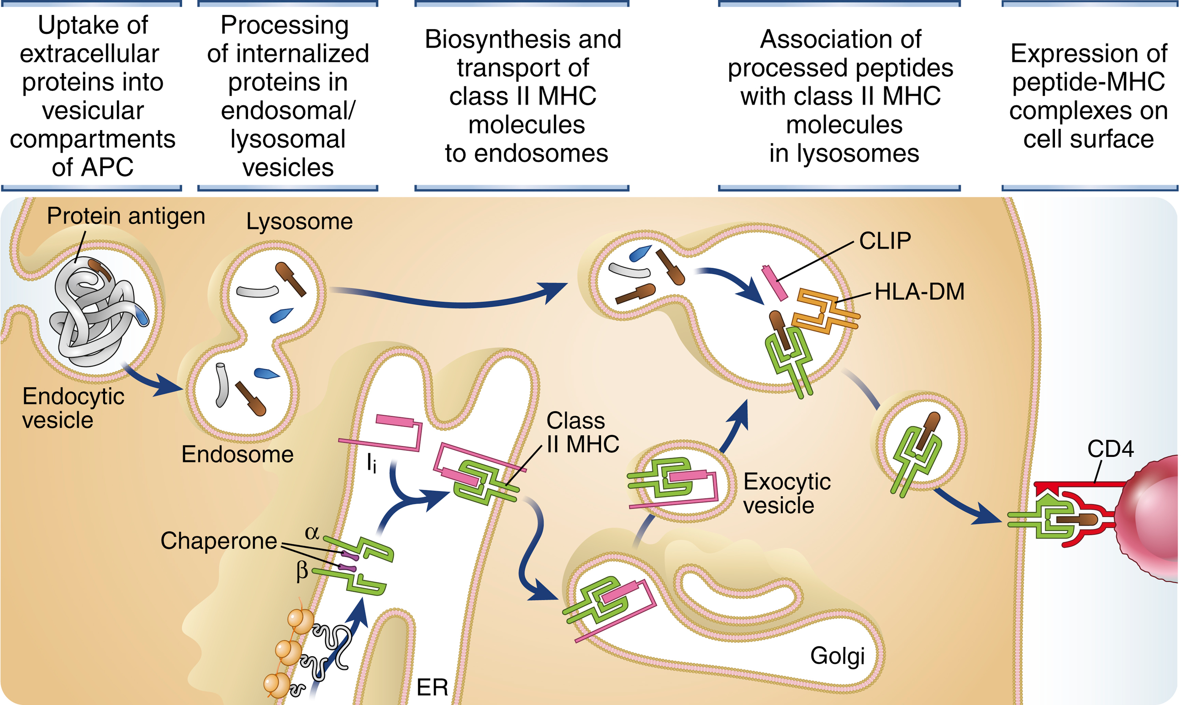
MHC class II pathway of antigen presentation
Lysosome/Endosome
Class II associated invariant chain peptide
invariant chain

Slide 12
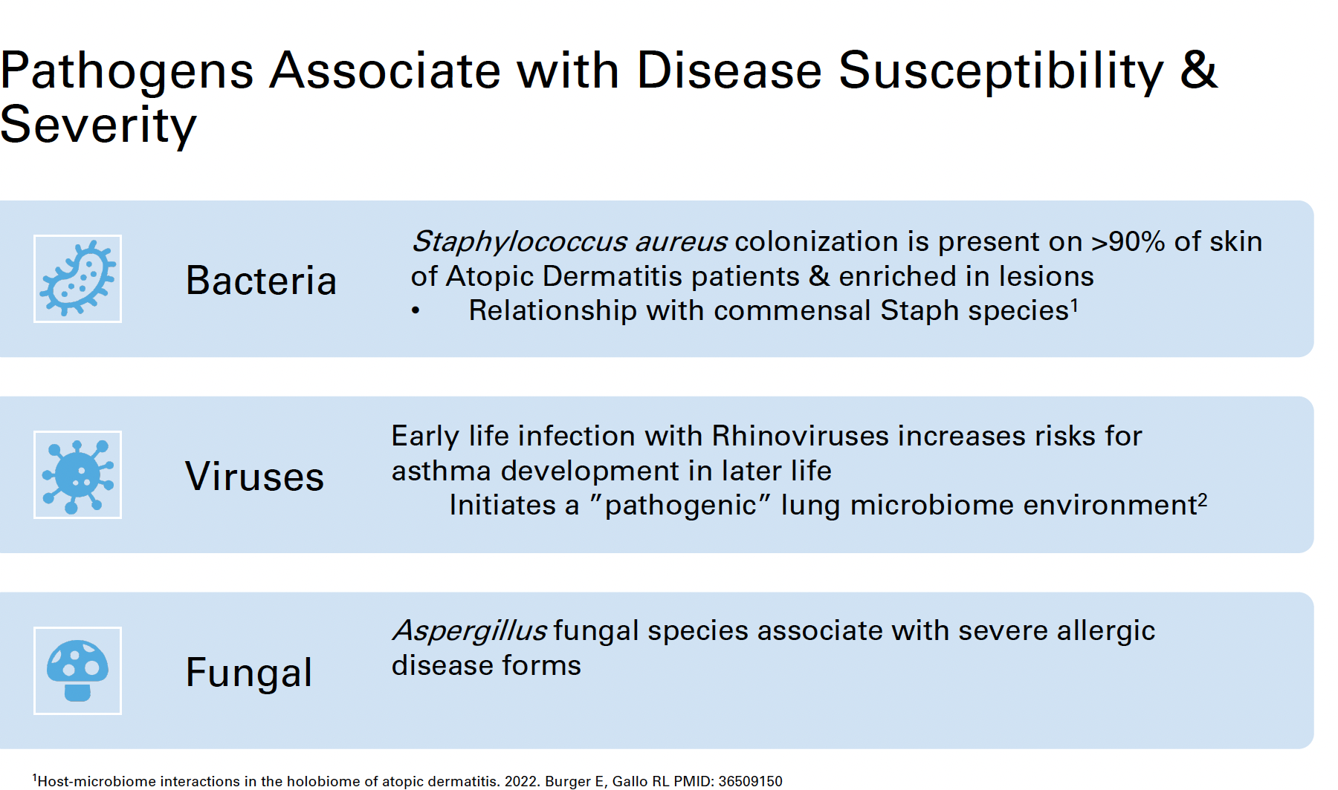
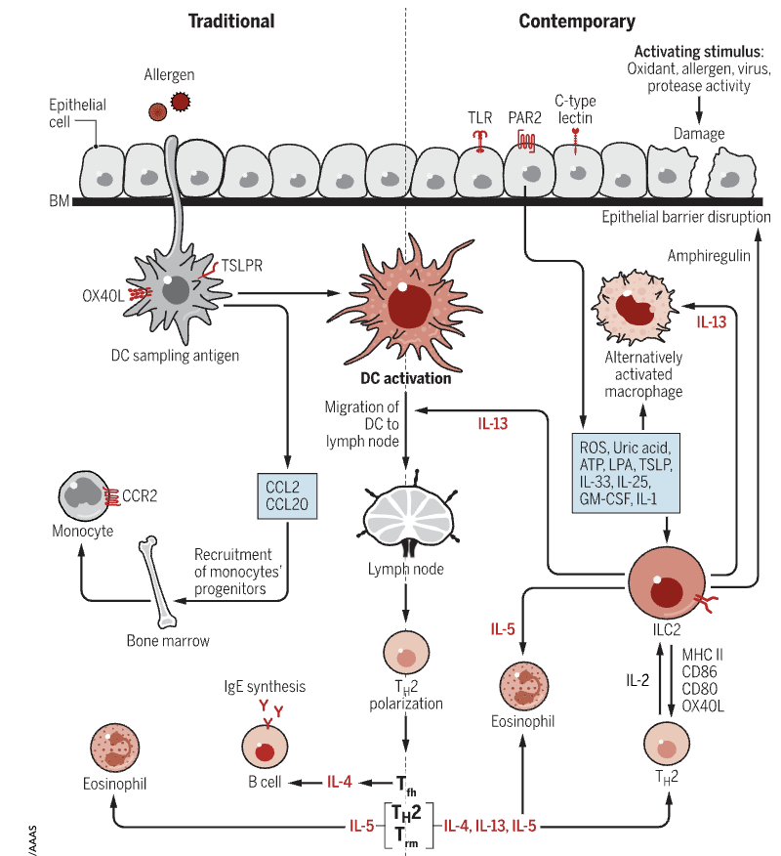
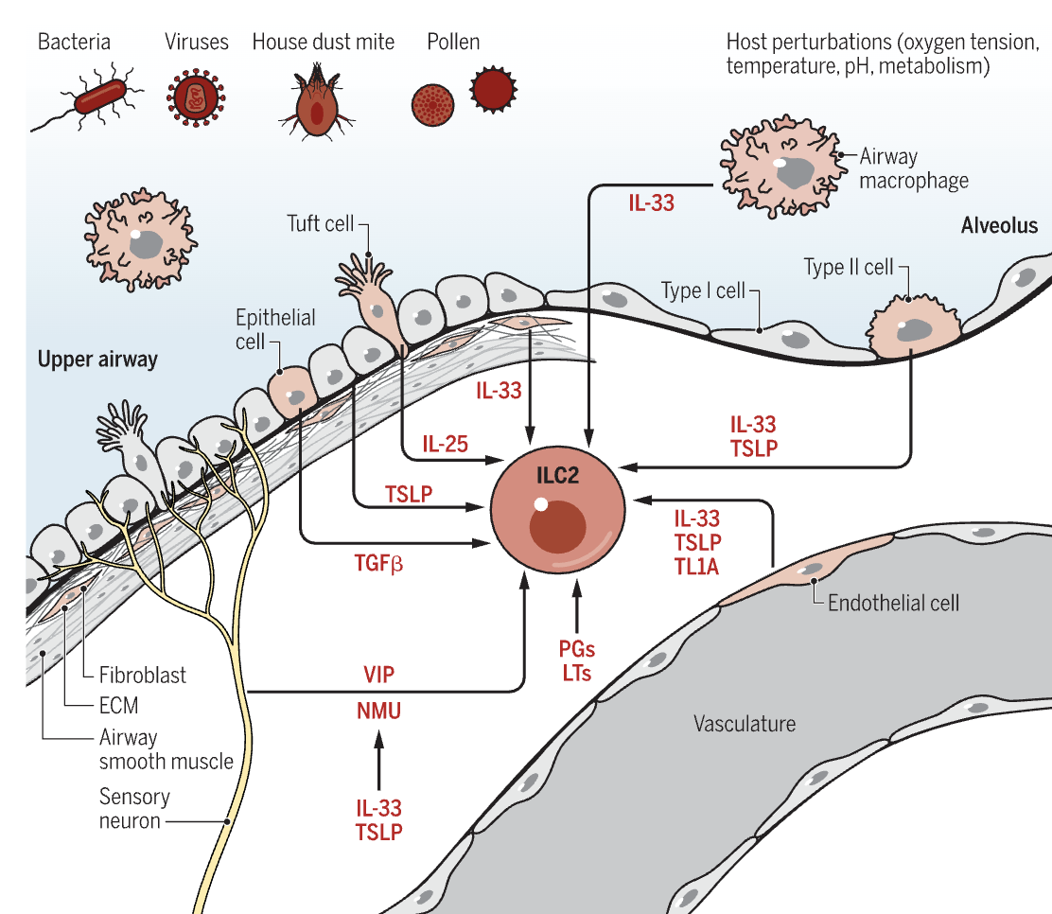
Mechanisms of sensitization
Lloyd and Snelgrove Sci Imm 2018

Slide 13
Th2 cells and
type 2 inflammation
Sensitization
Elicitation

Slide 14
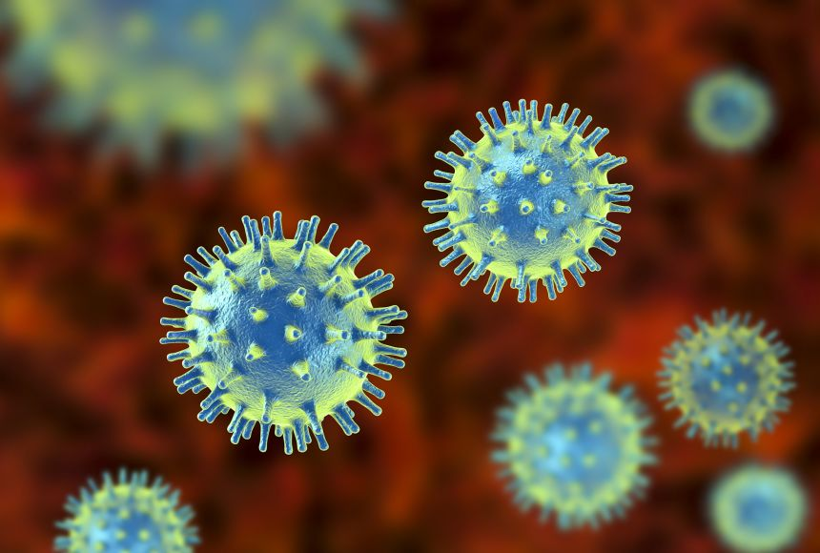
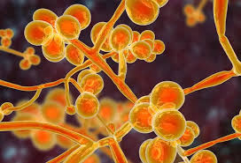
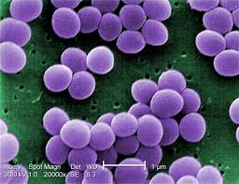
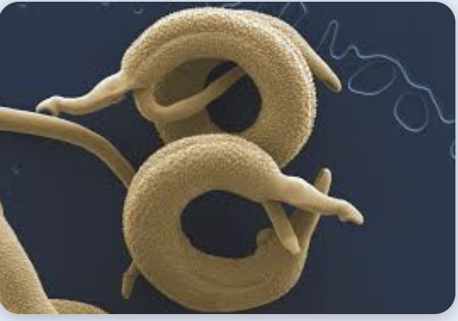
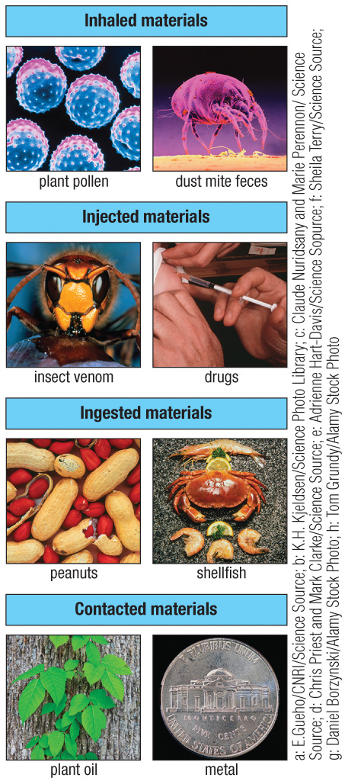
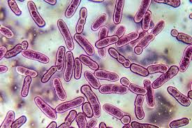
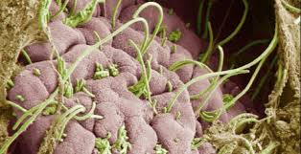
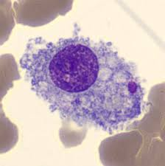
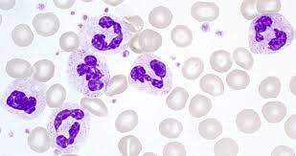
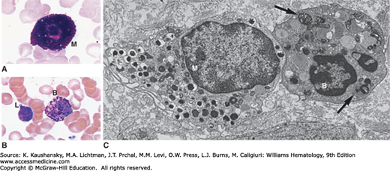
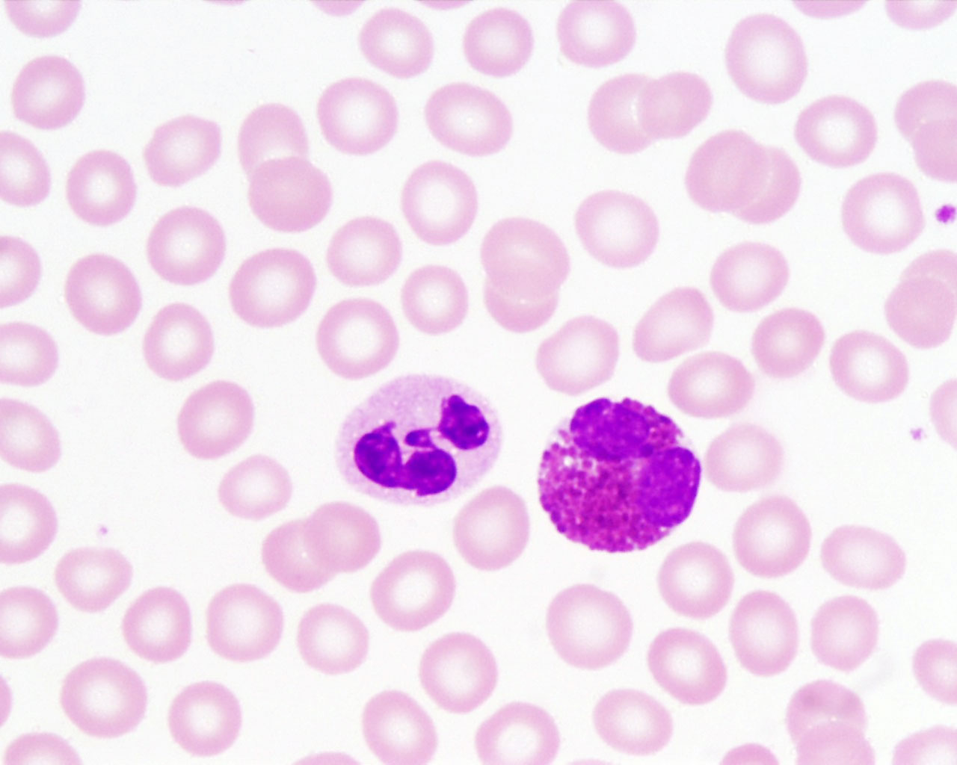
Th1 Th17 immunity
Th2 immunity
viruses
fungi
extracellular
bacteria
helminth parasites insect venom
intracellular
bacteria
commensal
bacteria
plant pollen
dust mites
peanuts shellfish
Innate immune recognition of conserved microbial pattern recognition receptors (MAMPs)
Innate immune recognition usually involves tissue damage and is sensed by neurons and specialized cell types (tuft cells alarmins) at epithelial barriers
innate effectors
recruited:
macrophages
neutrophils
mast cell eosinophil basophil
CD8⁺ CTL
CD4⁺ Th1
CD4⁺ Th17
CD4⁺ Th2
Kill/contain pathogen or establish commensalism
Weep and sweep response to clear noxious stimuli

Slide 15
Production of IgE
Sensitization
Elicitation

Slide 16
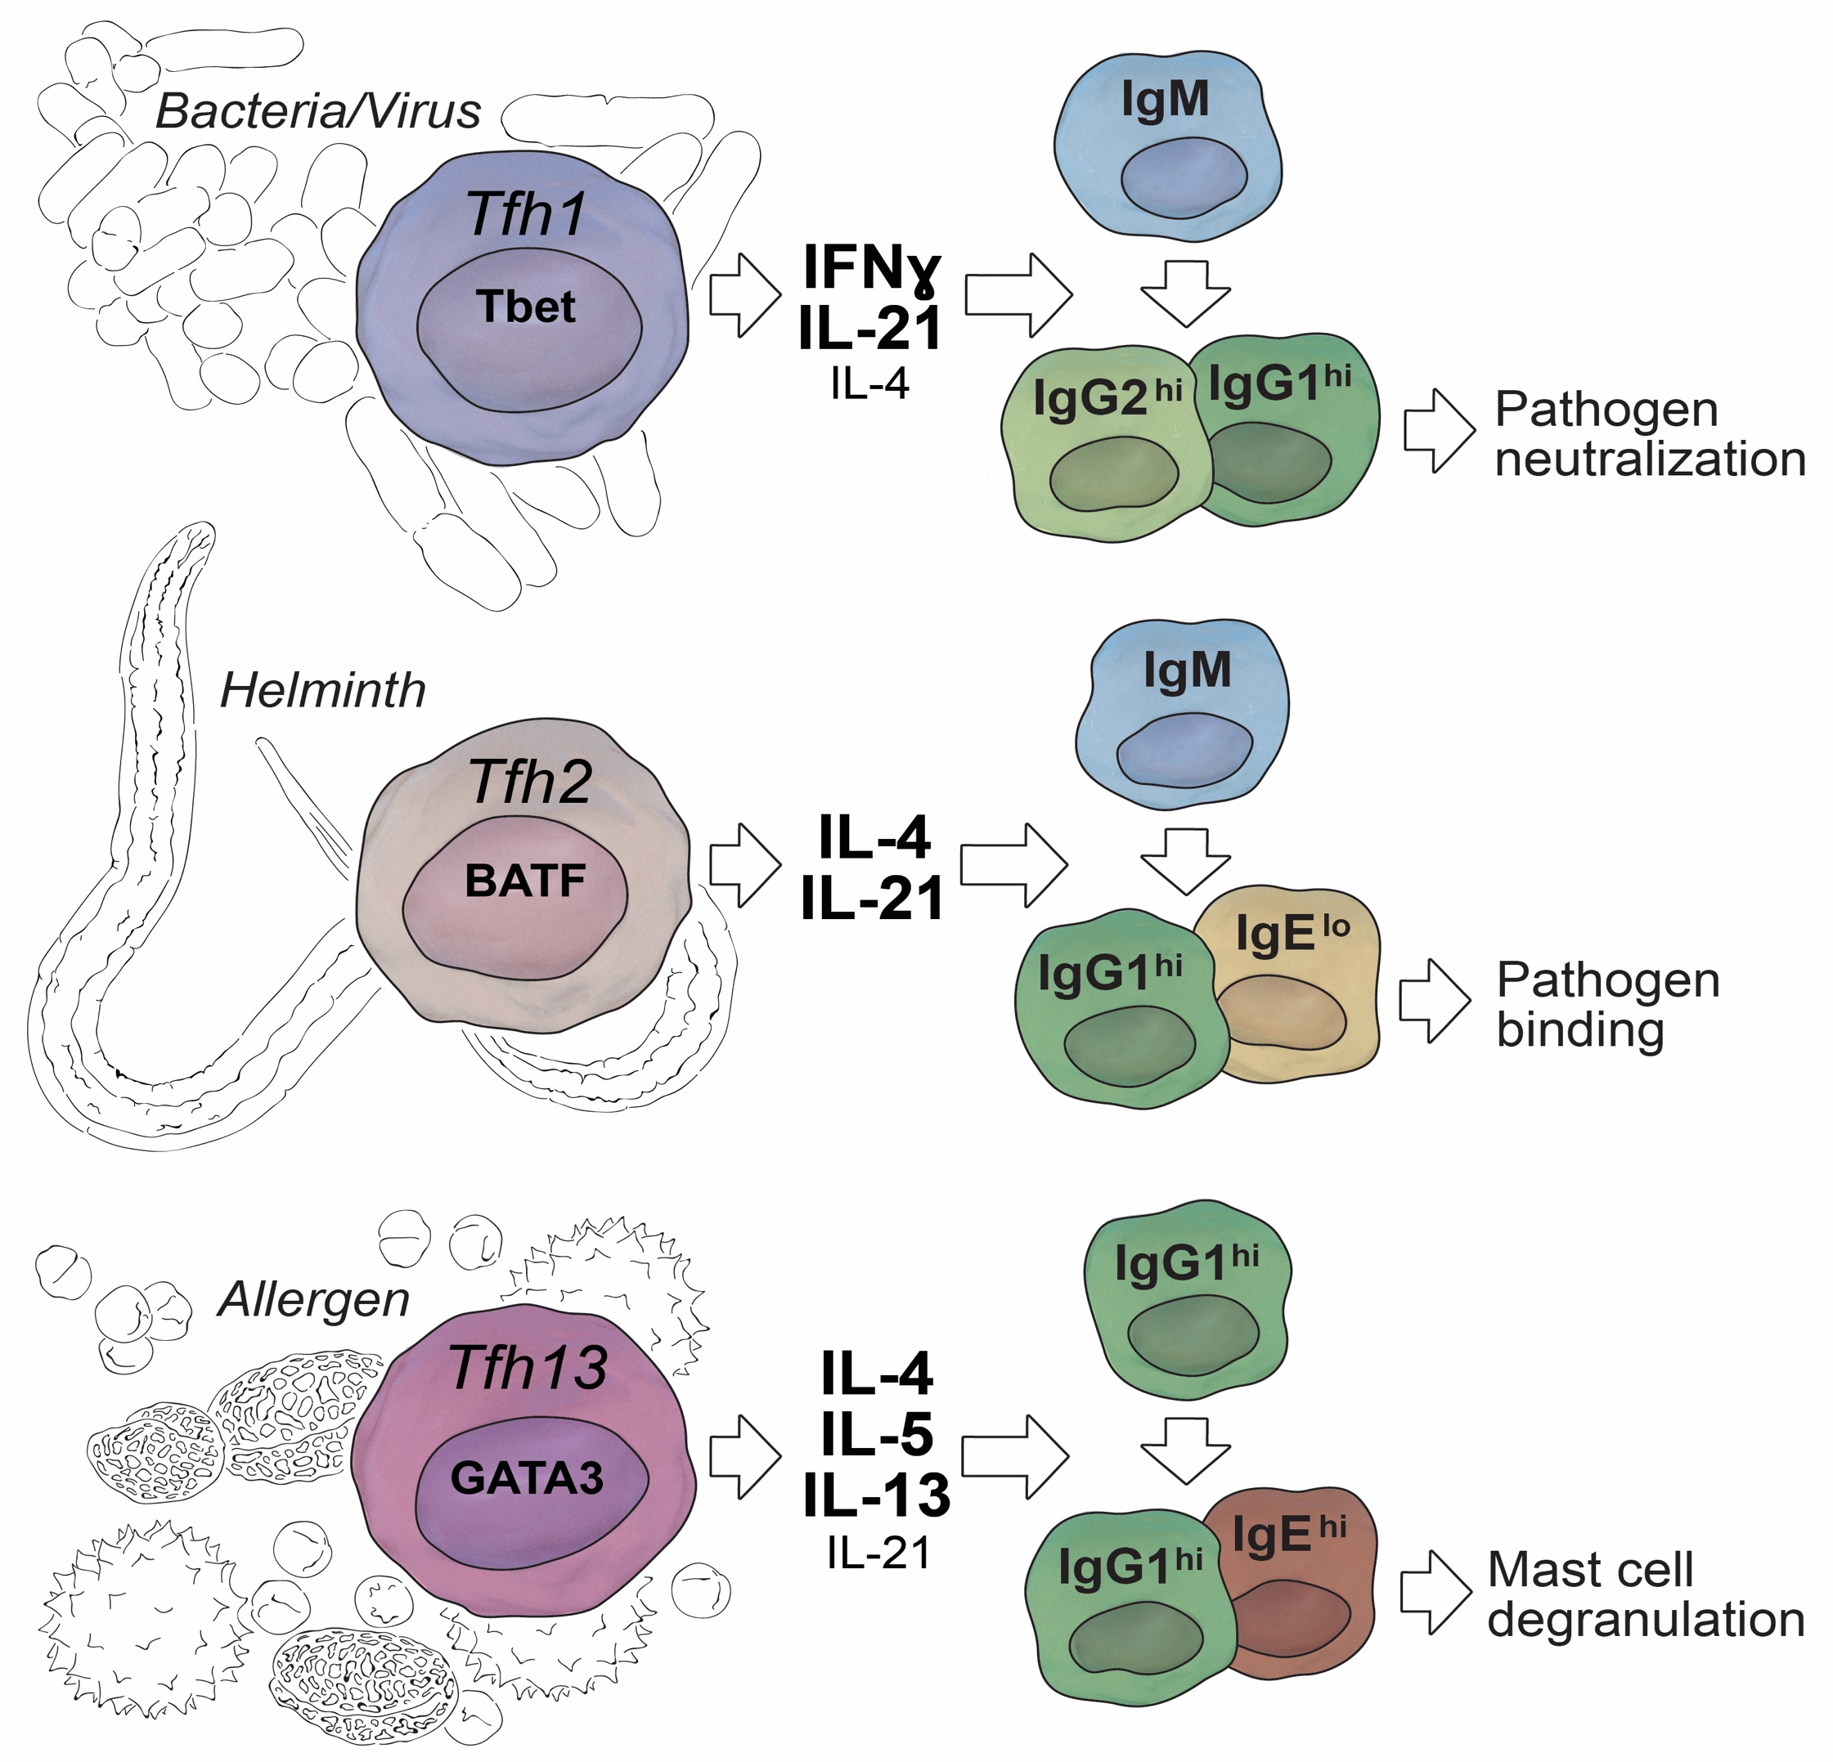
Different subsets of Tfh cells direct different antibody isotypes
Gowthaman et al Science 2019

Slide 17
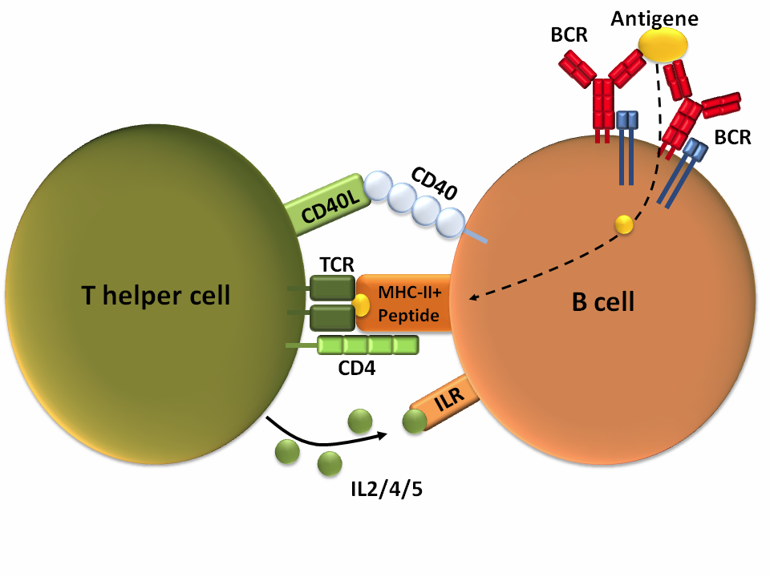
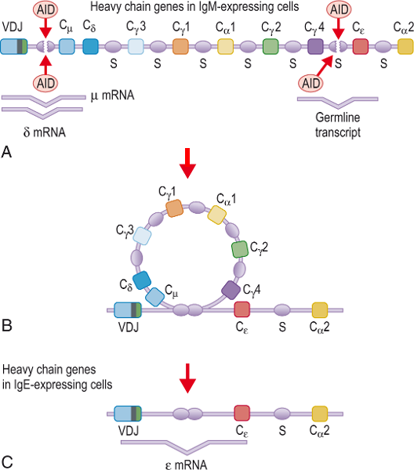
Activation of B cells & Switching to IgE
AID
Tfh cell
IL-4/13
BCR:
CD40:
Cytokine:
Proliferation and maturation
Induction of AID
Decision of isotype
AID (activation-induced cytidine deaminase)

Slide 18
Sensitization
IgE binds on IgE receptor (FcεRI)
Elicitation

Slide 19
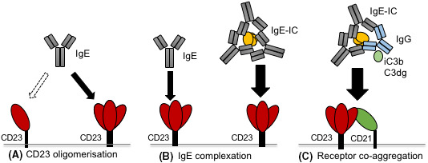
IgE receptors
There are two IgE receptors
FcεRI (High affinity IgE receptor)
FcεRII = CD23 (Low affinity IgE receptor)
Trimeric FcεRI (Dendritic cells)
Tetrameric FcεRI (Mast cell and basophils)
Engeroff et al Allergy 2020

Slide 20
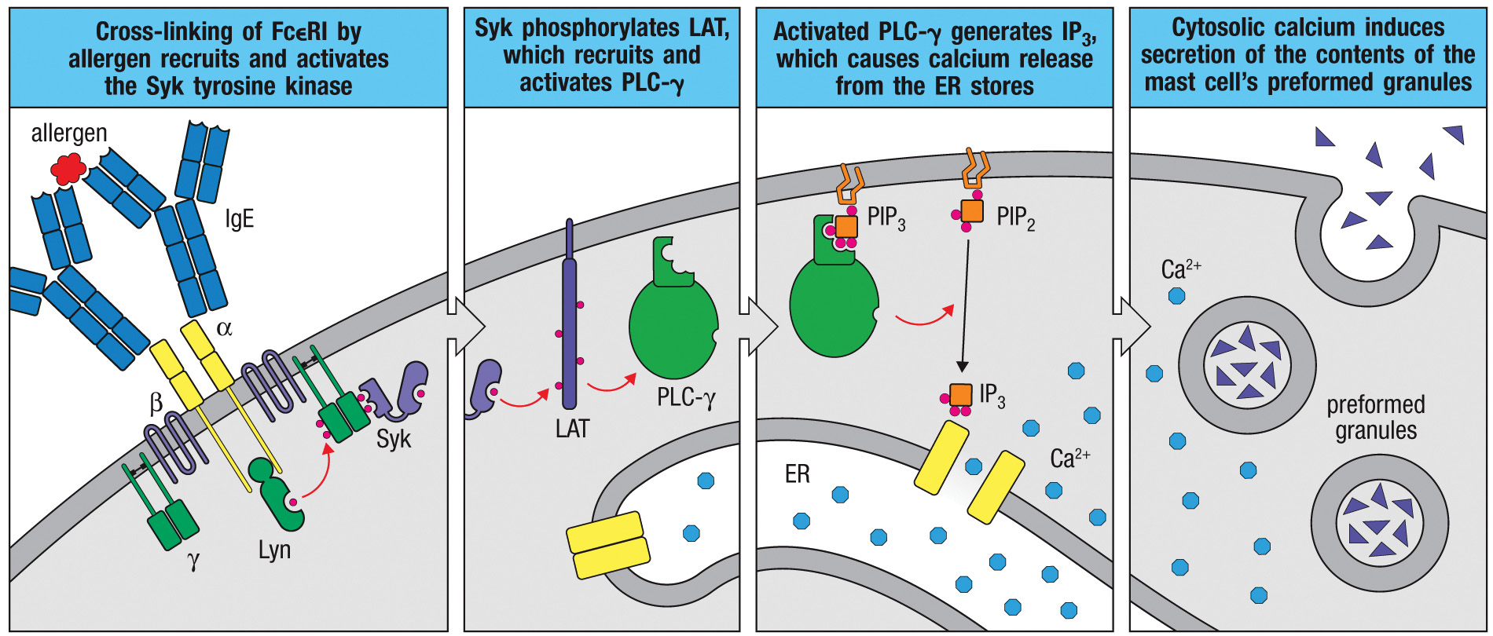
Allergens induce signaling by the FcεR1 receptor to cause mast cell degranulation
Janeway
Notes:
Fig. 14.7 Allergens induce signaling by the Fc´RI receptor to cause degranulation of mast cells. First panel: IgE specific to an allergen is bound to the high-affinity IgE receptor, FcεRI. Binding of a multivalent allergen to this IgE induces receptor cross-linking, leading to the phosphorylation by the bound kinases Fyn (not shown) and Lyn of the ITAMs in the γ chain of FcεRI, which is similar in structure to the TCR γζ chain, thus recruiting the ITAM-binding kinase Syk. Second panel: Syk phosphorylates the signaling molecule LAT, which recruits signaling components that lead to the activation of phospholipase C-γ (PLC-γ) (see Fig. 7-17). Third panel: Activated PLC-γ cleaves phosphatidylinositol 4,5-bisphosphate (PIP₂), generating inositol 1,4,5-trisphosphate (IP₃), which acts on receptors in the membrane of the endoplasmic reticulum (ER) to induce the release of calcium ions (Ca⁺²) into the cytosol. Fourth panel: This increase in cytosolic Ca⁺² ions induces the fusion of membranes of the preformed secretory granules in the mast-cell cytoplasm with the cell’s plasma membrane (mechanisms not shown) to release the granule’s contents, such as histamine, into the extracellular space.

Slide 21
Sensitization
Sensitized mast cells
Allergen
Elicitation
FcεRI
IgE

Slide 22
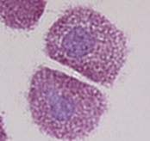
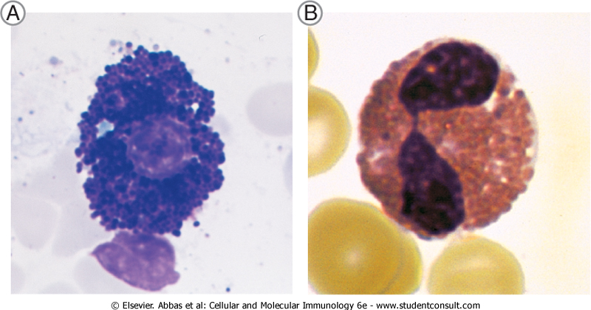
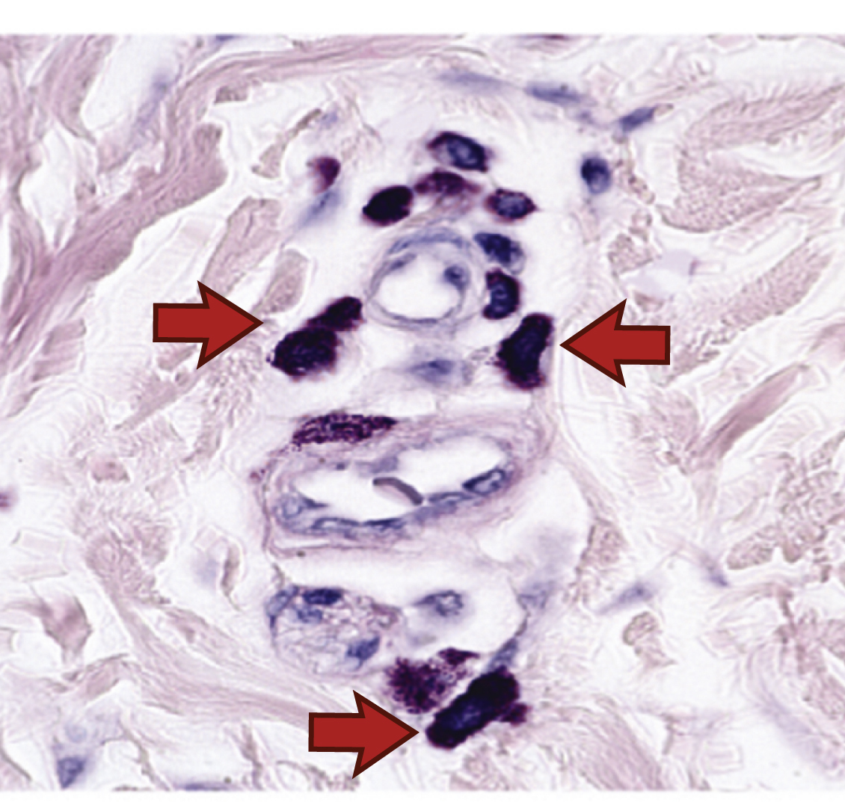
Cells involved in eliciting reactions
Characteristic | Mast cells | Basophils | Eosinophils
Major site of maturation | BM precursors mature in connective and mucosal tissues | Bone marrow | Bone marrow
Location of cells | Connective tissue and mucosal tissues | Blood (~0.5% of blood leukocytes); recruited into tissues | Blood (~2% of blood leukocytes); recruited into tissues
Life span | Weeks to months | Days | Days to weeks
Major growth and differentiation factor | Stem cell factor (SCF), IL-3 | IL-3 | IL-5
Expression of FcεRI | High | High | Low
Major granule contents | Histamine, heparin and/or chondroitin sulfate, proteases | Histamine, chondroitin sulfate, protease | Major basic protein, eosinophil cationic protein, peroxidases, hydrolases, lysophospholipase
(SCF)
Mast cell
Mast cell
Basophil
Eosinophil

Slide 23
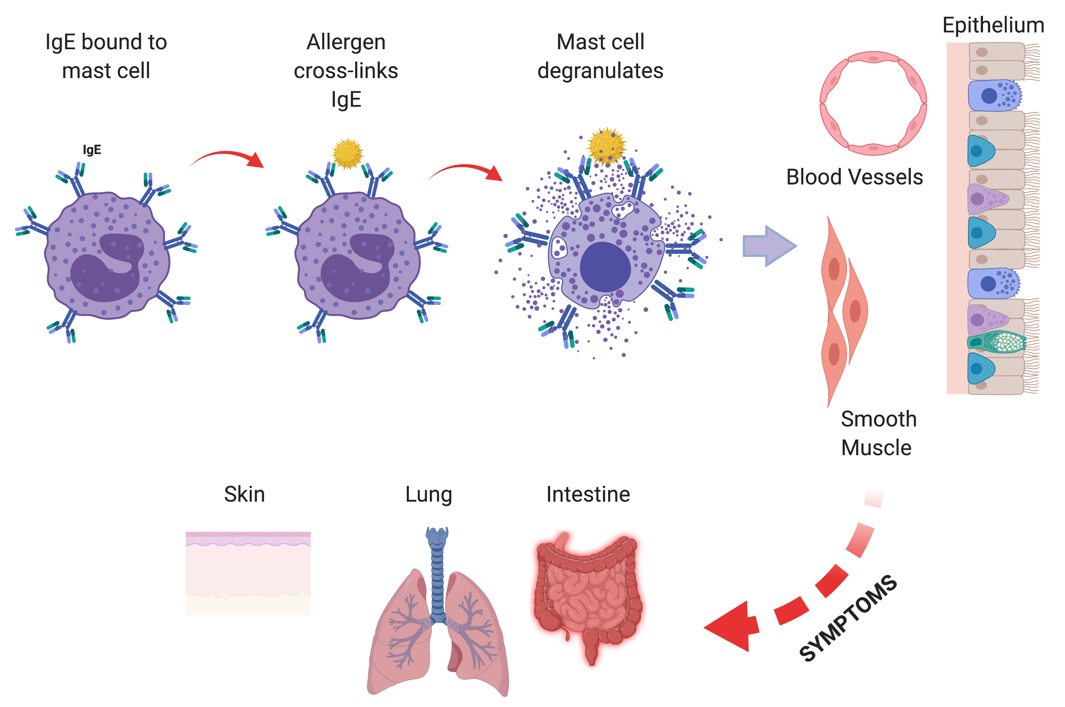

Slide 24
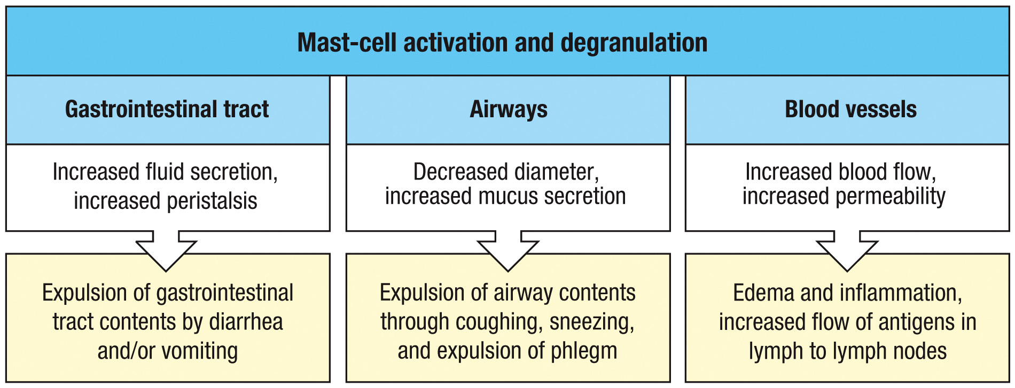
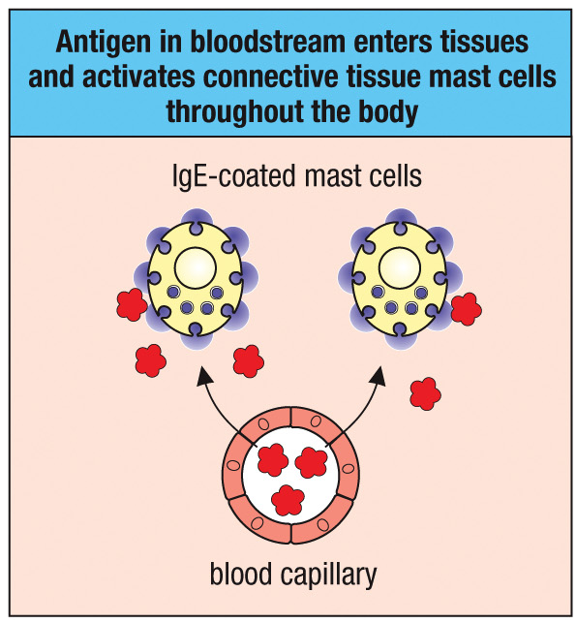
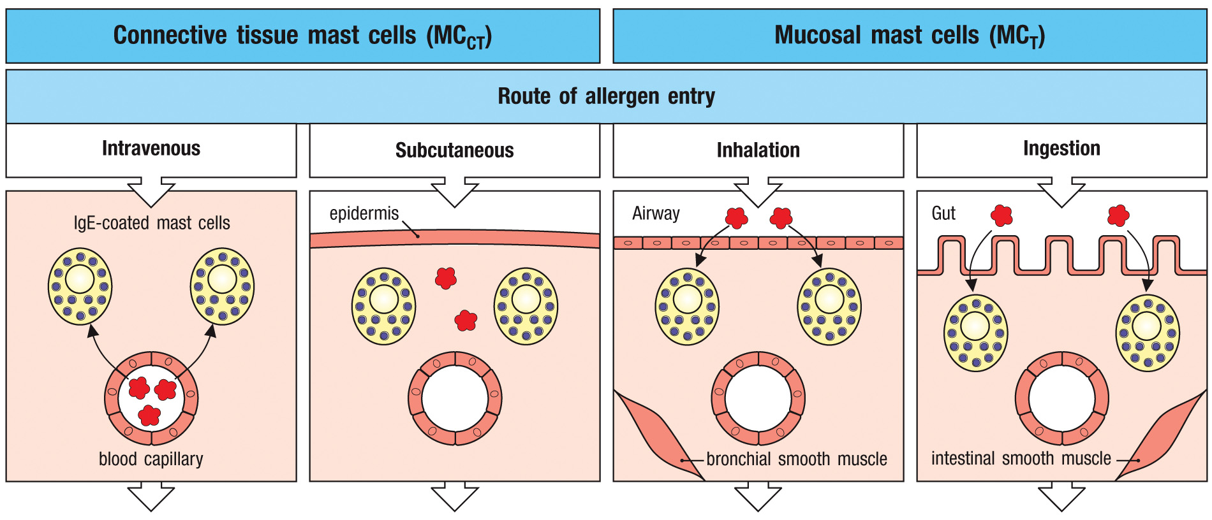
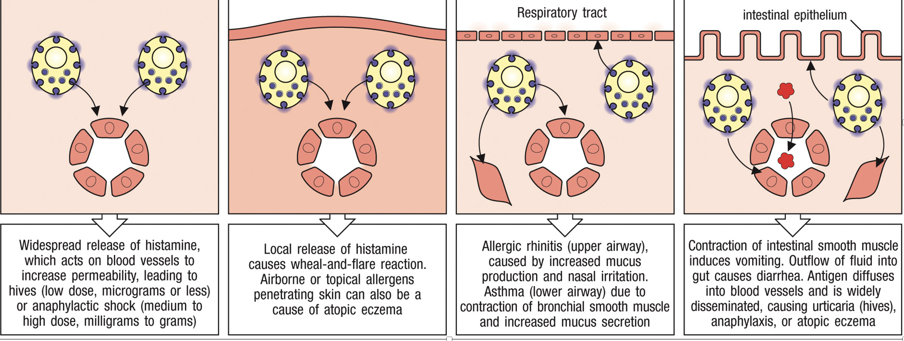
The physical effects of IgE-mediated mast-cell degranulation vary with the tissue exposed to allergen
Janeway
Notes:
Figure 14.28 The physical effects of IgE-mediated mast-cell degranulation vary with the tissue exposed to allergen.

Slide 25
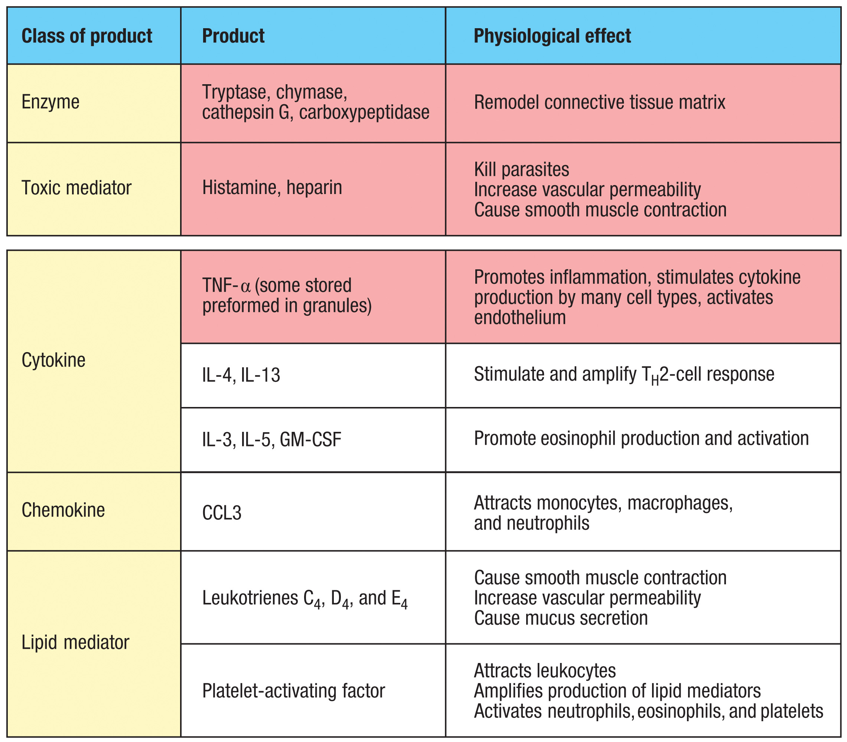
Activated mast cells release proteases, toxic mediators, cytokines, chemokines, and lipid mediators
Janeway
Notes:
Figure 14.17 Activated mast cells release proteases, toxic mediators, cytokines, chemokines, and lipid mediators. The red-shaded boxes list the inflammatory mediators: proteases, histamine, heparin, and TNF-α. These are preformed, packaged in granules, and are released immediately when a mast cell is activated by antigen cross-linking of FcεRI armed with antigen-specific IgE. TNF-α continues to be synthesized after mast-cell activation. The unshaded boxes list the inflammatory mediators that are made and released after activation of the mast cell.

Slide 26
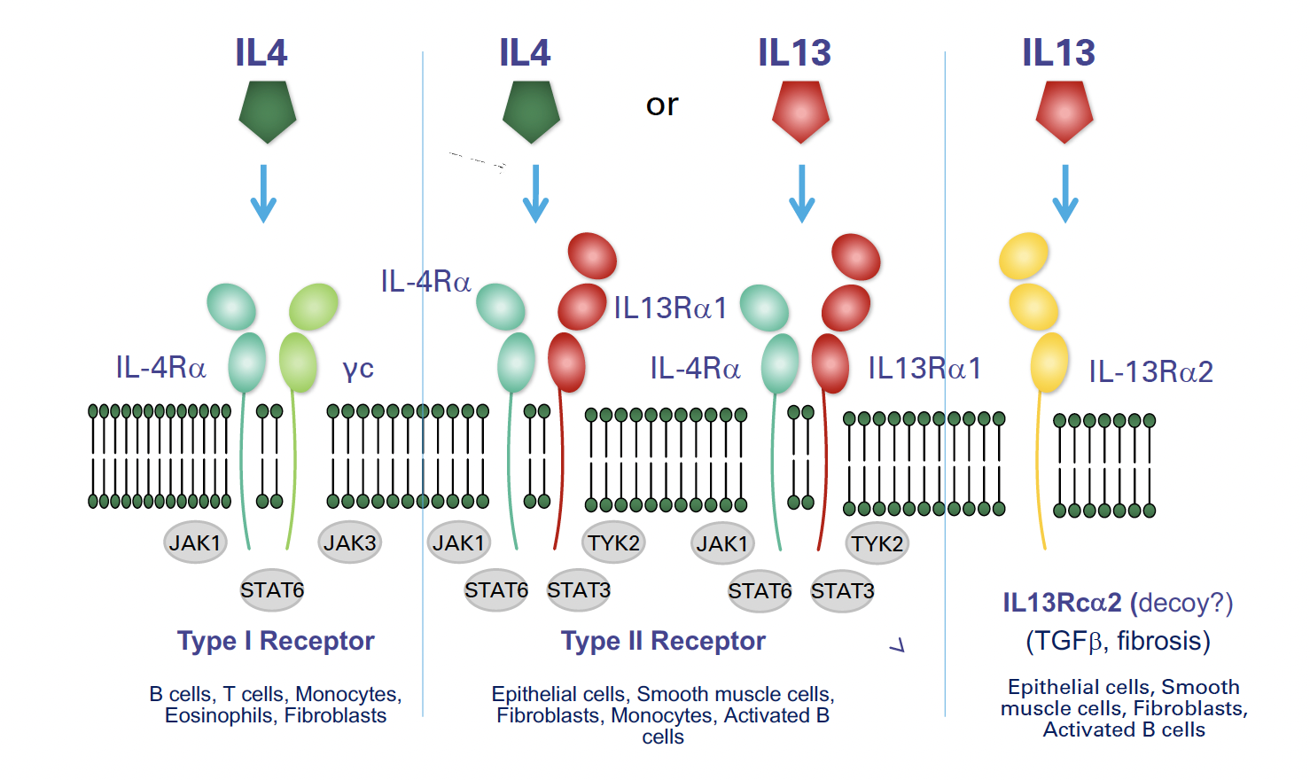
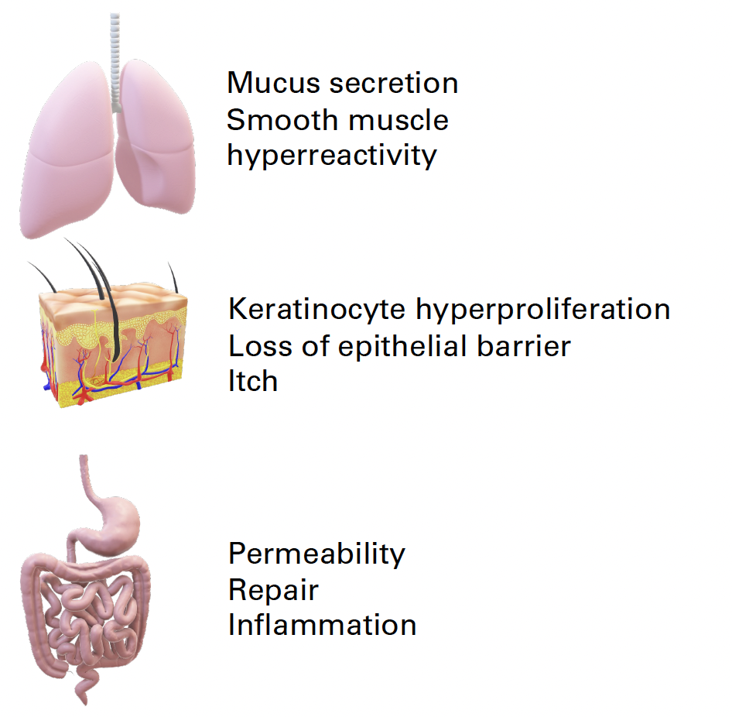
Tissue specific effects of IL4 & IL-13

Slide 27
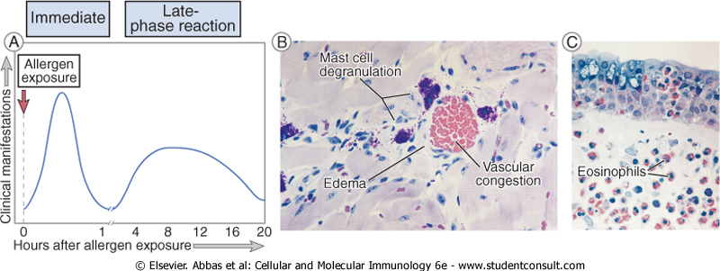
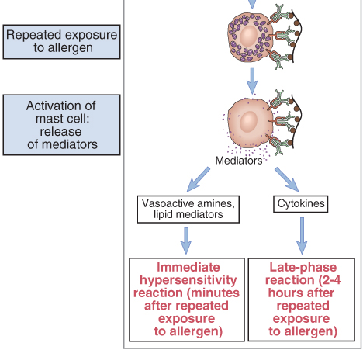
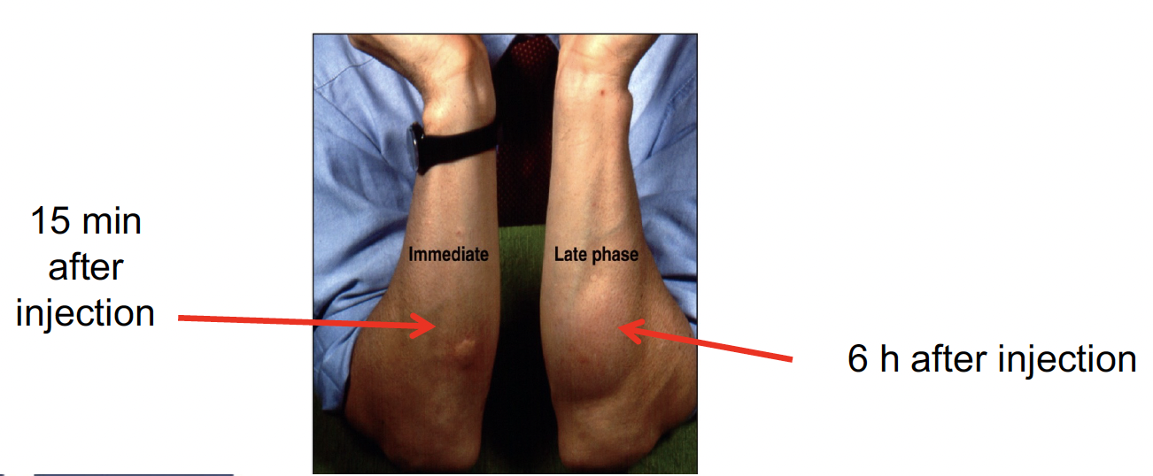

Slide 28


Slide 29
Couzin-Frankel, J., Science 2018, 362; 278

Slide 30

Reaction or disease | Common stimuli | Route of entry | Response
Systemic anaphylaxis | Drugs Venoms Food, example peanuts Serum | Intravenous (either directly or following absorption Into the blood after oral Intake) | Edema Increased vascular permeability Laryngeal edema Circulatory collapse Death
Acute urticaria (Wheal and flare) | Post viral Animal hair Bee stings Allergy testing | Through skin Systemic | Local Increase in blood flow and vascular permeability Edema
Seasonal rhinoconjunctivitis (hay fever) | Pollens (ragweed, trees, grasses) Dust mite feces | Contact with conjunctiva of eye and nasal mucosa | Edema of conjunctiva and nasal mucosa Sneezing
Asthma | Dander (cat) Pollens Dust-mite feces | Inhalation leading to contact with mucosal lining of lower airways | Bronchial constriction Increased mucus production Airway Inflammation Bronchial hyperreactivlty
Food allergy | Peanuts Tree nuts Shellfish Fish Milk Eggs Soy Wheat | Oral | Vomiting Diarrhea Pruritus (itching) Urticaria (hives) Anaphylaxis (rarely)
Janeway
Notes:
Fig. 14.1 IgE-mediated reactions to extrinsic antigens. All IgE-mediated responses involve mast-cell degranulation, but the symptoms experienced by the individual can be very different depending, for example, on whether the allergen is injected directly into the bloodstream, is eaten, or comes into contact with the mucosa of the ocular or respiratory tract.

Slide 31

The acute response in allergic asthma leads to chronic inflammation of the airways mediated by T_{H}2 cells
Janeway
Notes:
Figure 14.33 The acute response in allergic asthma leads to chronic inflammation of the airways mediated by T_{H}2 cells. First panel: in sensitized individuals, mast cells bearing allergen-specific IgE are present in the mucosa of the airways. Second panel: allergen-induced cross-linking of complexes of IgE and FcεRI on the cell surface activates the mast cell to secrete inflammatory mediators. They cause contraction of bronchial smooth muscle and increased epithelial secretion of mucus. Together these responses lead to airway obstruction. Third panel: increased blood-vessel permeability leads to edema and an influx of inflammatory cells, including eosinophils and T_{H}2 cells. Activated mast cells and T_{H}2 cells secrete cytokines that augment eosinophil activation and degranulation, causing further tissue injury and influx of inflammatory cells. The end result is a chronic inflammation that causes irreversible damage to the airways.

Slide 32

Genes expressed in airway epithelial cells
Chemokines: C C L 5, C C L 1 1, C C L 2 4, C C L 2 6
Antimicrobial peptides: D E F B 1
Secretoglobin family: S C G B 1 A 1
Epithelial barrier protein: F L G
Genes regulating CD4 T cell and I L C 2 differentiation and function
Transcription factors G A T A 3, T B X 2 1, R O R A, S T A T 3, P H F 1 1, I K Z F 4
Cytokines I L 4, I L 5, I L 1 O, I L 1 3, I L 2 5, I L 3 3, T G F beta 1
Cytokine receptors I L 2 R B, I L 4 R A, I L 5 R A, I L 6 R, I L 1 8 R, I L 1 R L 1, F C E R 1 B
Pattern recognition receptors C D 1 4, T L R 2, T L R 4, T L R 6, T L R 1 0, N O D 1, N O D 2
Antigen presentation H L A D R B 1, H L A D R B 3, H L A D Q A, H L A D Q B, H L A D P A, H :L A D P G, H L A G
Prostaglandin receptors: P D F E R 2, P T G D R
Genes with other functions
Proteinase or proteinase inhibitor U S P 3 8, S P I N K 5
Signaling proteins I R A K M, S M A D 3, P Y H I N 1, N O T C H 4, G A B 1, T N I P 1
Receptors A D R B 2, P 2 X 7
Other D P P 1 0, G P R A, C O L 2 9 A 1, O R M D L 3, G S D M B, W D R 3 6, D E N N D 1 B, R A D 5 0, P B X 2, L R R C 3 2, A G E R, C D K 2
Notes:
Fig. 14.5 Susceptibility loci for asthma. Loci that have shown linkage on the basis of GWASs or targeted gene analysis are listed, separated into genes that are expressed in epithelial cells of the airways, genes that regulate the differentiation and/or function of CD4 T cells and ILC2 cells, and genes with other miscellaneous or unknown functions.

Slide 33


Atopic dermatitis (eczema) causes dry, itchy and inflamed skin
Atopic dermatitis typically
presents first in infancy

Slide 34

Allergic rhinitis is caused by allergens entering the respiratory tract
Janeway
Notes:
Figure 14.32 Allergic rhinitis is caused by allergens entering the respiratory tract. Histamine and other mediators released by activated mast cells increase the permeability of local capillaries and activate the nasal epithelium to produce mucus. Blood-borne eosinophils are attracted into the inflamed nasal tissue, where they are activated to release their inflammatory mediators. Activated eosinophils are shed into nasal passages and are removed from the body in the mucus.

Slide 35


Examples of adverse reactions to food
Food allergy
  Atopic (not all IgE mediated)
    Peanut, milk, egg
    Food-associated, exercise-induced anaphylaxis
    Eosinophilic Esophagitis
    FPIES (Food protein-induced enterocolitis syndrome)
    AlphaGal Syndrome
  Intolerance
    Milk intolerance = Lactose intolerance
    Gluten intolerance = ?
  Other
    Celiac disease
McKenna, M. Scientific American, 2025
Notes:
Lactose intolerance = No immune cell in sight

Slide 36

Alpha-gal syndrome (AGS, mammalian meat allergy)
AGS is an allergy involving an IgE antibody response to galactose-α-1,3-galactose. This sugar, commonly known as alpha-gal, is found in all mammals except for Old World monkeys, apes, and humans. The onset of AGS is associated with tick bites.

Slide 37

McKenna, M. Scientific American, 2025; PMID: 40828068

Slide 38


Early introduction of peanuts
reduced disease incidence

Slide 39

Protection against allergic sensitization to food requires a barrier protective response mediated by bacteria in the Clostridia class
Stefka, Feehley et al PNAS 2014, 111; 13145
Notes:
Are Clostridia and/or butyrate necessary
for retinoic acid (RA) mediated antigen specific
Treg induction?

Slide 40

Modern industrialized lifestyle factors trigger shifts in the commensal microbiota which are driving chronic disease
Light and Nagler, Immuno. Rev. 2024, 326; 203

Slide 41
RORγt⁺ APC (Thetis Cells, Janus Cell, ILC3, etc) are most abundant around
weaning and are critical for inducing tolerance to dietary antigens
Johansson, C. Science 2025

Slide 42



IgE-mediated allergic disease can be treated by inhibiting effector pathways
or by desensitization techniques that aim at restoring immunological tolerance
to the allergen
Target | Mechanism of treatment | Specific approach
In clinical use | In clinical use | In clinical use
Mediator action | Inhibit effects of mediators on specific receptors Inhibit synthesis of specific mediators | Antihistamines, beta agonists Leukotriene receptor blockers Lipoxygenase inhibitors
Chronic inflammatory reactions | General anti-inflammatory effects | Corticosteroids
T H 2 response | Induction of regulatory T cells | Desensitization therapy by injections of specific antigen
l g E binding to mast cell | Bind to l g E F e region and prevent l g E binding to F e receptors on mast cells | Anti I g E antibodies (omalizumab)
Janeway
Sampath at al Allergy 2020
Notes:
Fig. 14.17 (Part 1) Approaches to the treatment of allergic disease. Examples of treatments in current clinical use for allergic reactions are listed in the top half of the table, with approaches under investigation listed below. mAb, monoclonal antibody against monomeric galectin-10.

Slide 43



Drugs targeting type 2 immunity
Tezepelumab
Etokimab
REGN3500
Anti-OX40
Dupilumab
IL4/13 receptor
Anti-BCMA
Baricitinib
Upadacitinib
Abrocitinib
ASN002

Slide 44

Omalizumab rapidly reduces serum IgE levels, leading to decreased FceR1 on mast cells and basophils
Casale, T.B. et al. JACI 2024

Slide 45


Drugs that block leukotriene receptors or synthesis are used to
treat asthma and allergic rhinitis
Montelukast (Singulair)
Leukotriene receptor
antagonist
(black box warning for
suicidal ideation)
Zileuton
Orally active inhibitor of
5-lipoxygenase (inhibits leukotriene
(LTB4, LTC4, LTD4, LTEF)
formation

Slide 46
Questions?

